Slide 1
A
HISTORICAL FACT
OF ABIGBORODO COMMUNITY VIZ – A – VIZ HER CLAIM OVER THE UKPE – SOBO FOREST RESERVE

Slide 2
INTRODUCTION:
1. AbigborodoCommunity is an Itsekiri speaking Communitywhose current head is CHIEF EMMANUEL ORITSEJOLOMI UDUAGHAN, the Alema of Warri Kingdom under the Overlordship of the Olu of Warri Kingdom.

Slide 3
2. Abigborodo Community is situated in Warri North Local Government Area of Delta State .Abigborodo Community are the owners of the large expanse of land known as GBEKOKO-UTON-IYATSERE. The size and the area of the GBEKOKO-UTON-IYATSERE measures approximately 11136.95 Hectares (43 square miles). The Abigborodo Community land traverse from GBEKOKO WATERSIDE to SAPELE and the mainland known as GBEKOKO-UTON-IYATSERE and OGOUNDE.

Slide 4
3. TheGBEKOKO-UTON- IYATSERE was part of the lands originally annexed to form part of the Forest Reserve known as Ukpe- Sobo Native Administration Reserve constituted by Order No. 33 of 1933 during the British Rule over Nigeria.

Slide 5
4. HISTORICAL FACTS:
The Abigborodo Community are descendants of IYATSERE EGHAREGBEMI who was a prominent Chief (Ojoye Alema) in Warri Kingdom in the 17th Century. The GBEKOKO-UTON- IYATSERE was founded by the IYATSEE EGHAREGBEMI who gave the portion of the land known as GBEKOKO to his slave ‘EKOKO’ to be farming on the said portion of land and remit a fraction of the proceeds of the farm produce to his masters as tribute. It should be noted that UGBEKOKO is an Itsekiri word which simply means EKOKO’S FARM.

Slide 6
5. The UTON-IYATSERE portion of the Abigborodo land was founded by IYASERE EGHAREGBEMI which was also inherited by his grandson, late CHIEF UMUEGBE OGHEGHE. The word UTON-IYATSERE simply means “IYATSERE CREEK’’.

Slide 7
6. The Abigborodo Community progenitors’ slave ‘EKOKO’ continued farming on the GBEKOKO portion of the land and giving the farm produce to his master; IYATSERE EGHAREGBEMI and upon the abolition of slave trade in the 19th century, IYATSERE EGHAREGBAMI set his slave; EKOKO free in compliance with the law to set slaves free.

Slide 8
7. Upon the departure of EKOKO after his freedom, ARIBIOWU a farmer from the present day Ifon came several years later and met the descendants of IYATSERE EGHAREGBEMI who was now late in the present day Abigborodo Community and asked to be given lands to enable him carry out his farming activities.

Slide 9
The Abigborodo Community through its Head and Leader in the early 20th century namely PA UDUN and OKOMAMA entered into agreement dated 24/05/1919 with ARIBIOWU who was the head of the farmers as tenants of Abigborodo Community. The signatories to the said Lease Agreement were: Aribiowu, Johnson, Daniel, Ogbaharikomi, Inomiama & Johnnie. Herein attached is the said Lease Agreement dated 24/05/1919 and marked as Annexure 1A.

Slide 10
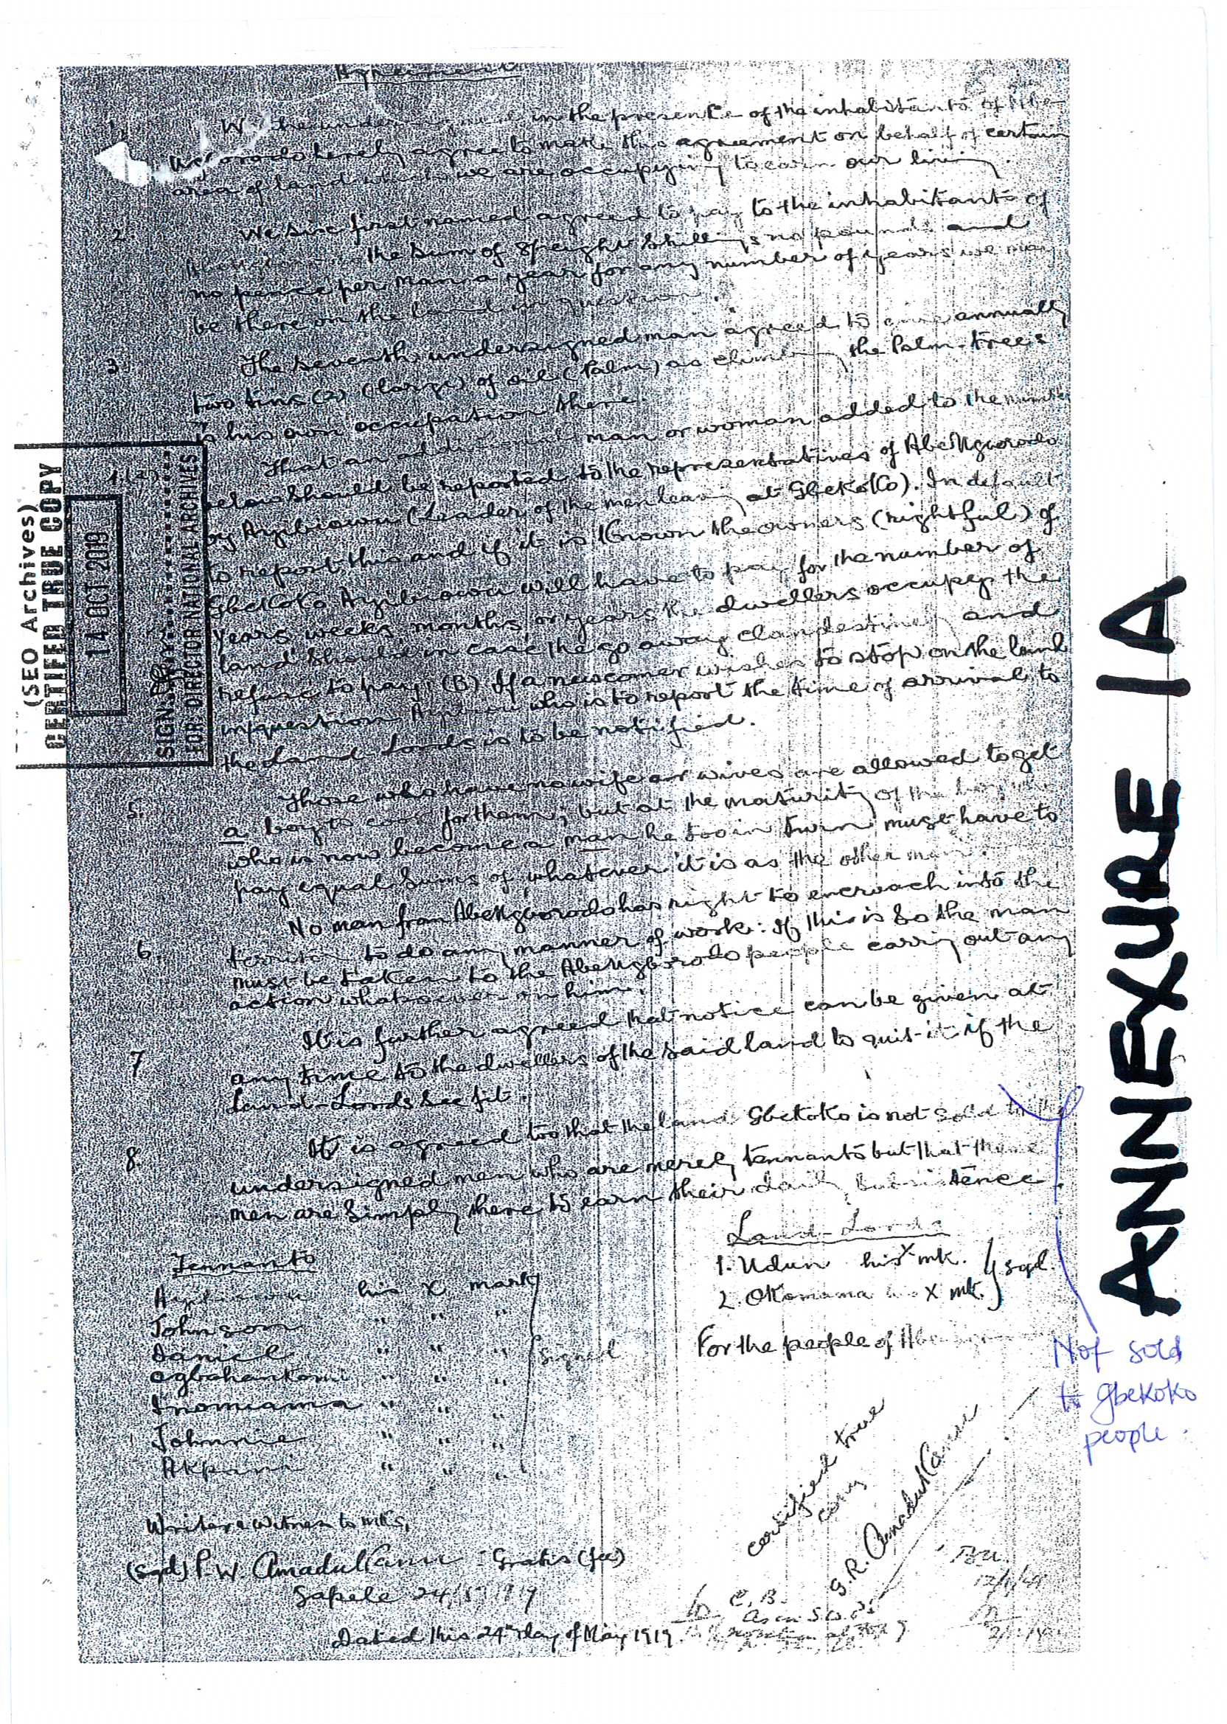

Slide 11
9. The Abigborodo Community wish to state that when the said GBEKOKO- UTON-IYATSERE was to be placed into the Ukpe-Sobo Native Administration Forest Reserve, t he people of Abigborodo Community were not aware of any Public Notice with regard to the Reserve. They were not consulted neither were they settled with regards to compensation. It is the submission of the Abigborodo Community that the said tenants led by the head farmer; Aribiowu continued and carried on their farming activities as agreed by both parties until they were arrested and charged before the Magistrate Court Holden at Sapele on the 27th day of March, 1940 before His Worship A. V. SCALLION ESQ.

Slide 12
Magistrate (Limited Powers) where they were charged for trespassing and encroaching on Government Reserve Land. Upon their arraignment before the Magistrate, Aribiowu and the other farmers pleaded not guilty to the said charge and made their defence to the charge by pleading a copy of the Lease Agreement (Annexure 1a) which was entered into with the Abigborodo Community as their Legal Instrument to farm on the said land and which was marked as Exhibit A by Magistrate A.V. SCALLION ESQ. It was on the basis of the Lease Agreement, the said charge was adjourned sine die and the tenants were released and set free. Annexed and marked as Annexure 1B is the Charge Sheet duly Certified from the National Archive, Ibadan.

Slide 13
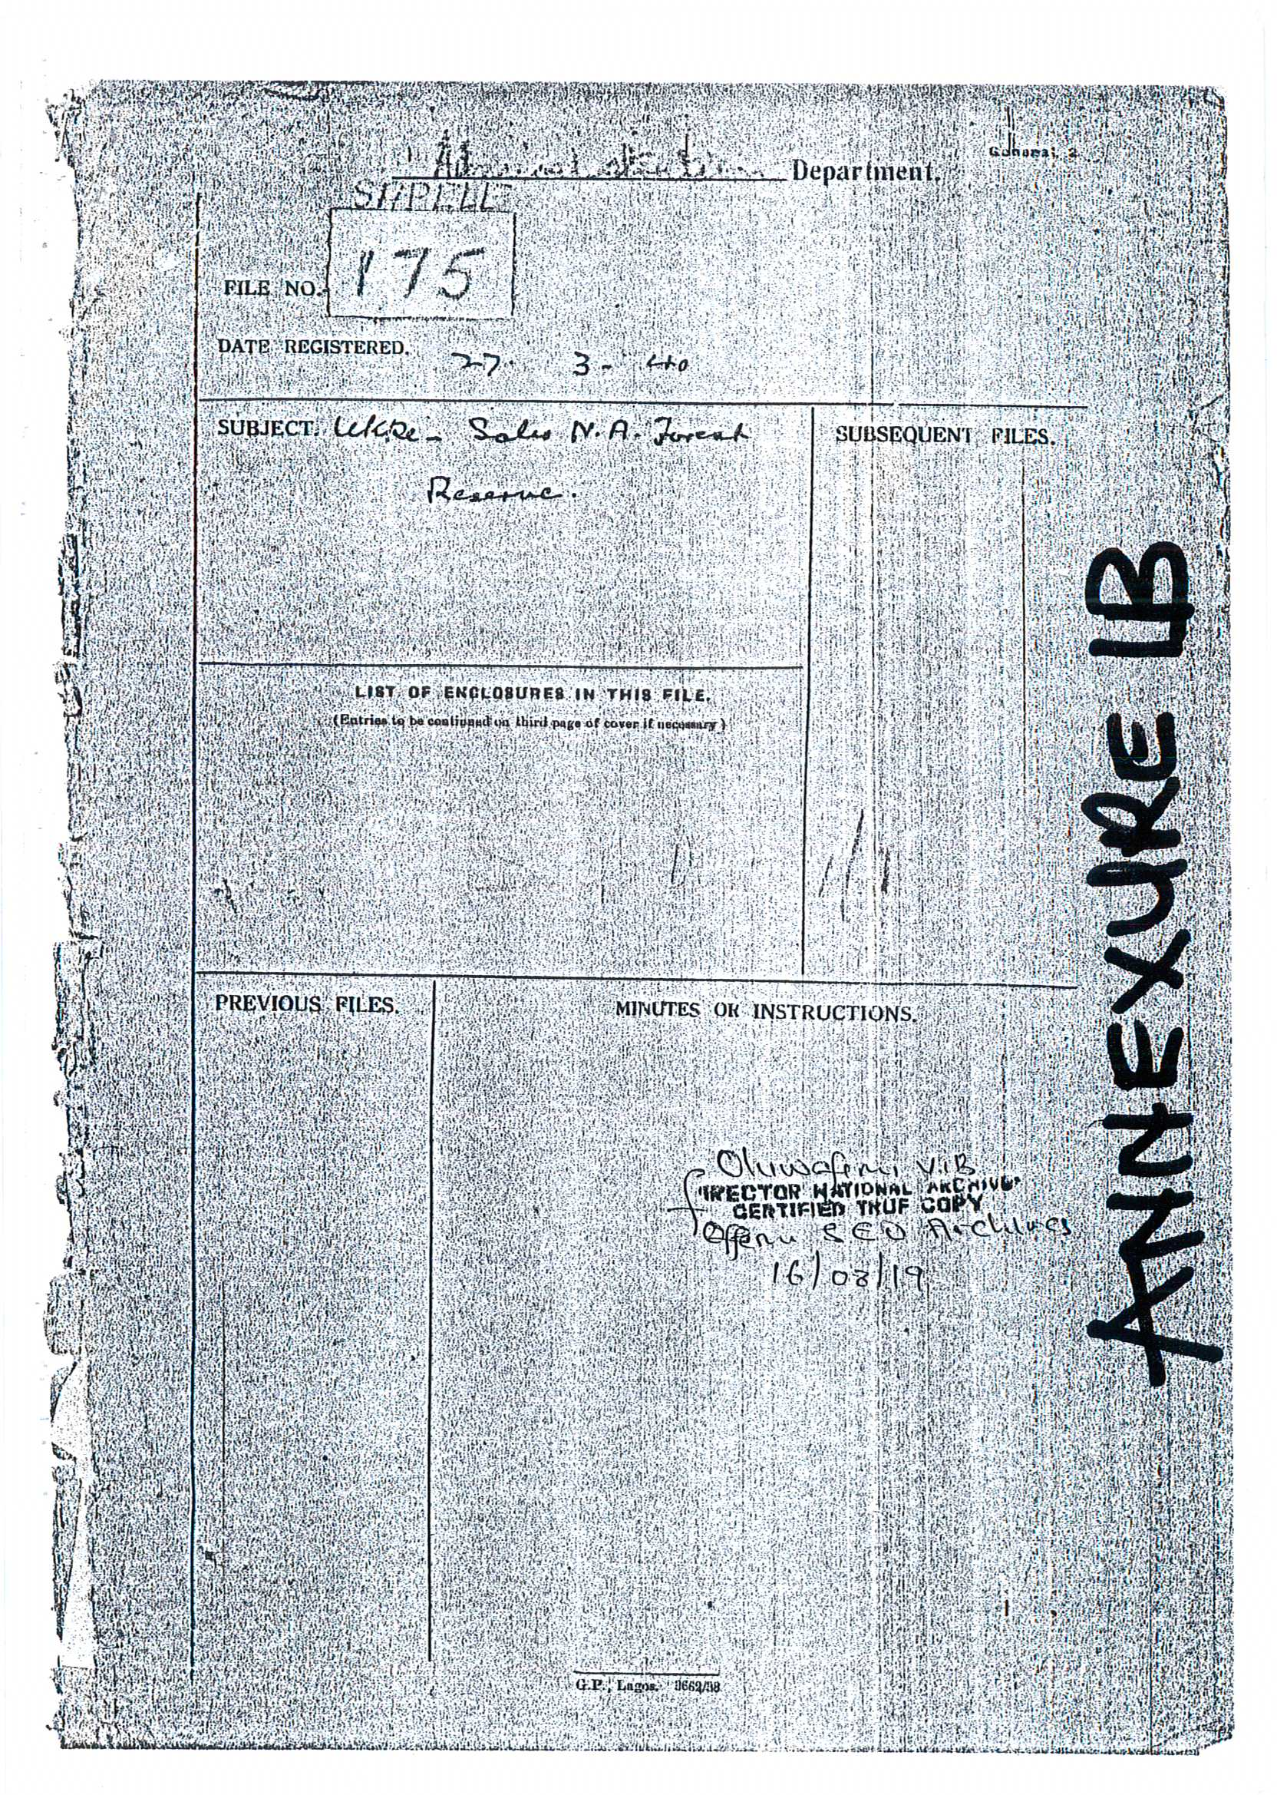

Slide 14
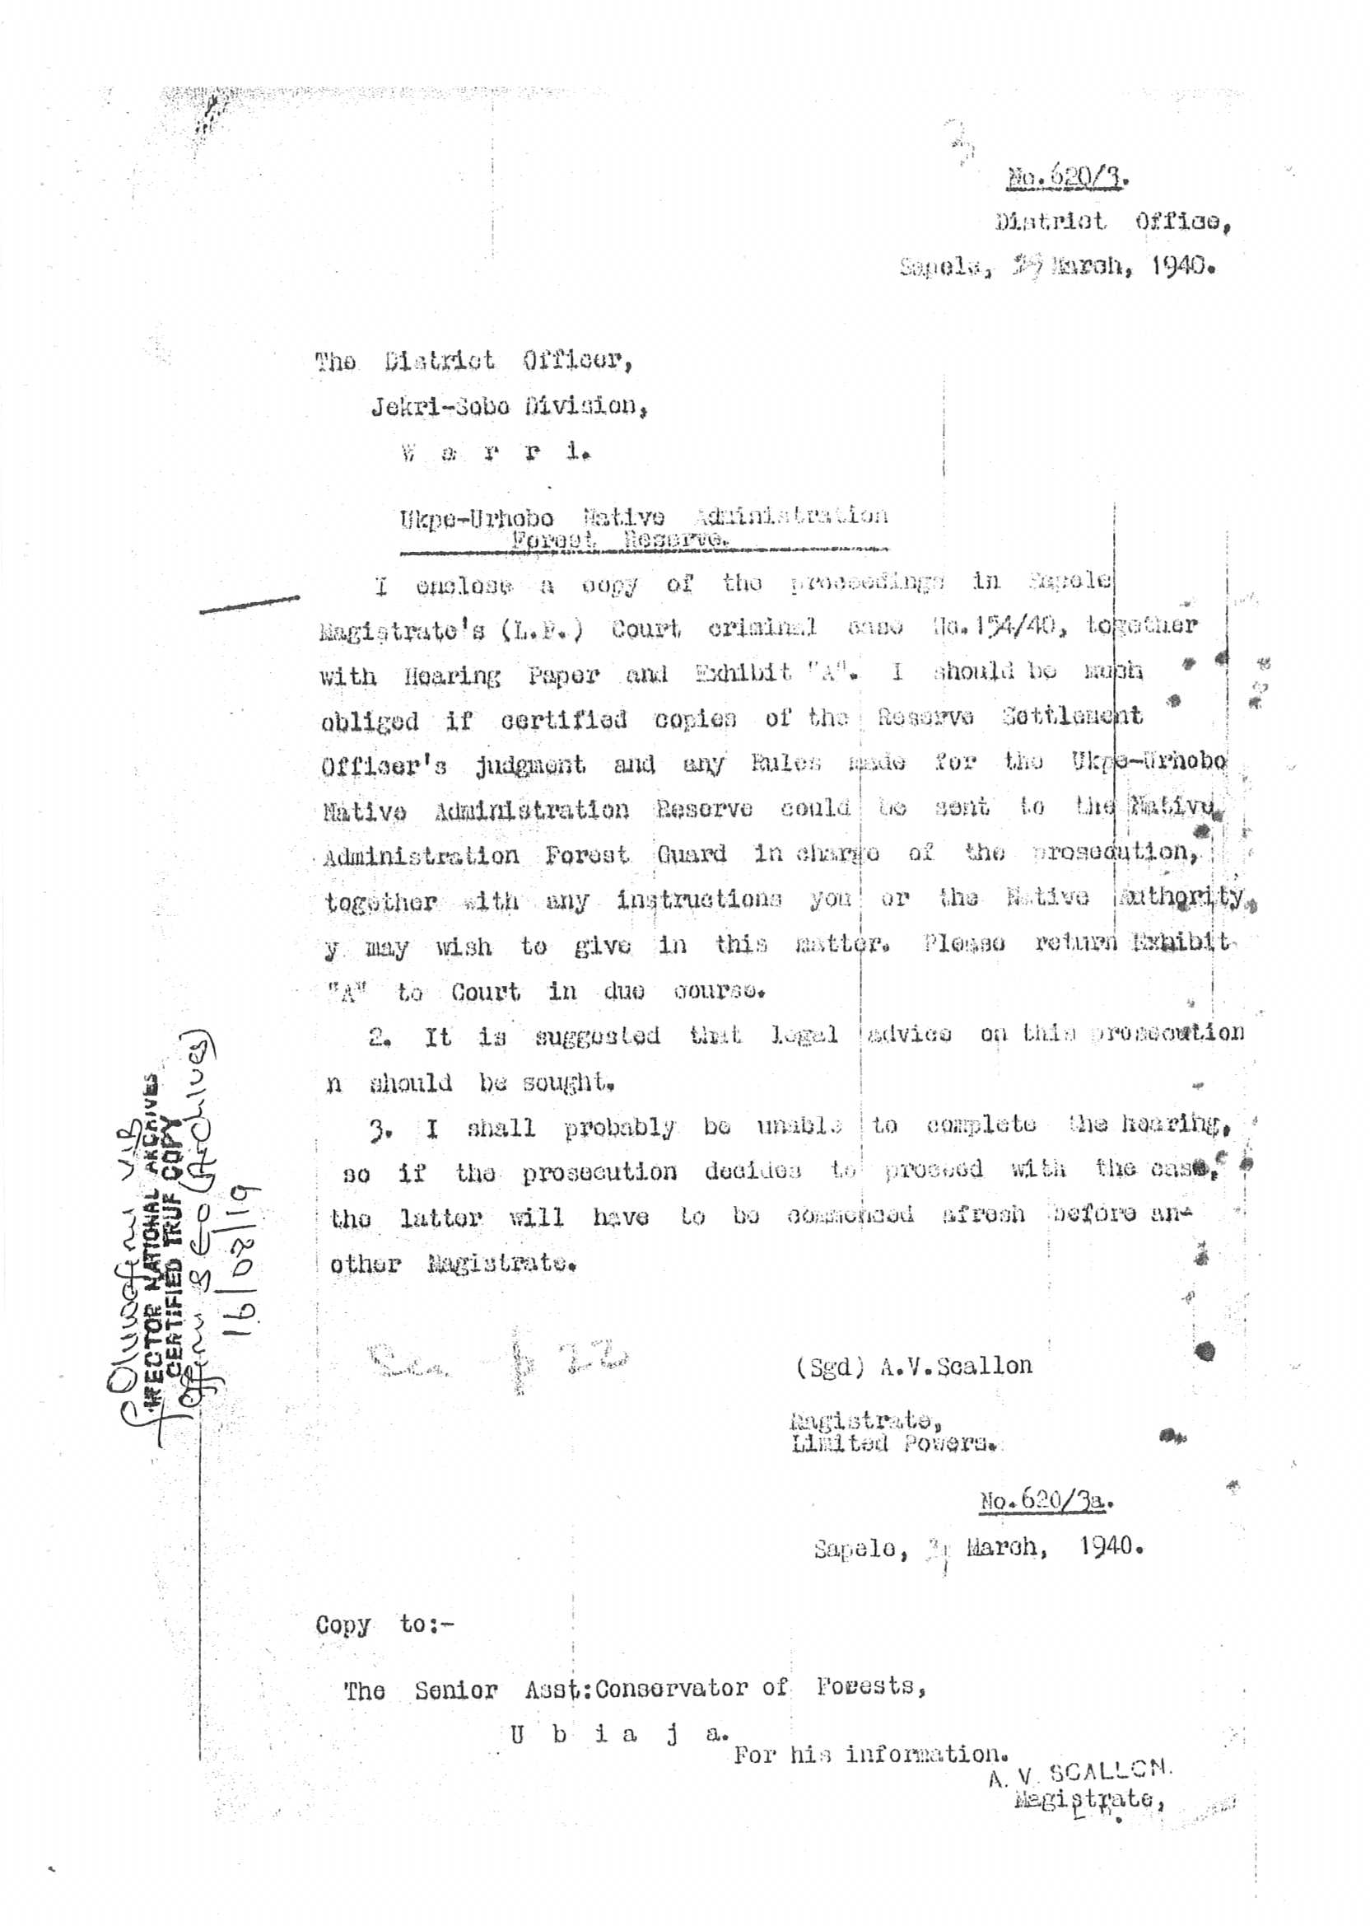

Slide 15
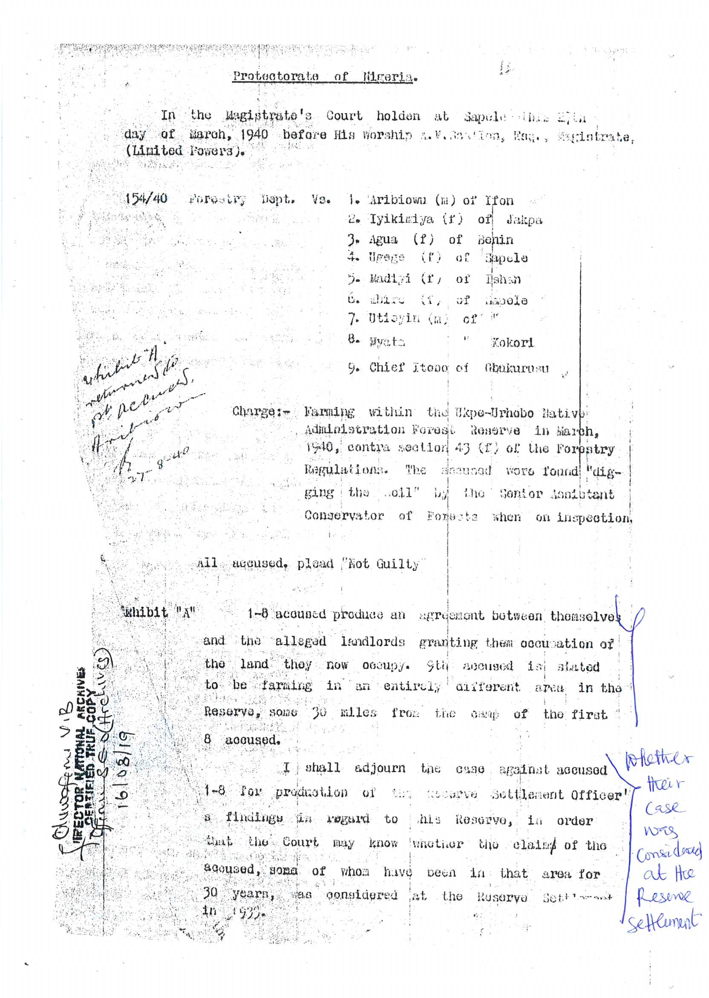

Slide 16
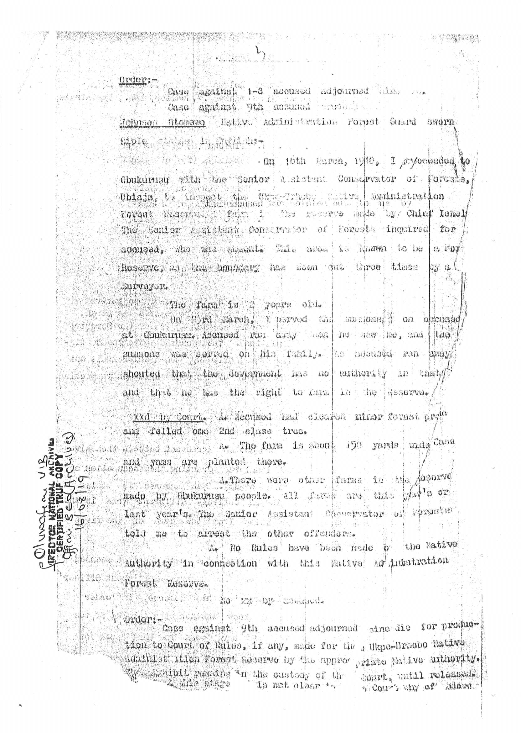

Slide 17
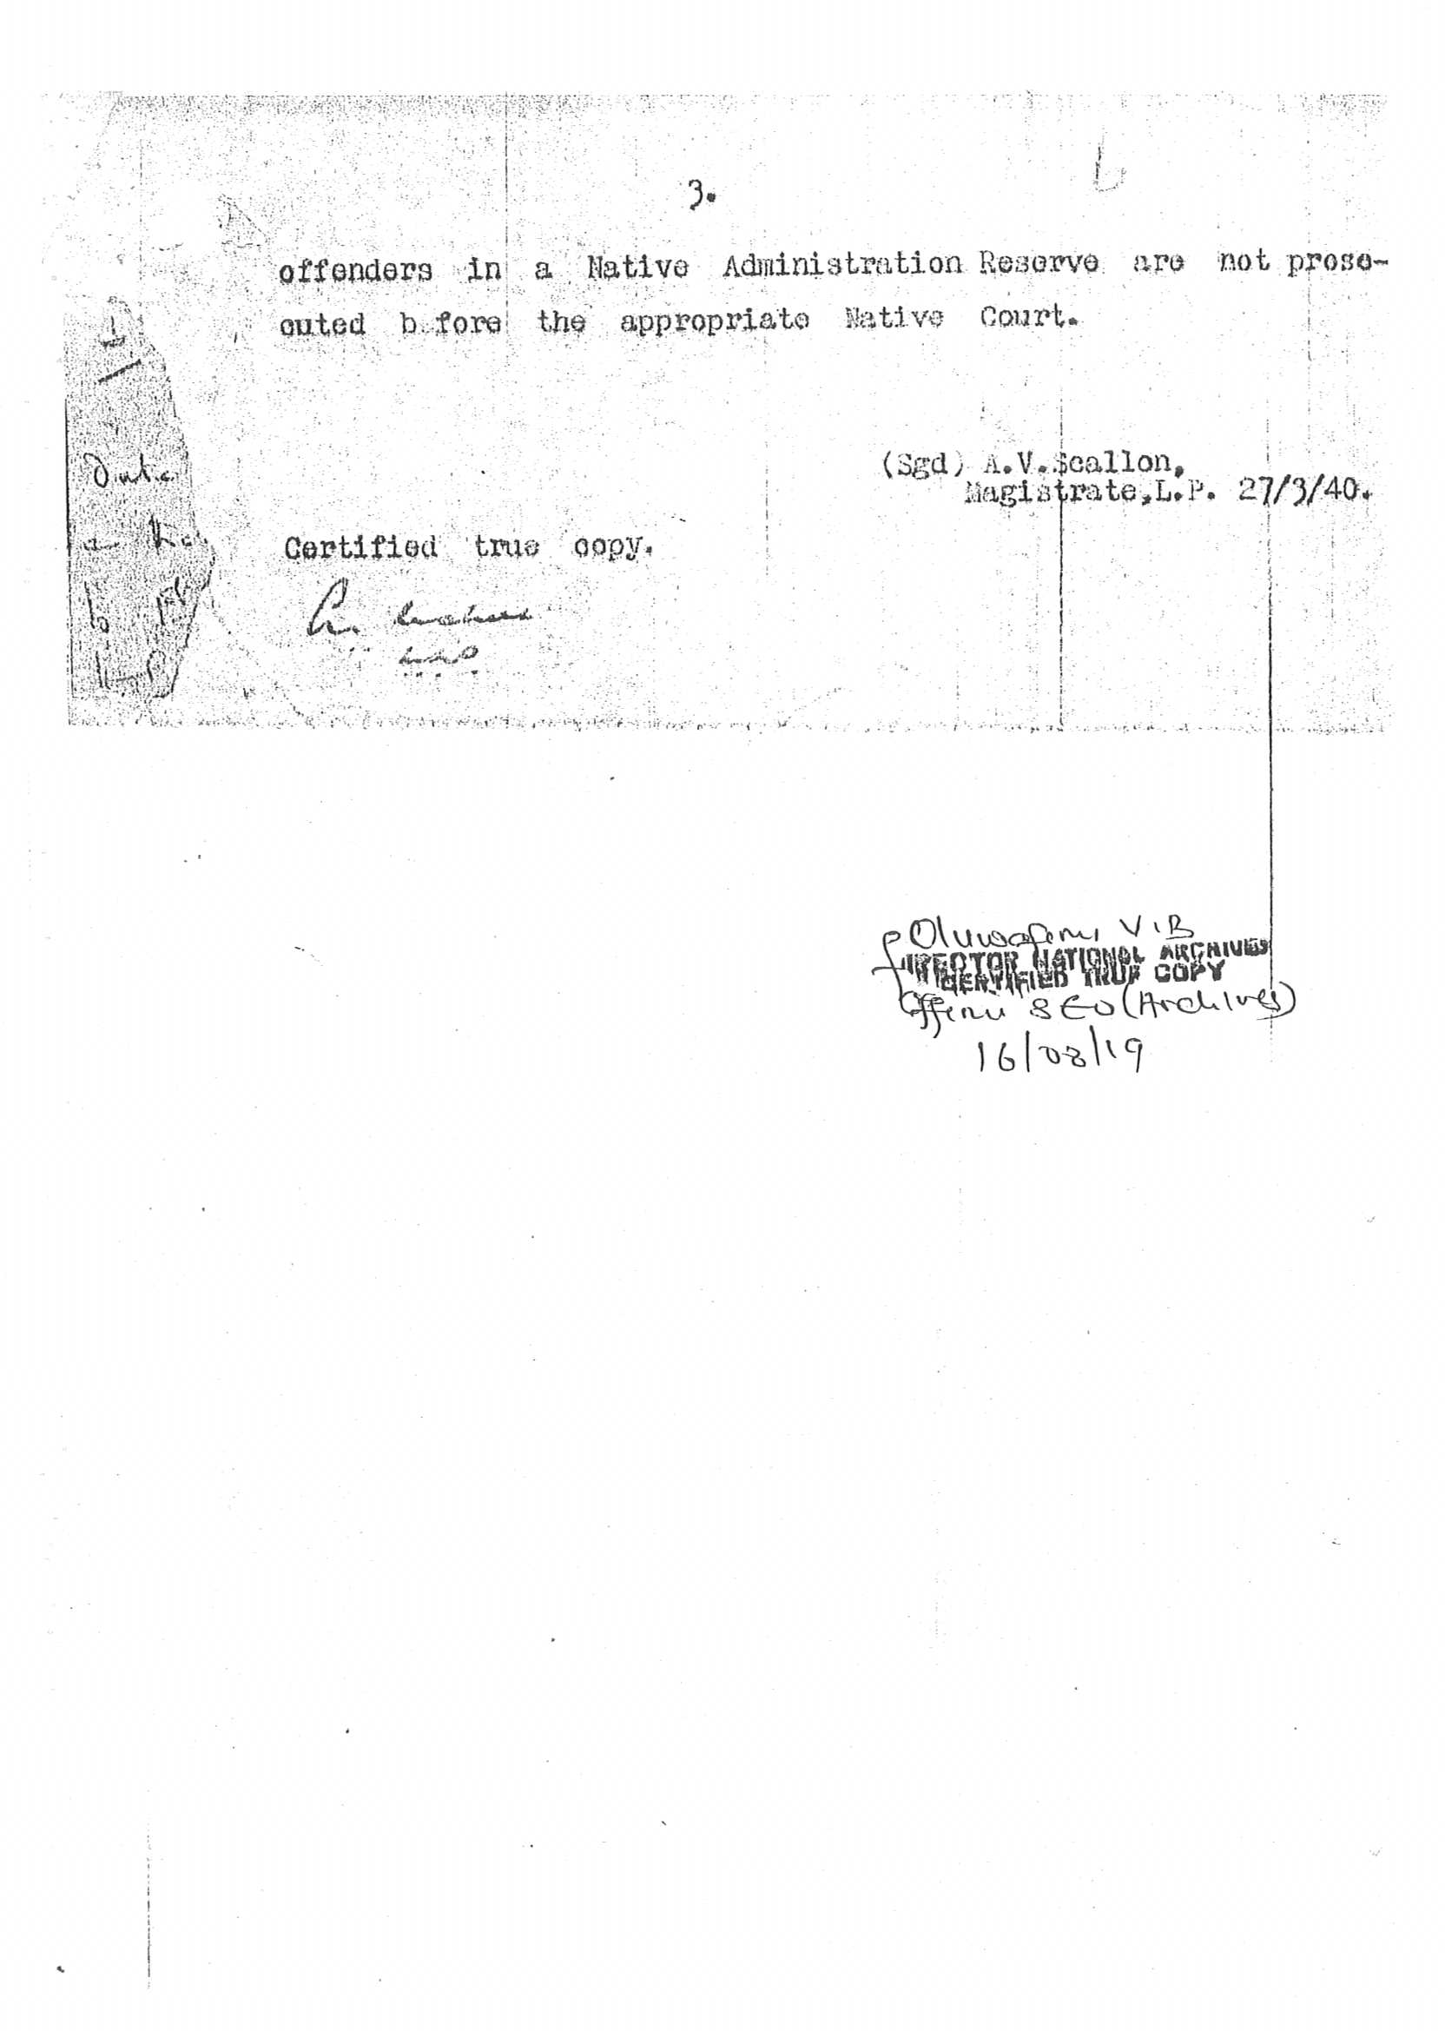

Slide 18
10. When CHIEF OKONEDO who was the Alema and Head of the Abigborodo community heard that his tenants led by Aribiowu were arrested and the subsequent placement of the GBEKOKO- UTON- IYATSERE land into the Ukpe-Sobo Native Administration Forest Reserve, CHIEF OKONEDO caused a petition to be written to the office of the Governor General, Lagos against the said inclusion of the GBEKOKO-UTON- IYATSERE large expanse of lands into the Ukpe- Sobo Native Administration Forest Reserve without the consent and authority of the Abigborodo community.

Slide 19
10. In the said petition to the Governor General, CHIEF OKONEDO gave an historical background on how the Abigborodo community became owners of the said land and he requested the Governor General to investigate his claims and revert back the said land to the Abigborodo community. The petition which is duly Certified by the National Archives dated 3rd November, 1940 is attached and marked as Annexure 1C.

Slide 20
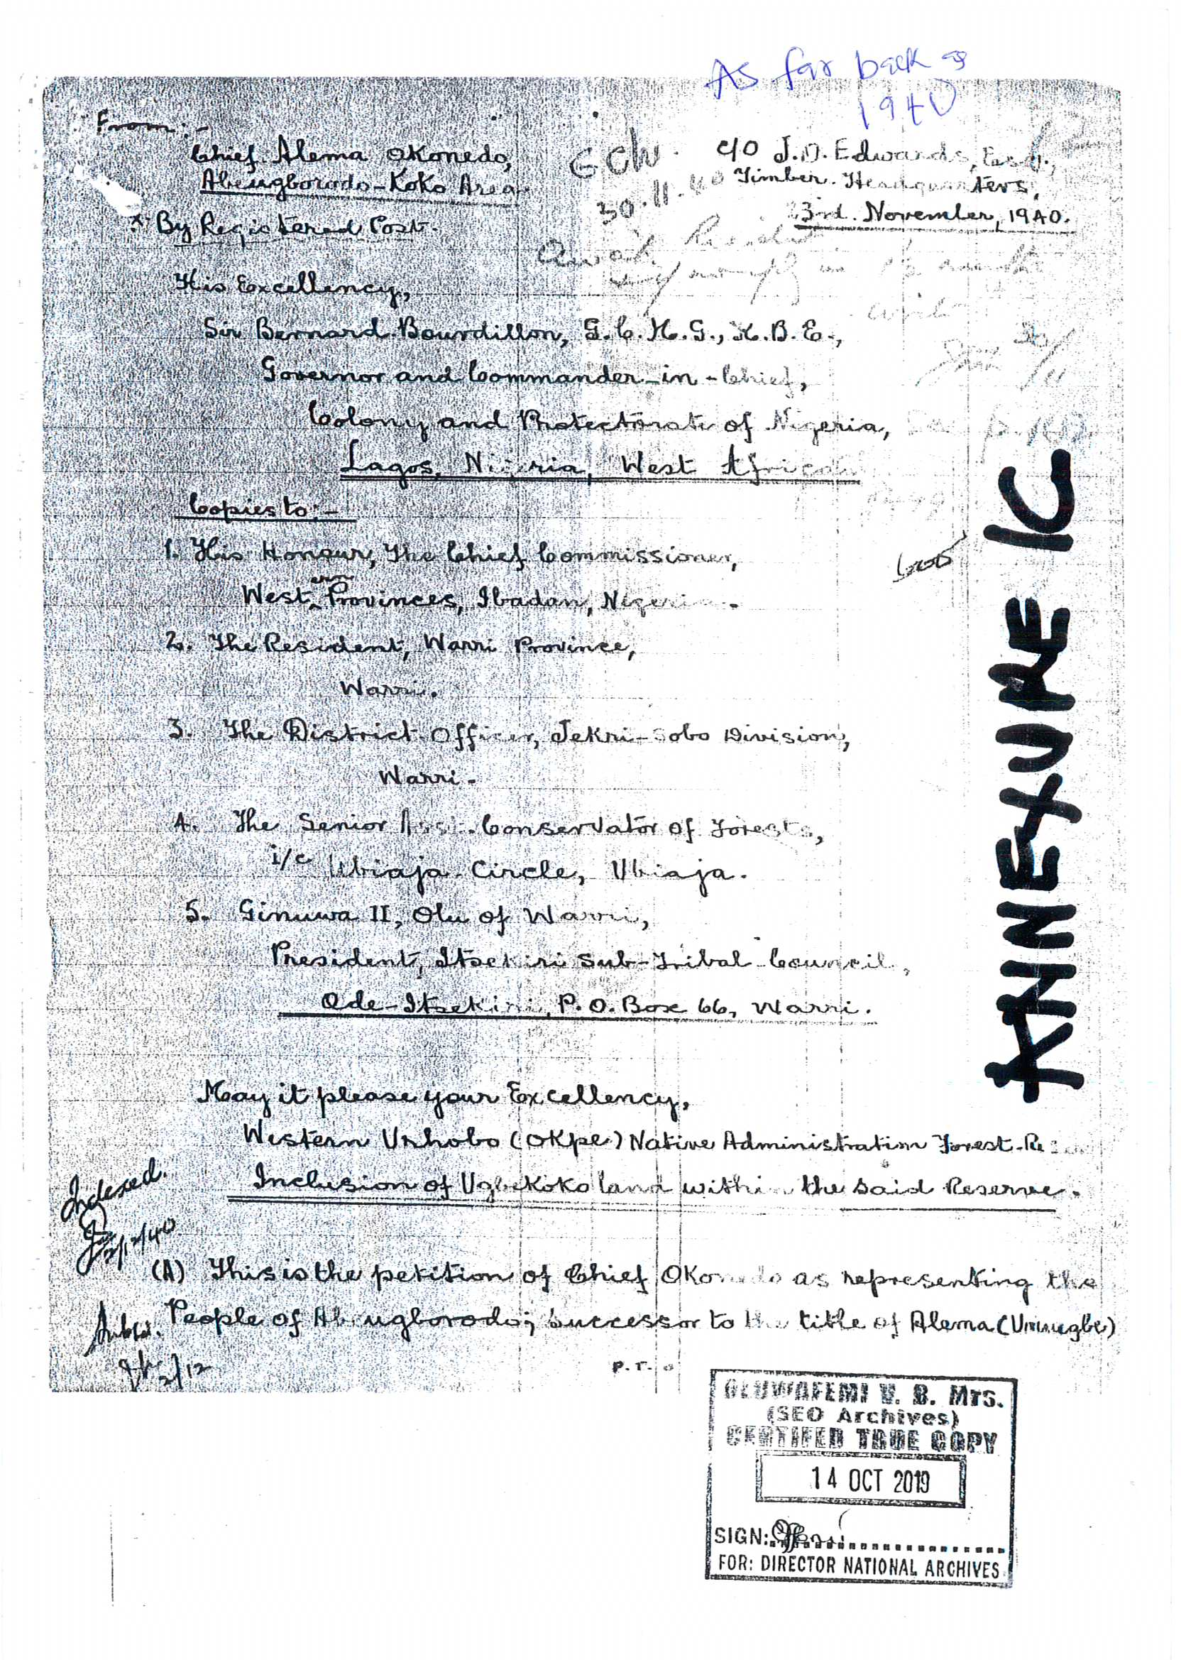

Slide 21
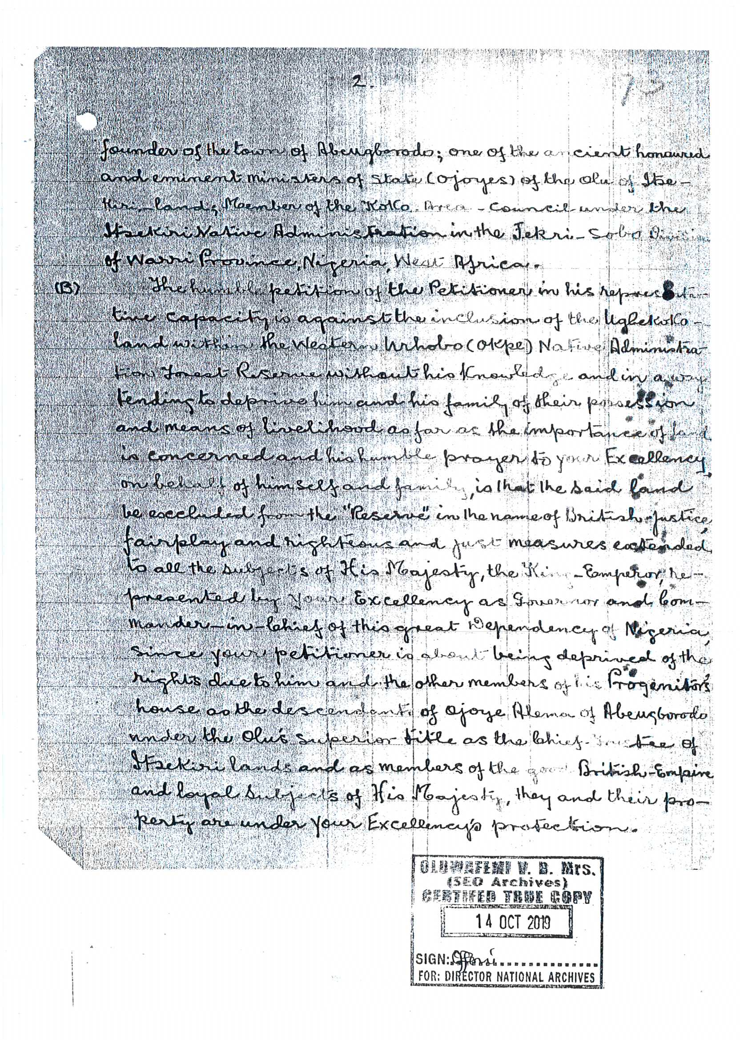

Slide 22
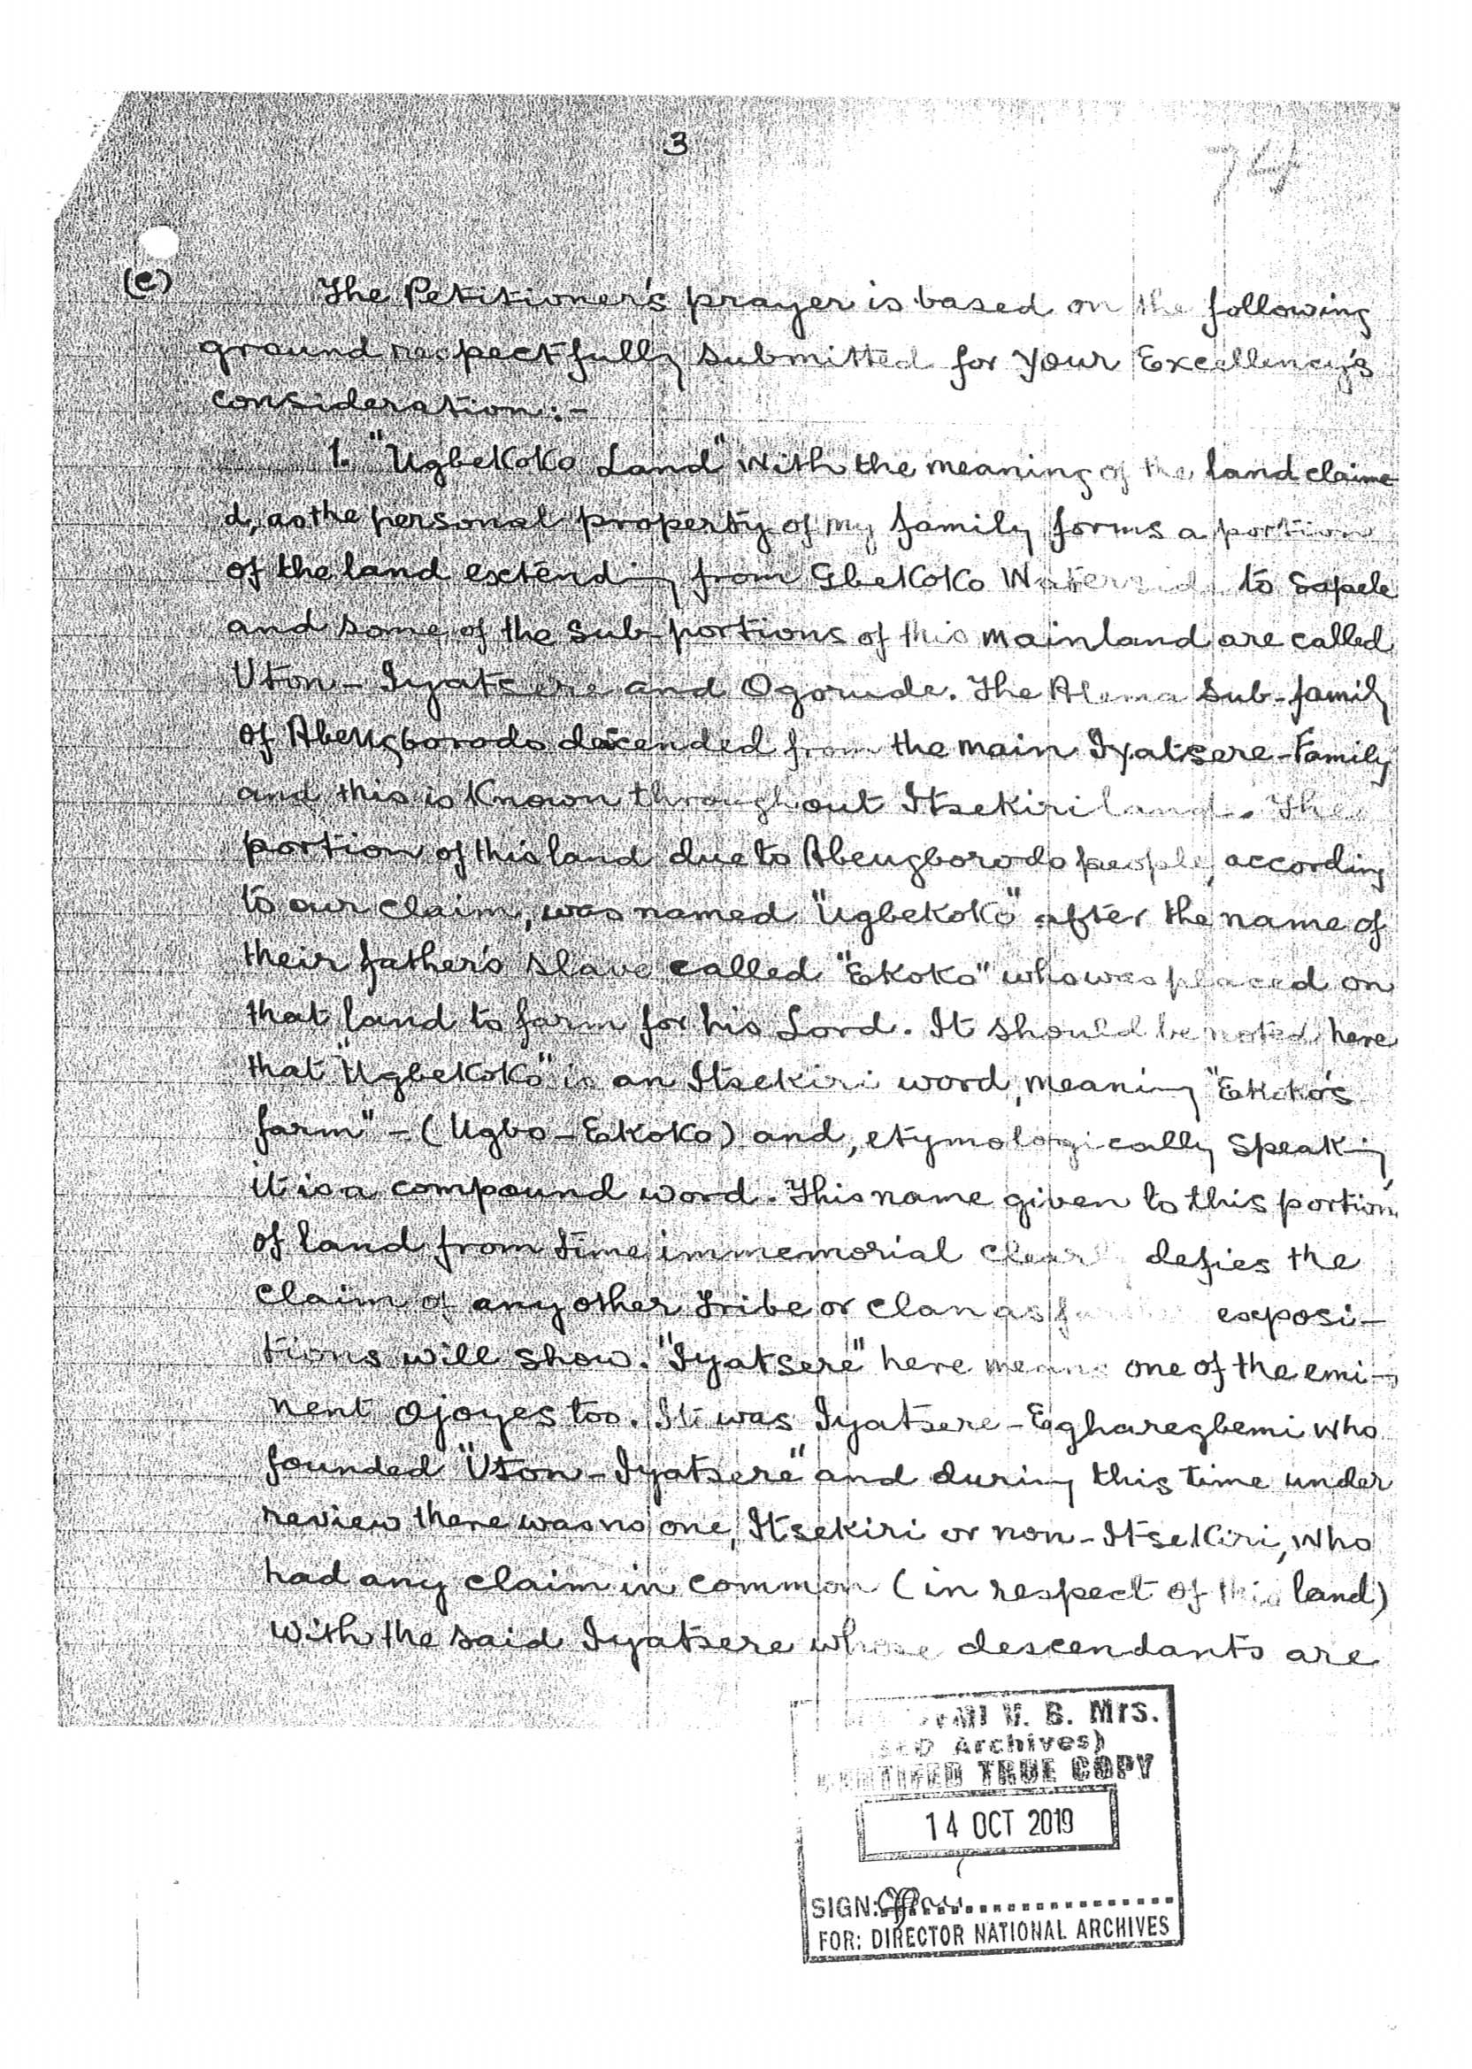

Slide 23
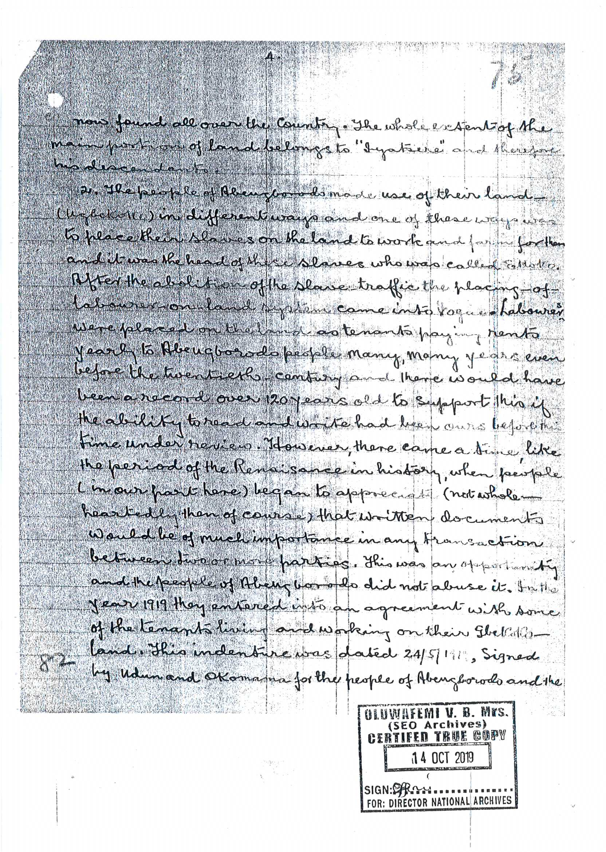

Slide 24
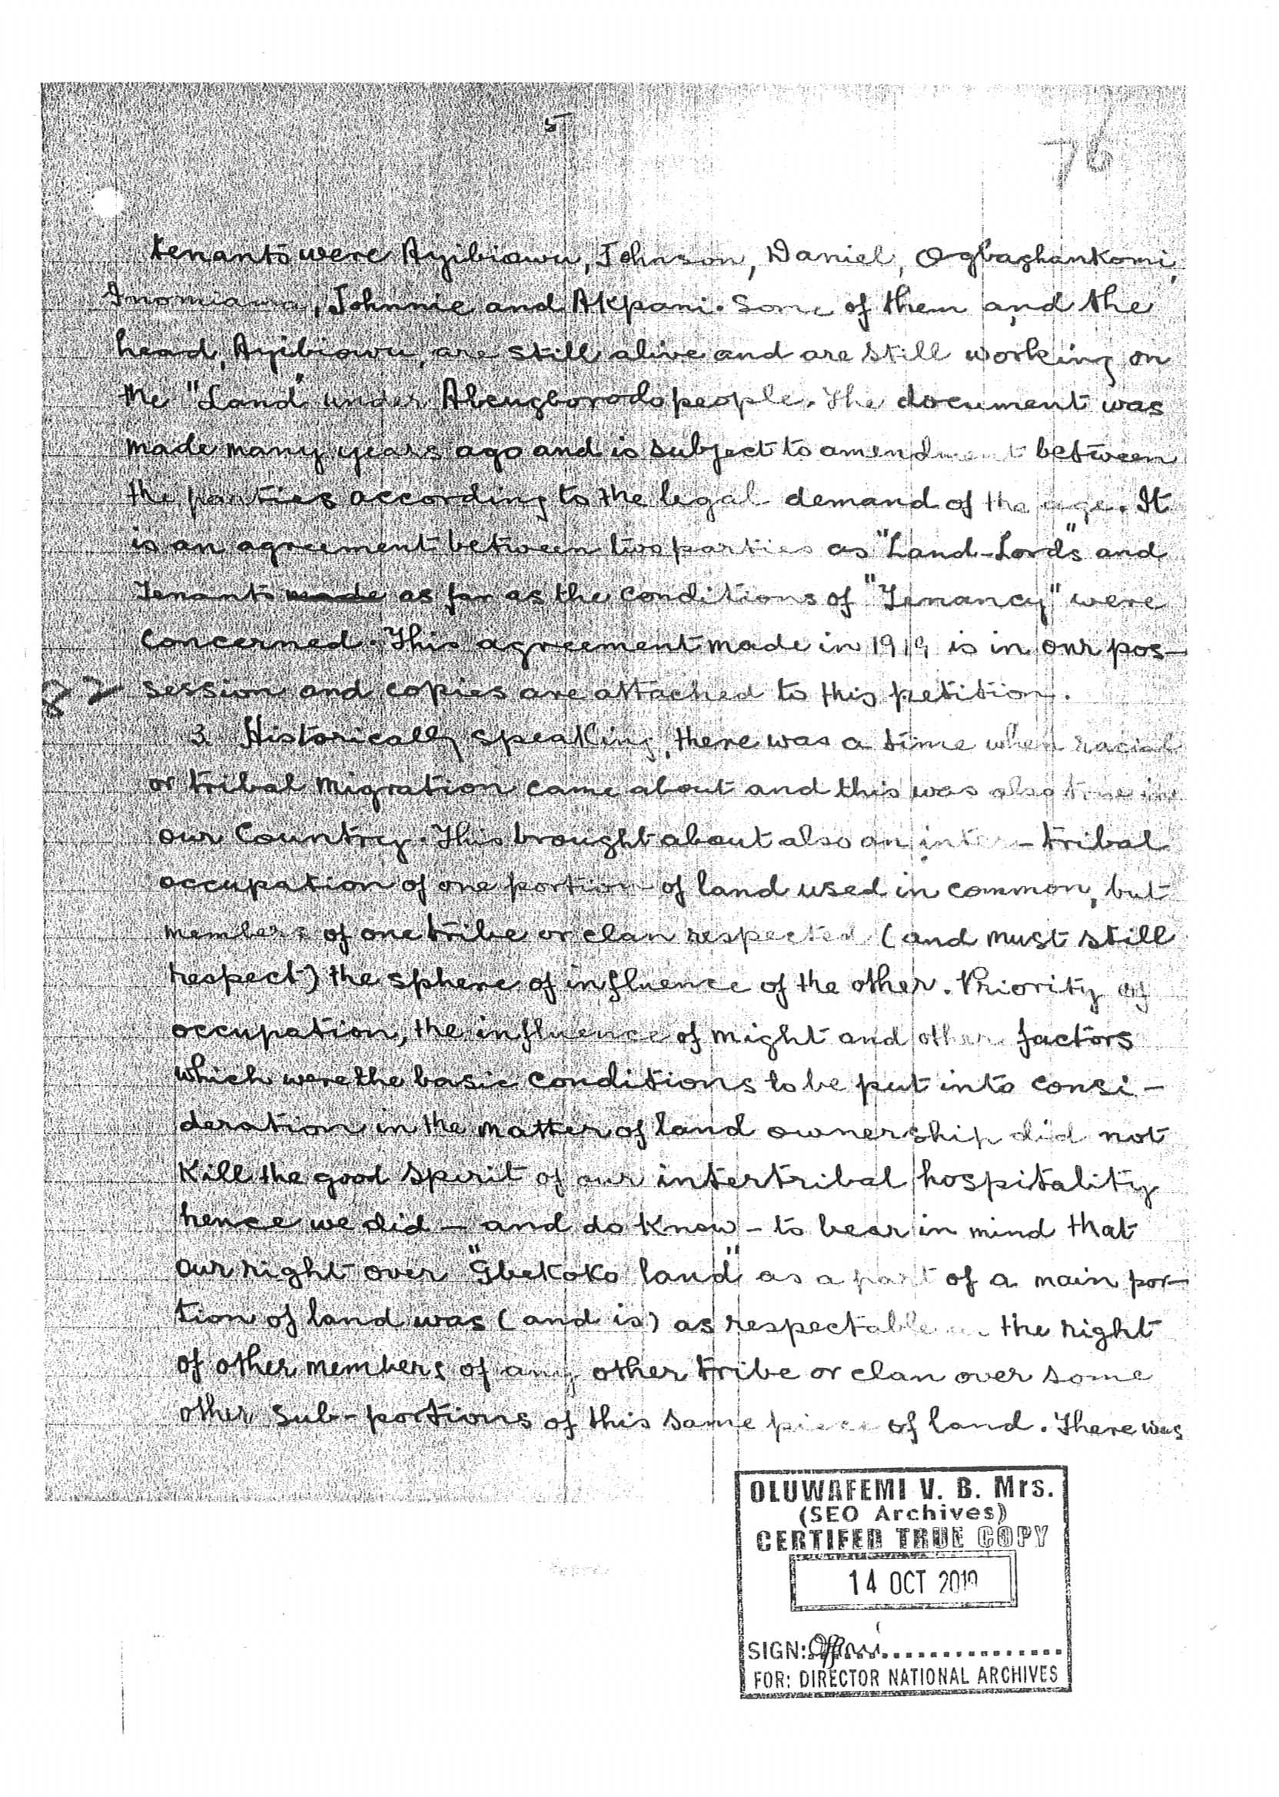

Slide 25
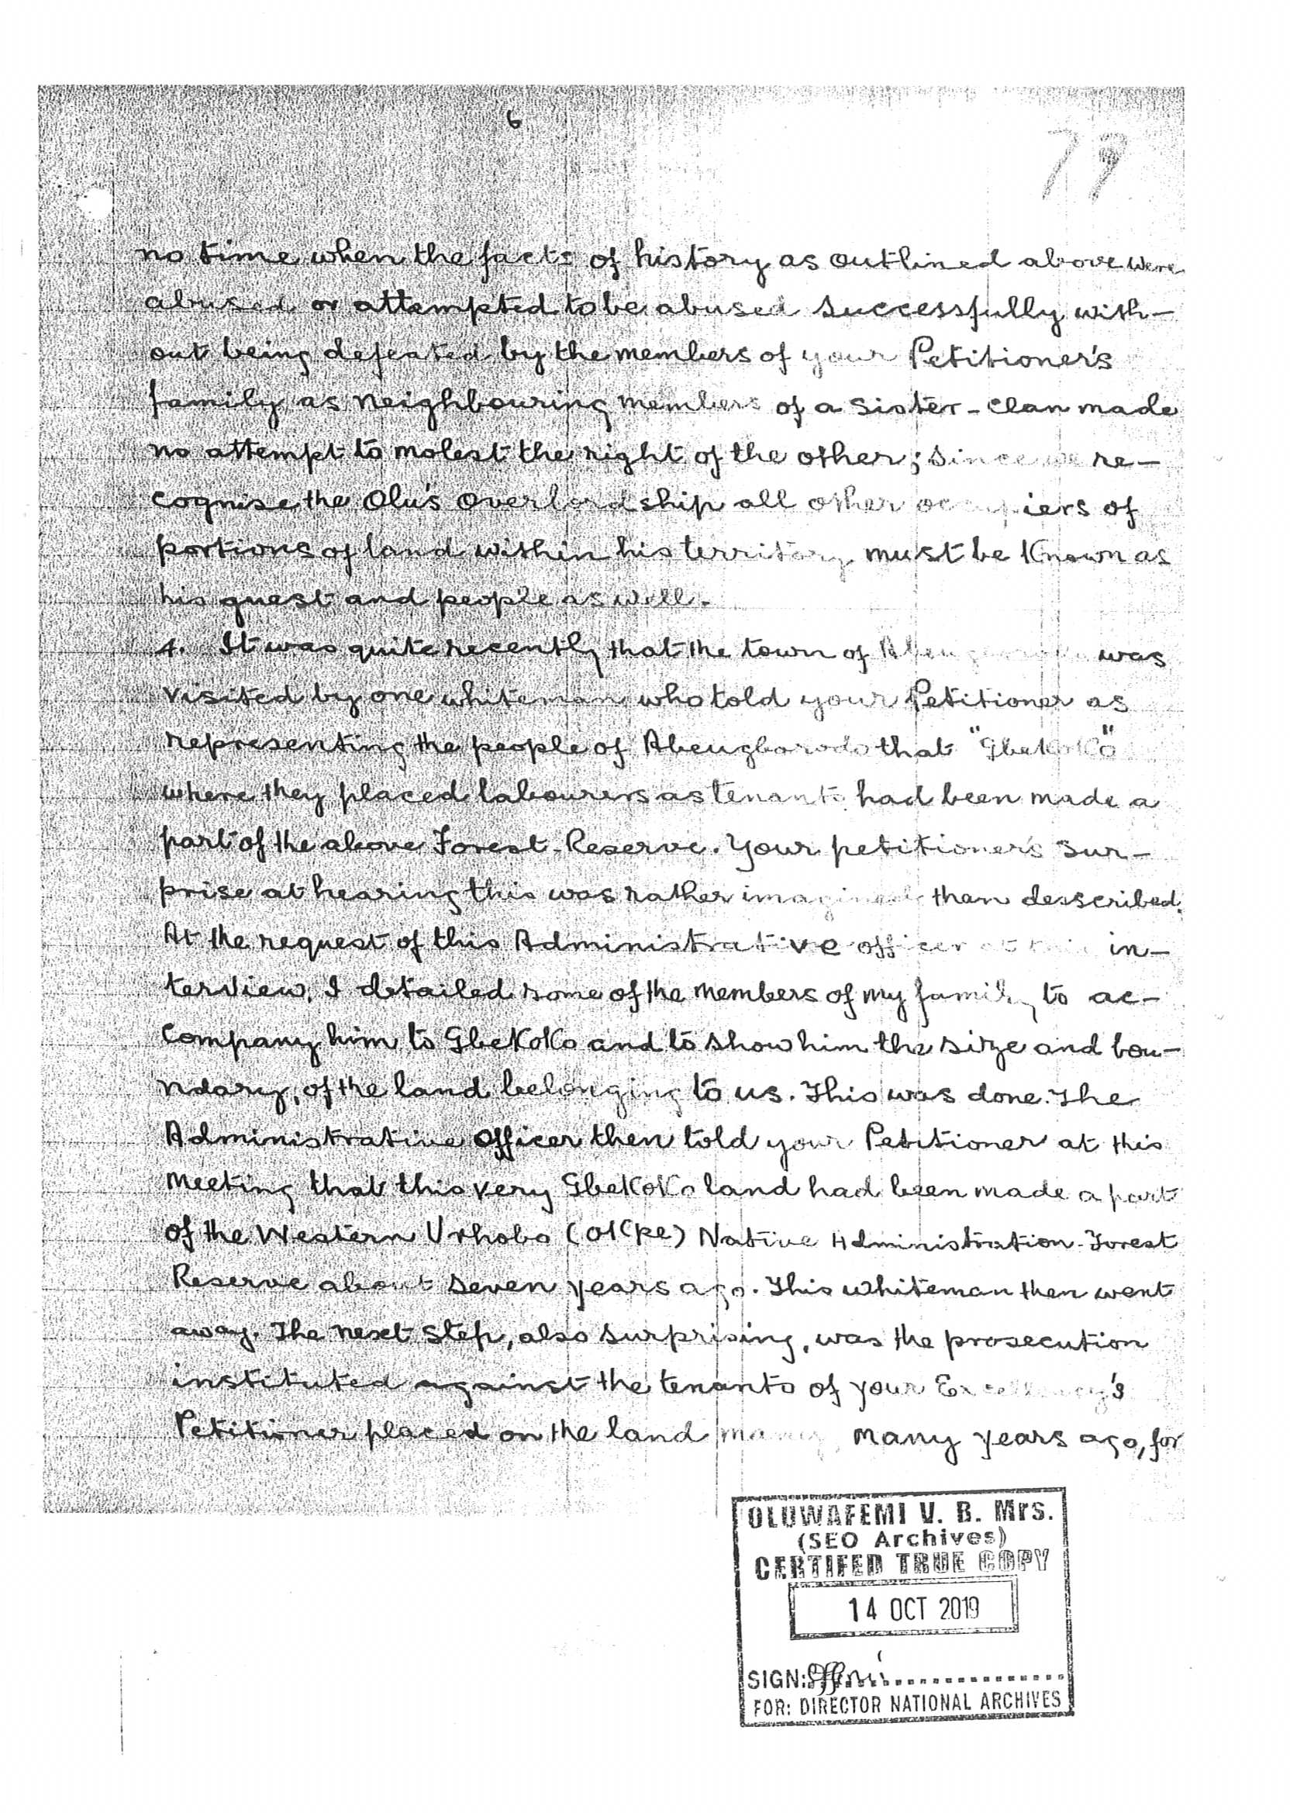

Slide 26
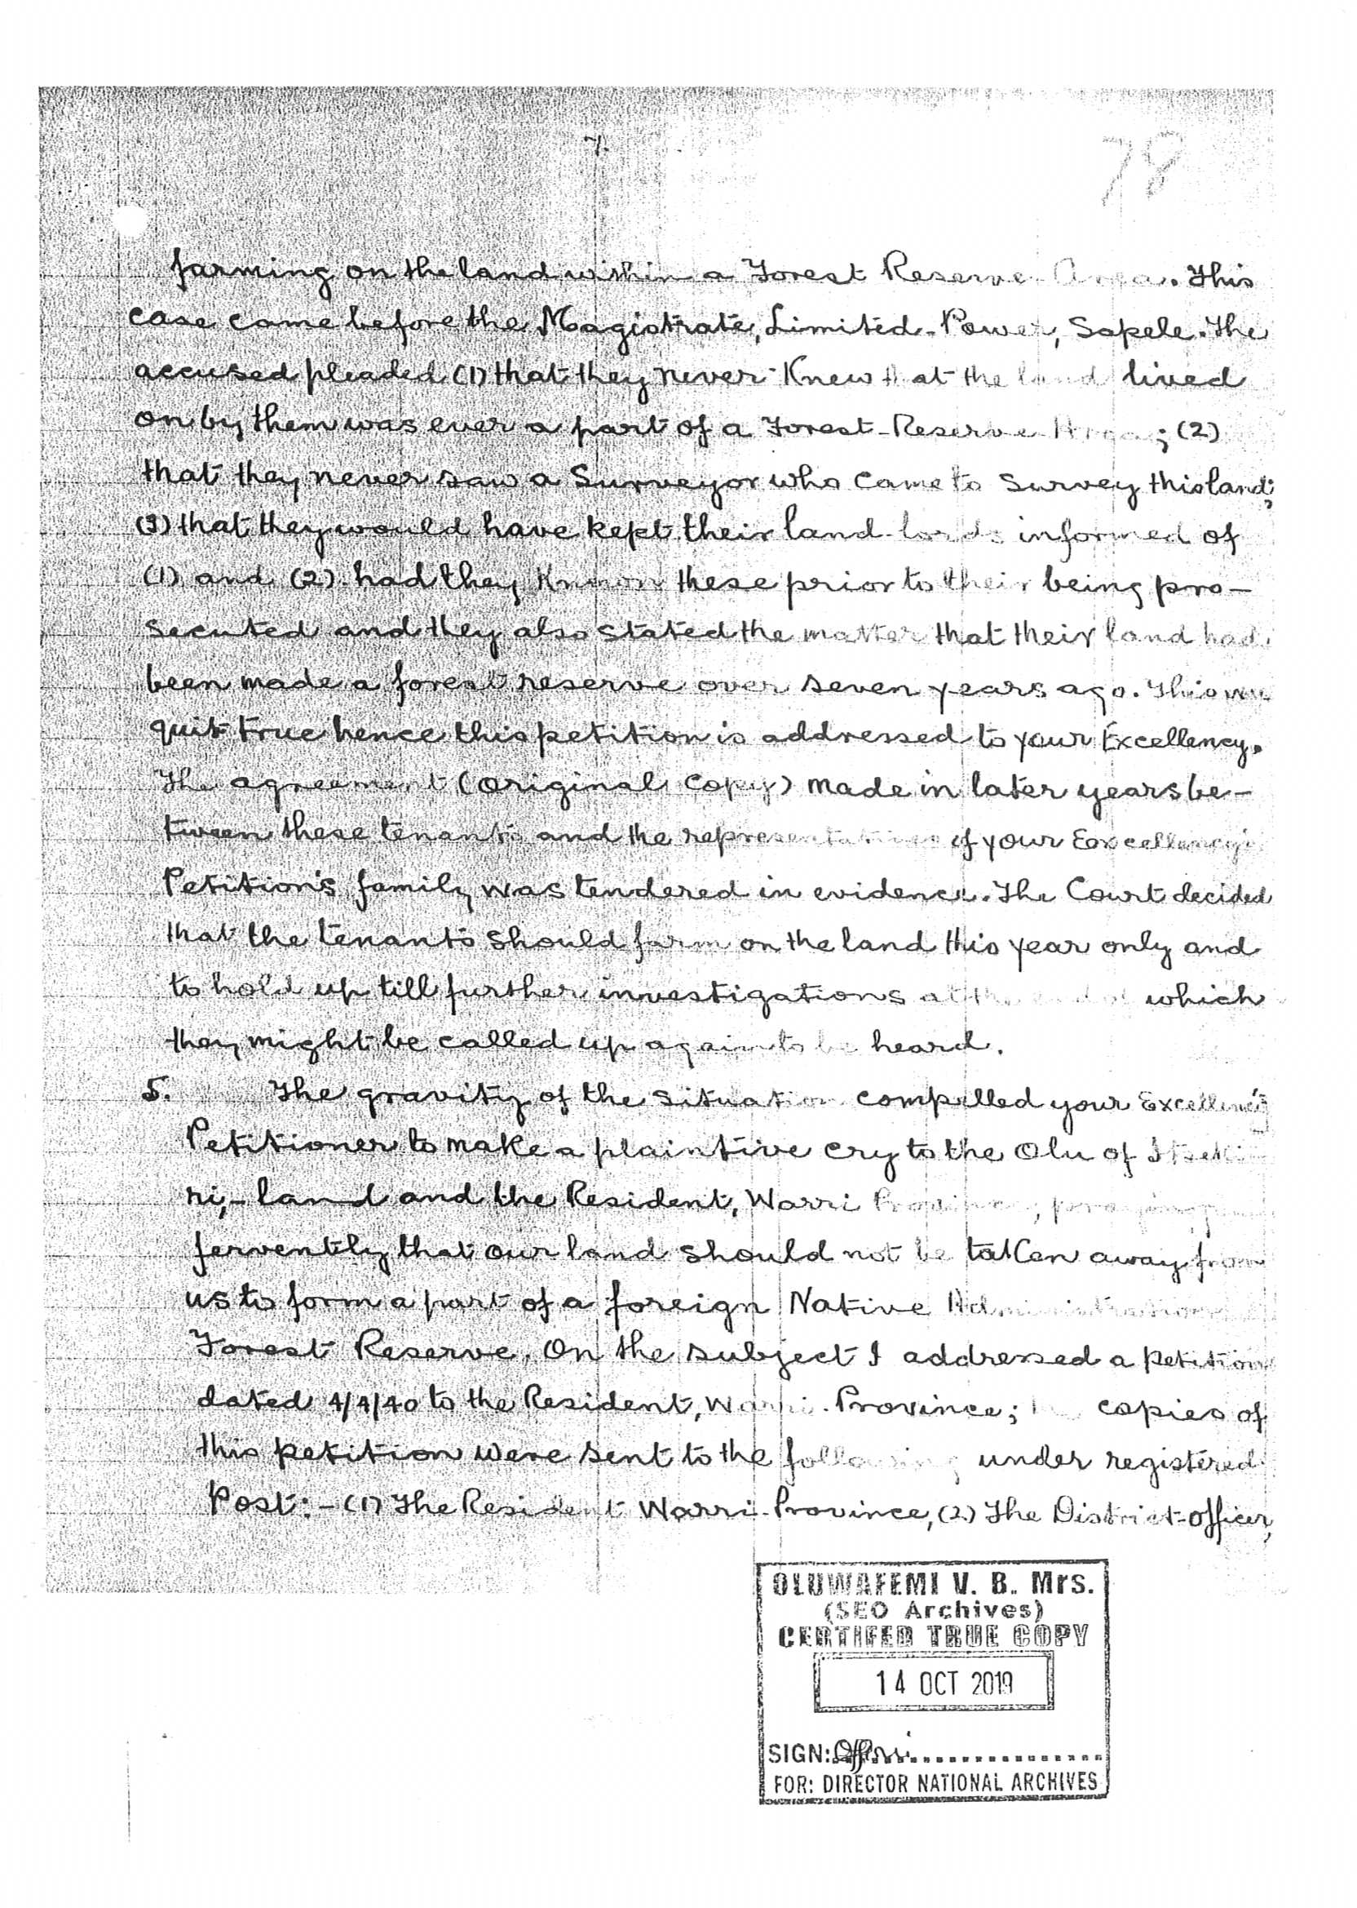

Slide 27
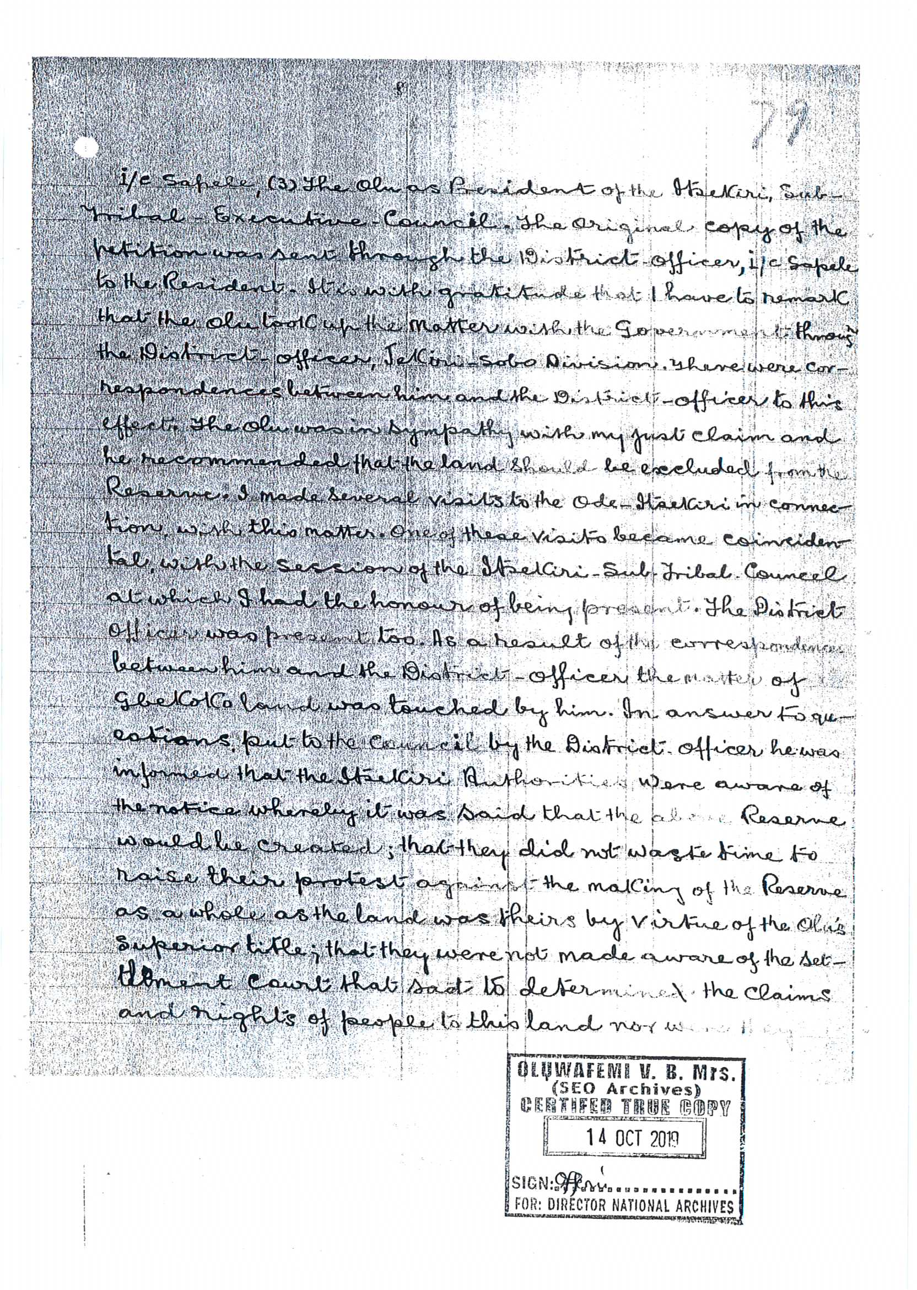

Slide 28
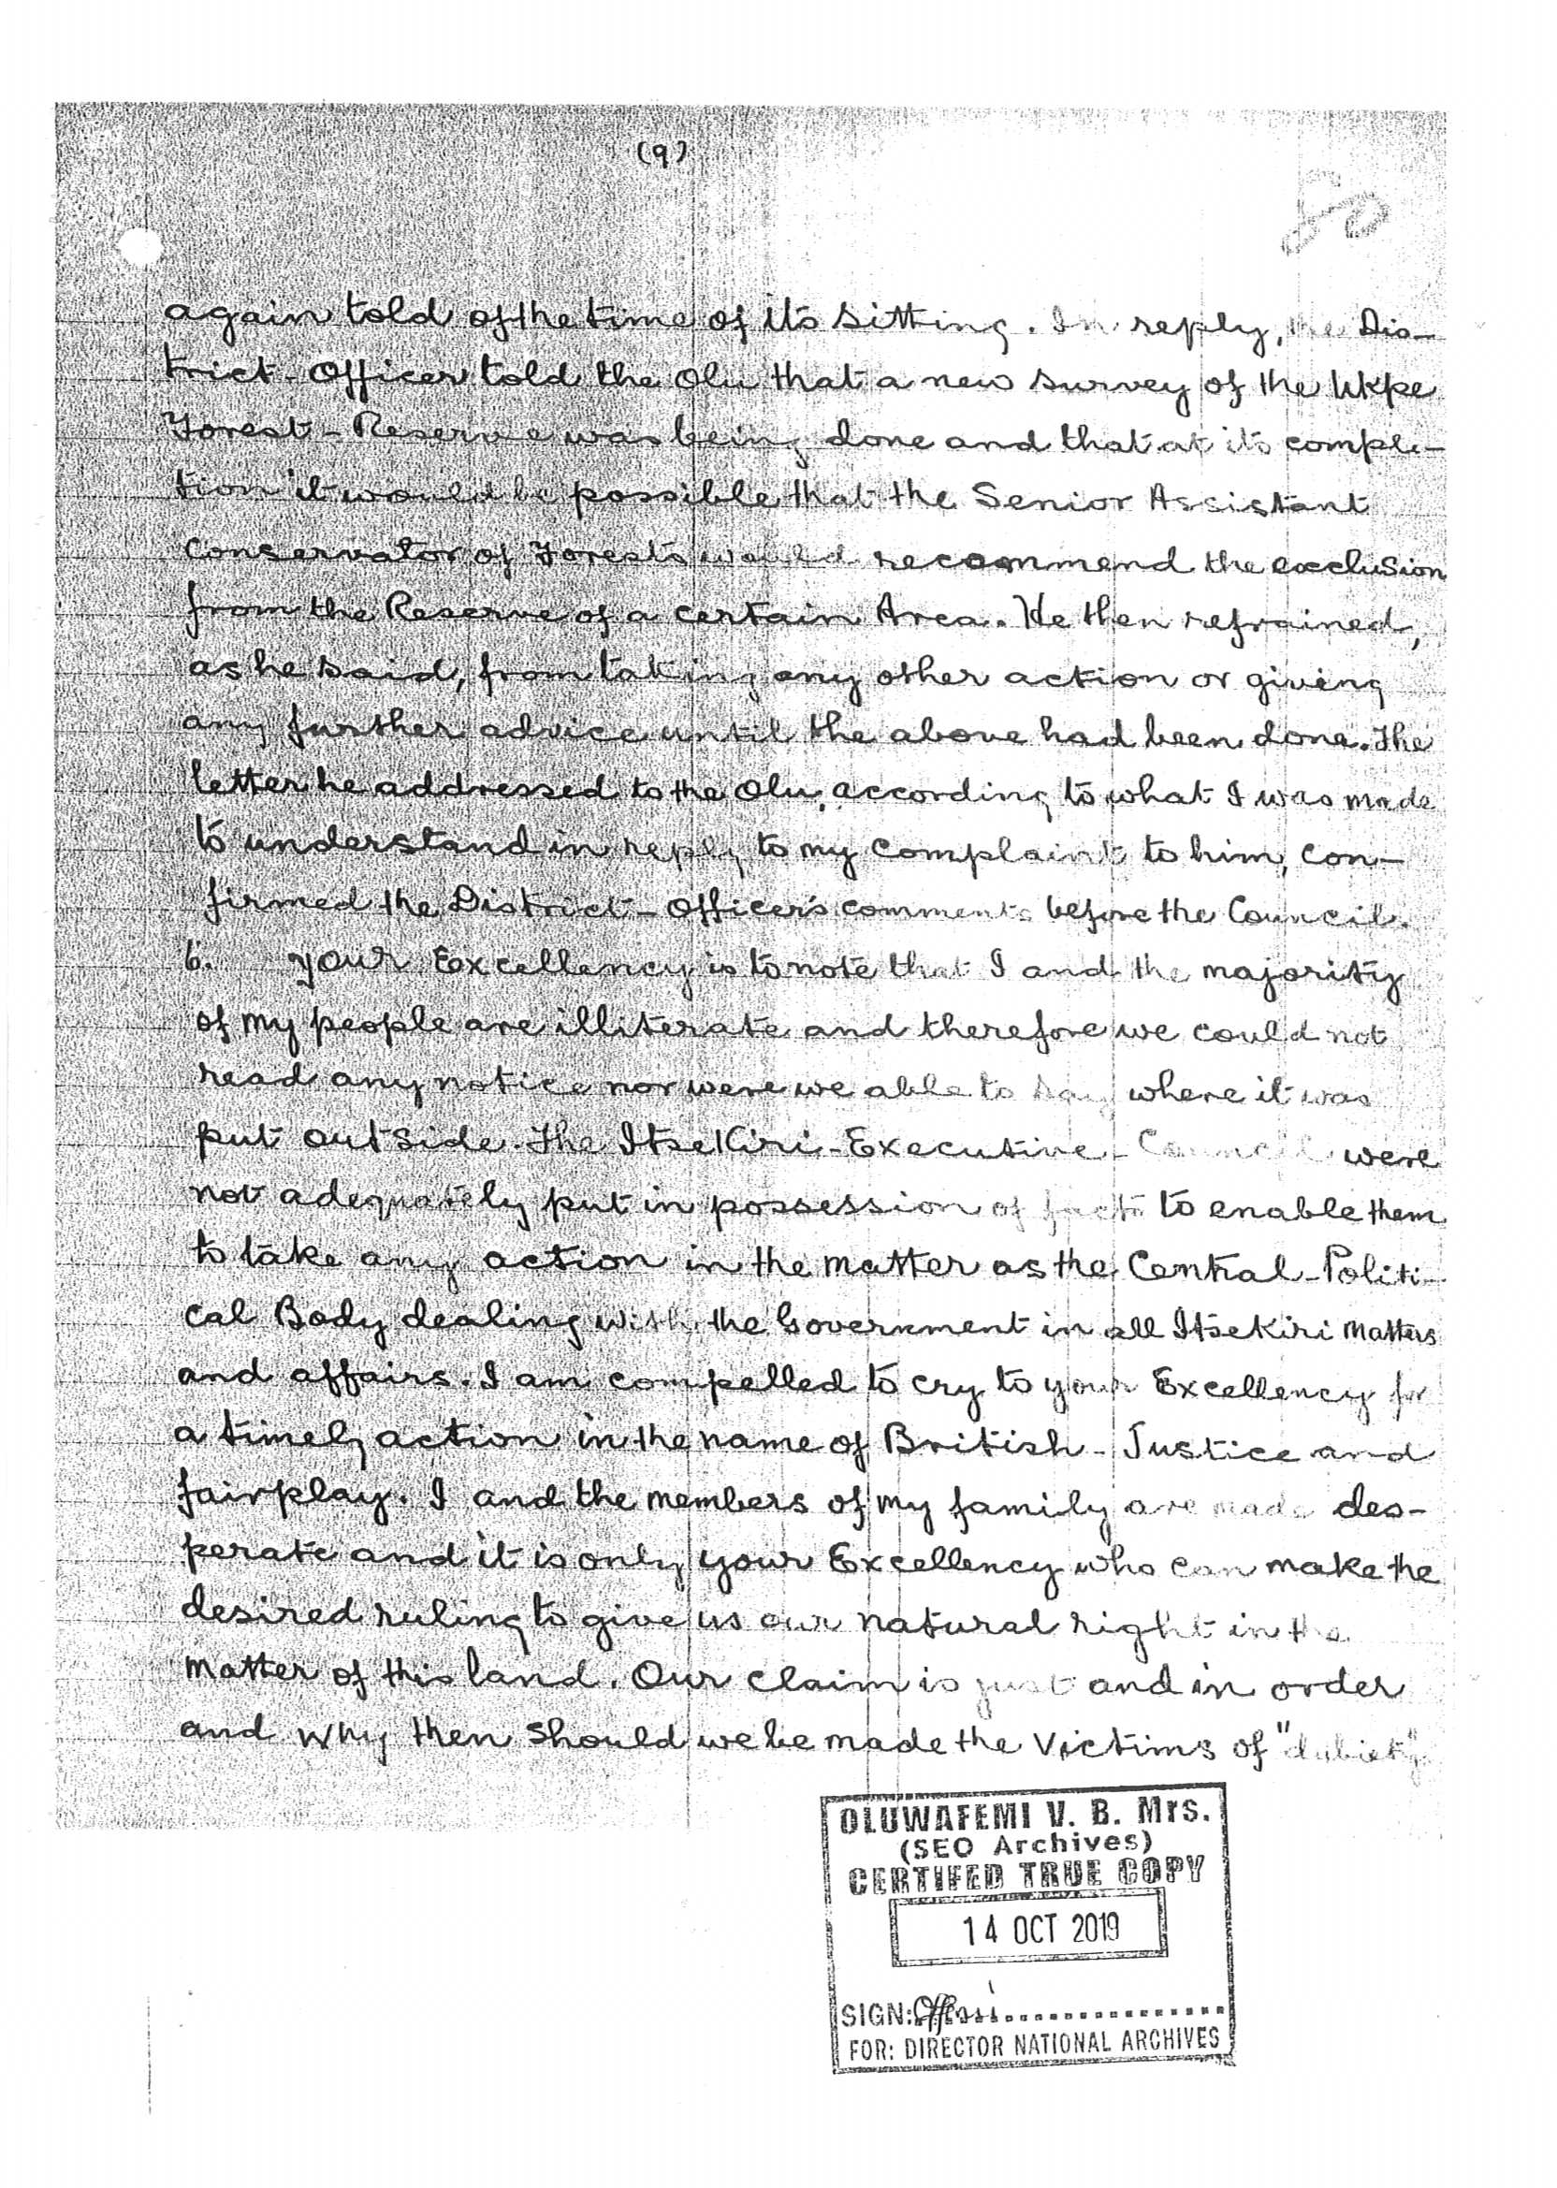

Slide 29
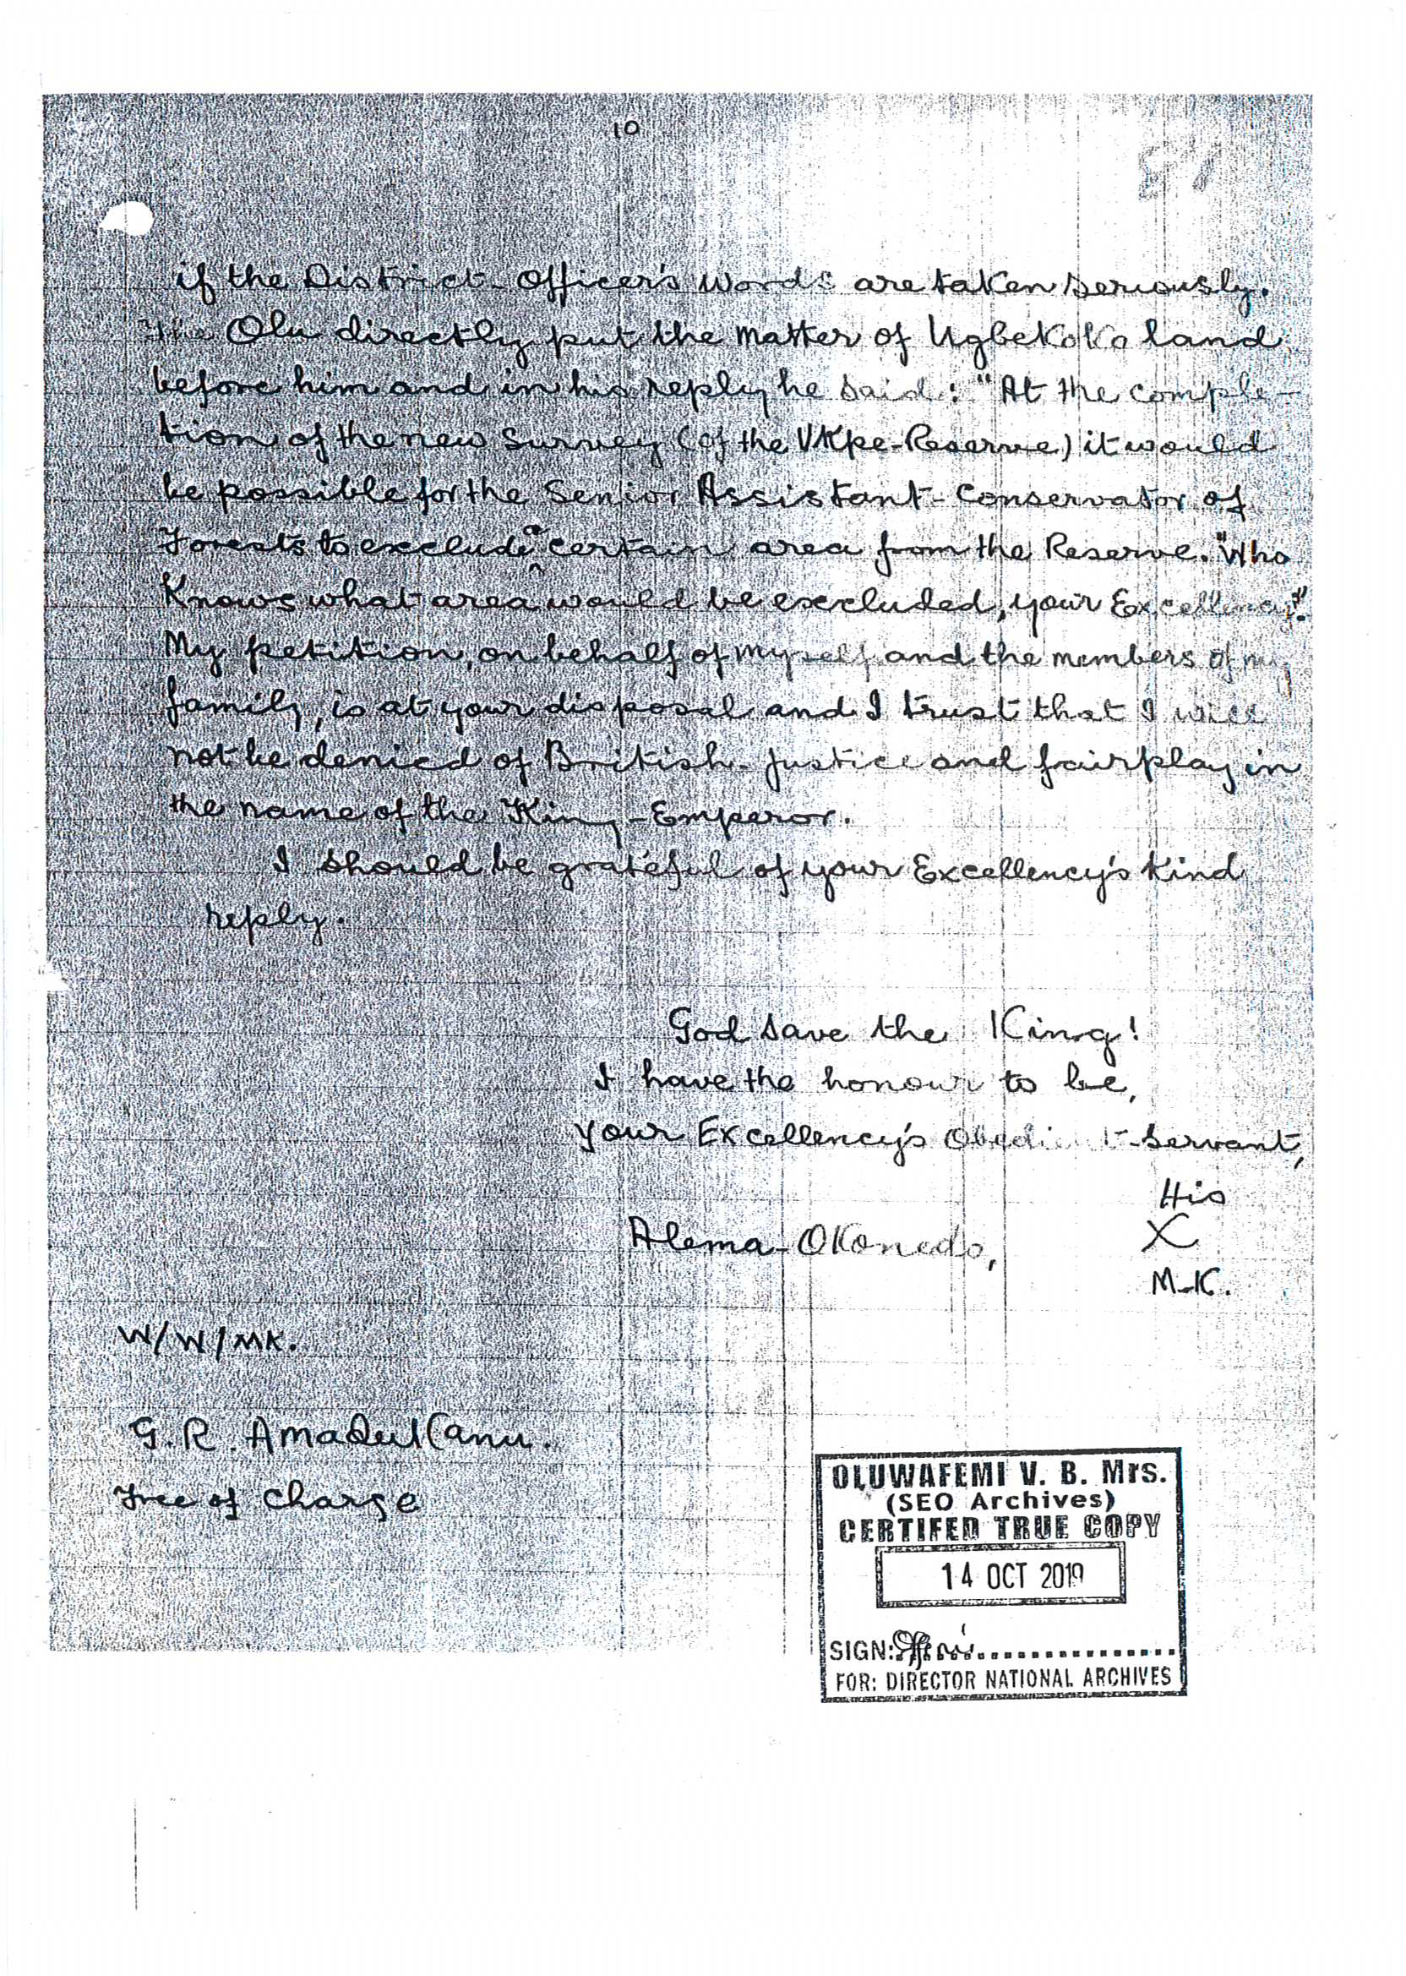

Slide 30
11. Upon the receipt of the petition from CHIEF OKONEDO, the Governor General acknowledged receipt of the petition from CHIEF OKONEDO. We wish to state that apart from acknowledging receipt of CHIEF OKONEDO’s petition, several other correspondences were exchanged with regards to the subject matter of CHIEF OKONEDO’s petition. Attached herein are the copies of the various correspondences marked as Annexures 2A, 2B, 2C, 2D, 2E, 2F, 2G, 2H, 2I and 2J duly Certified by the National Archives.

Slide 31
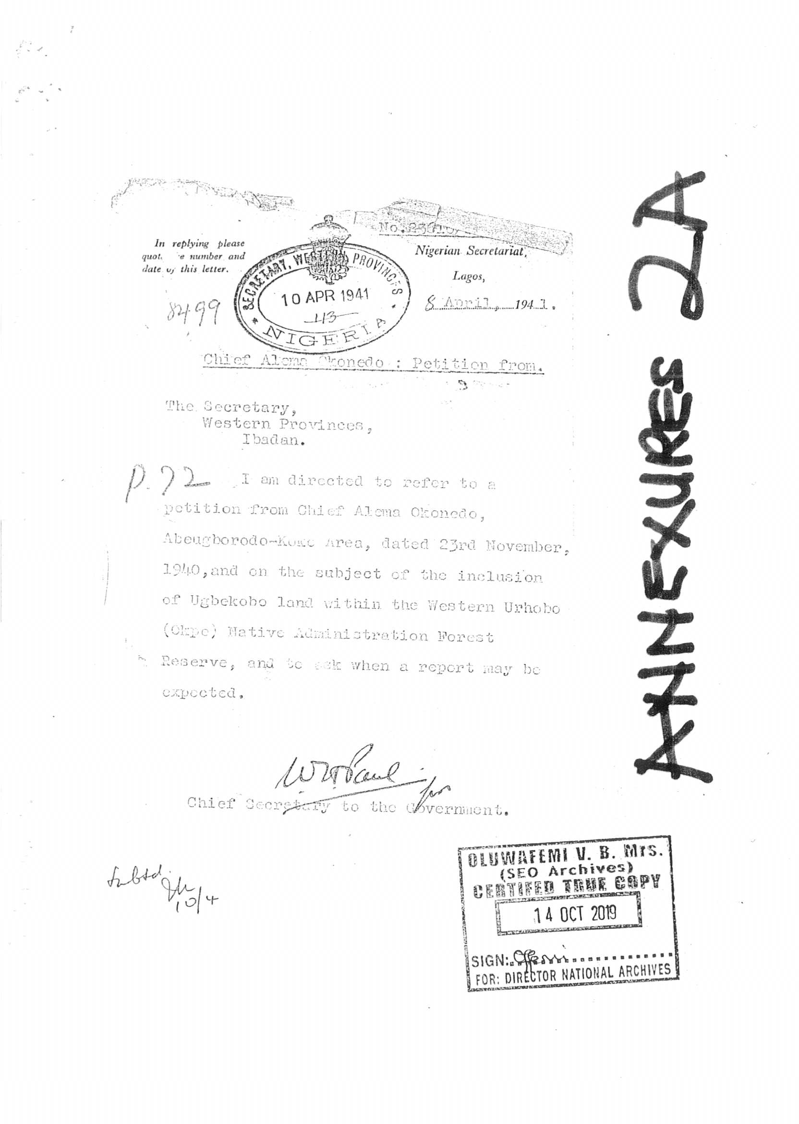

Slide 32
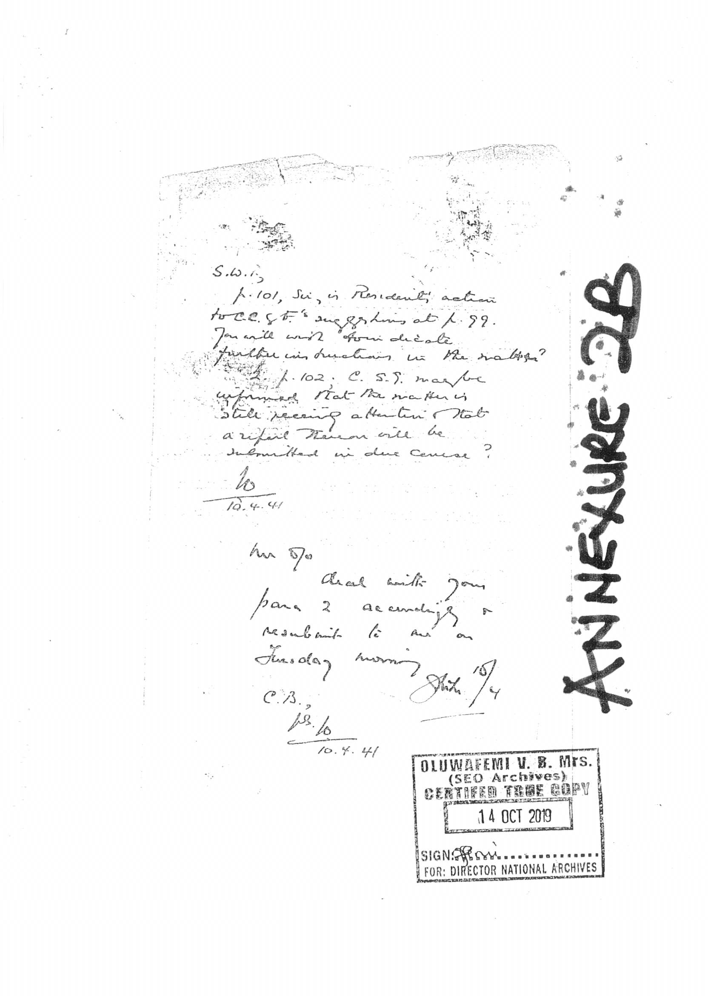

Slide 33
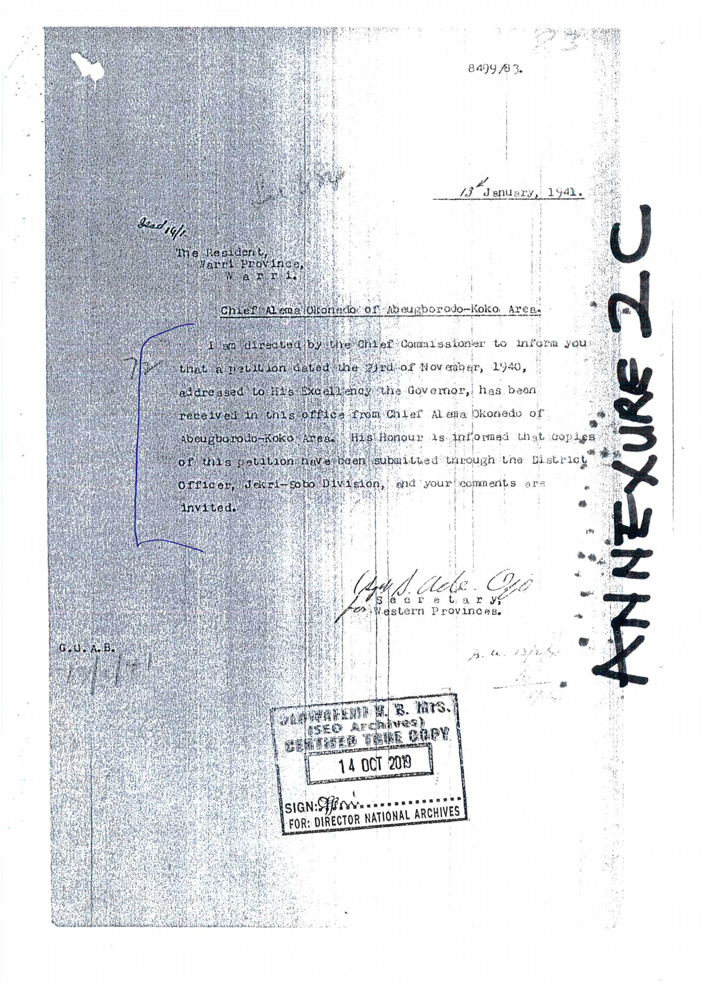

Slide 34
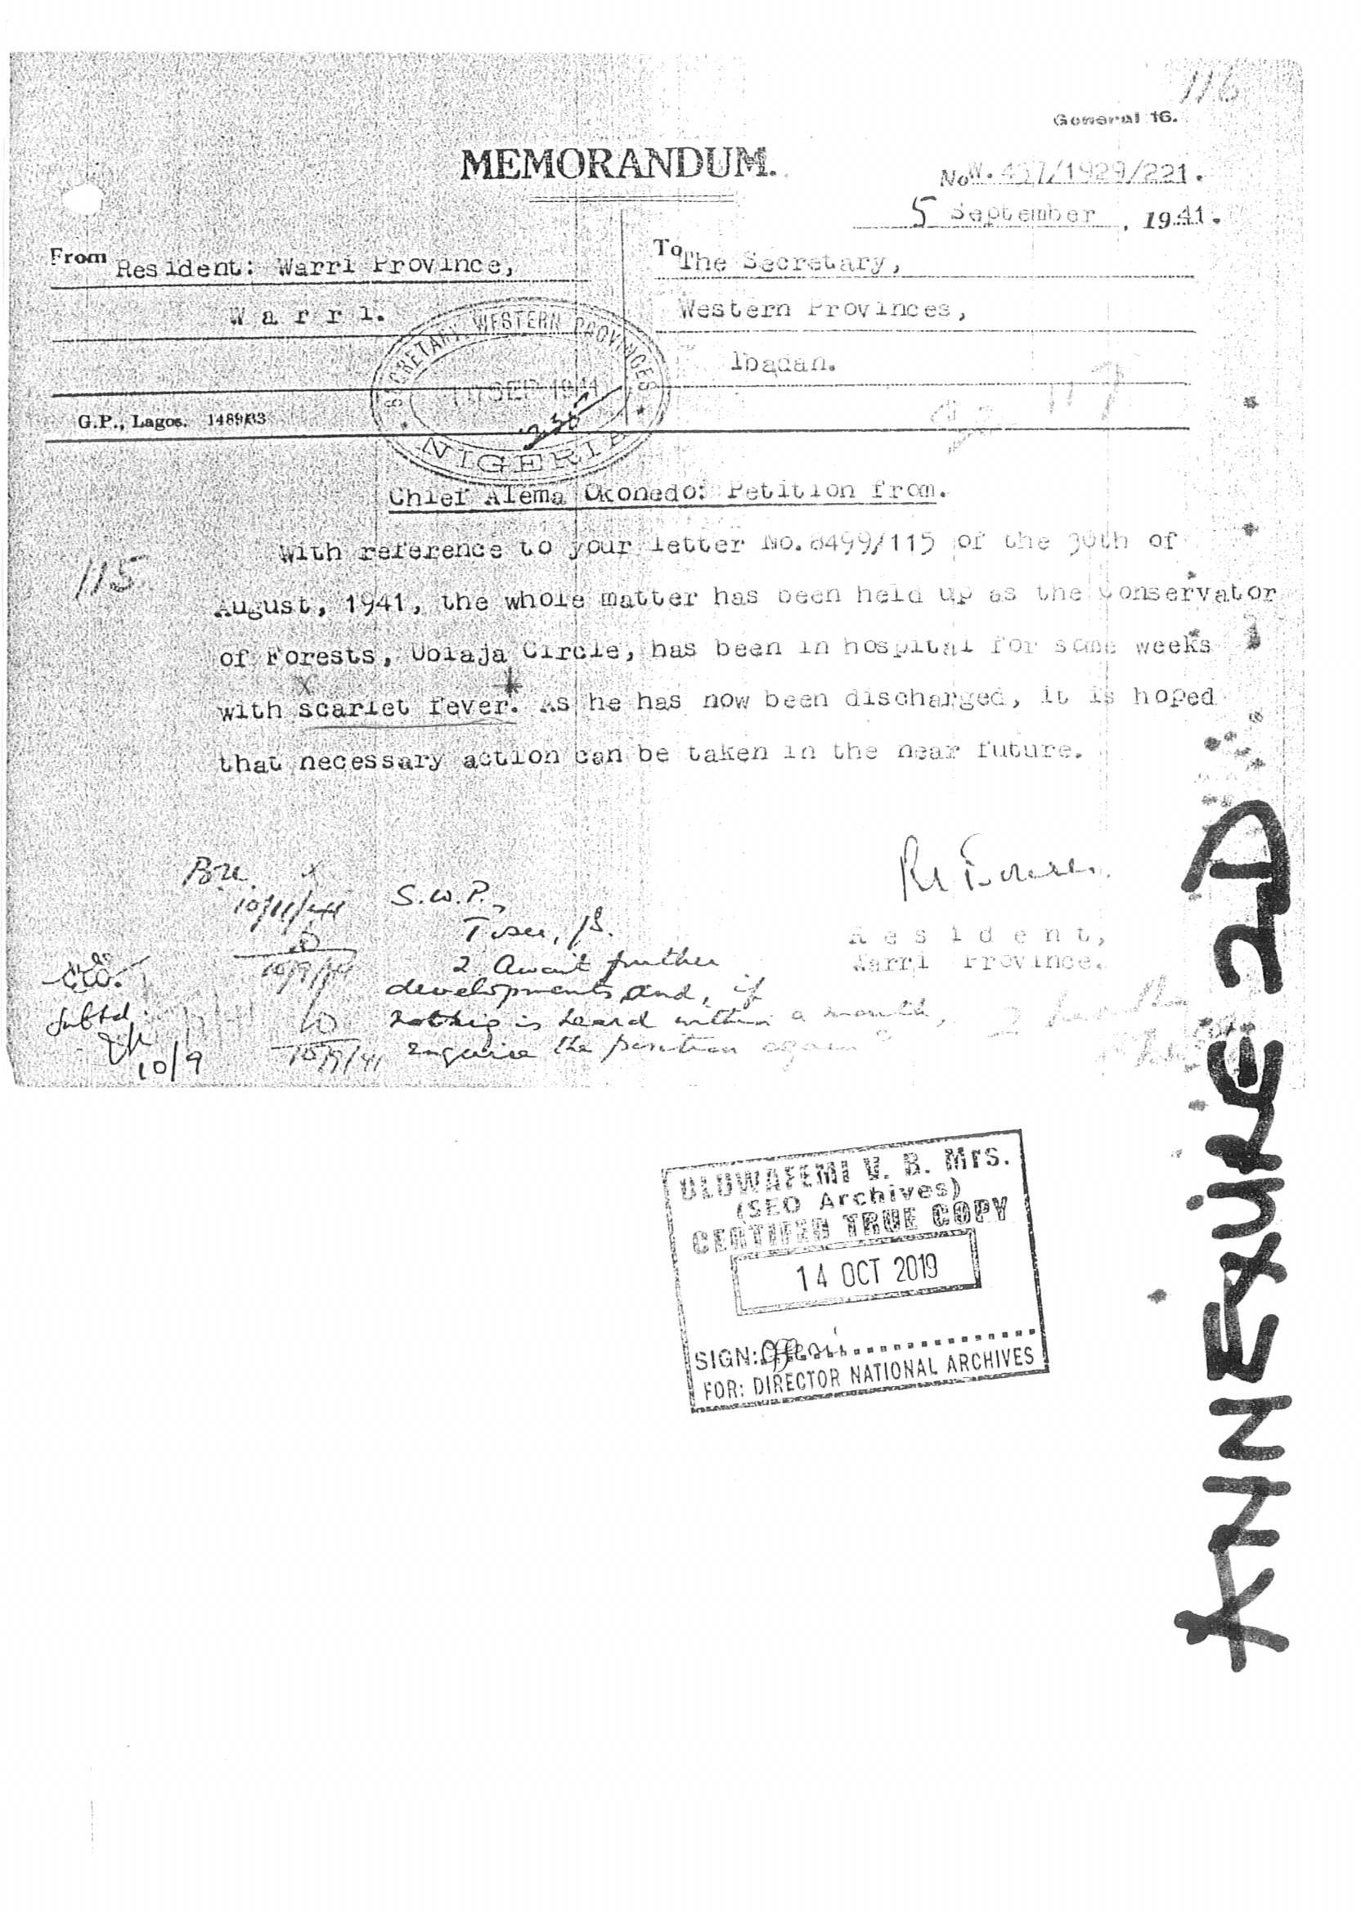

Slide 35
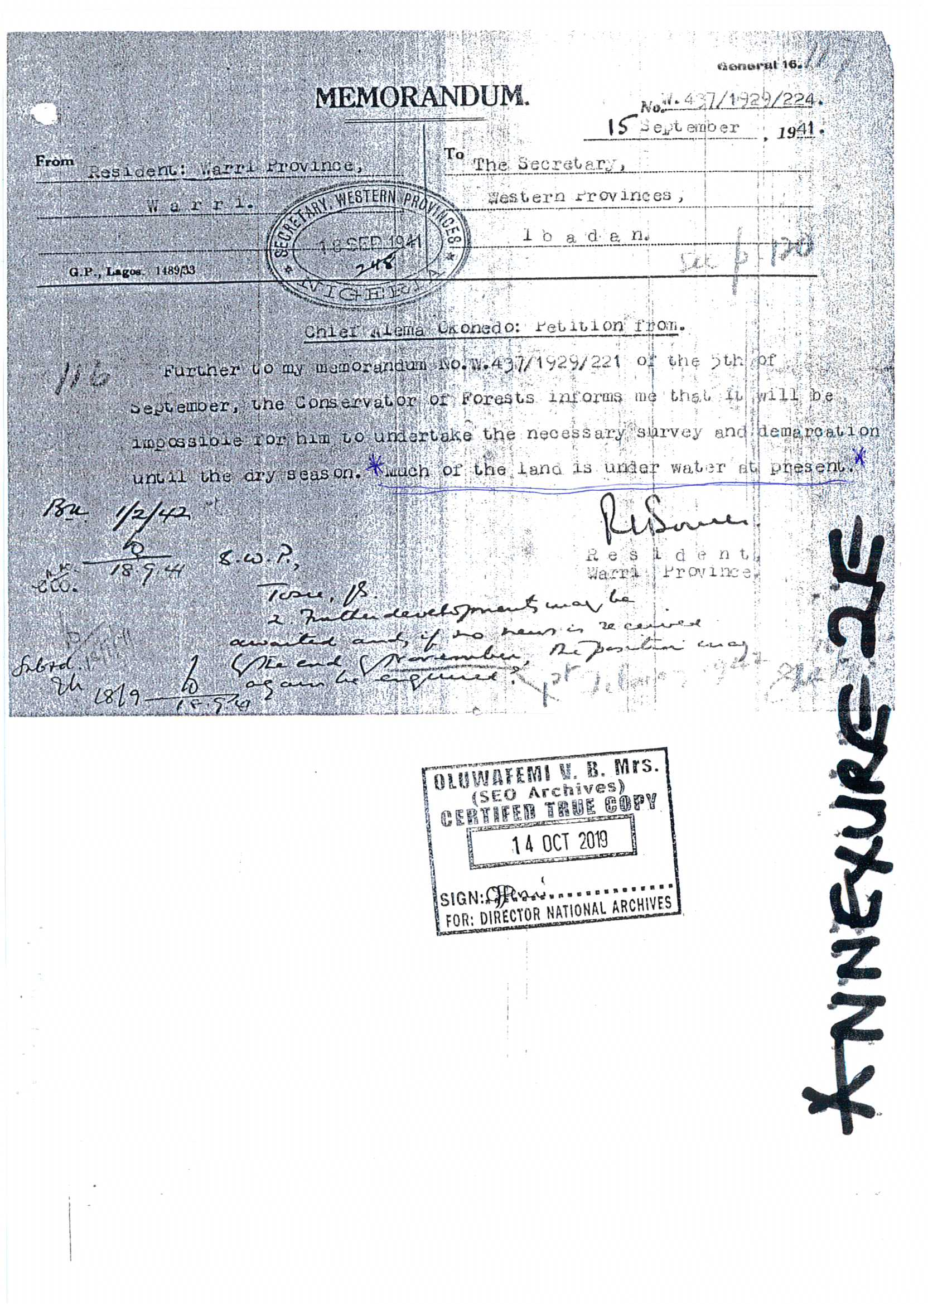

Slide 36
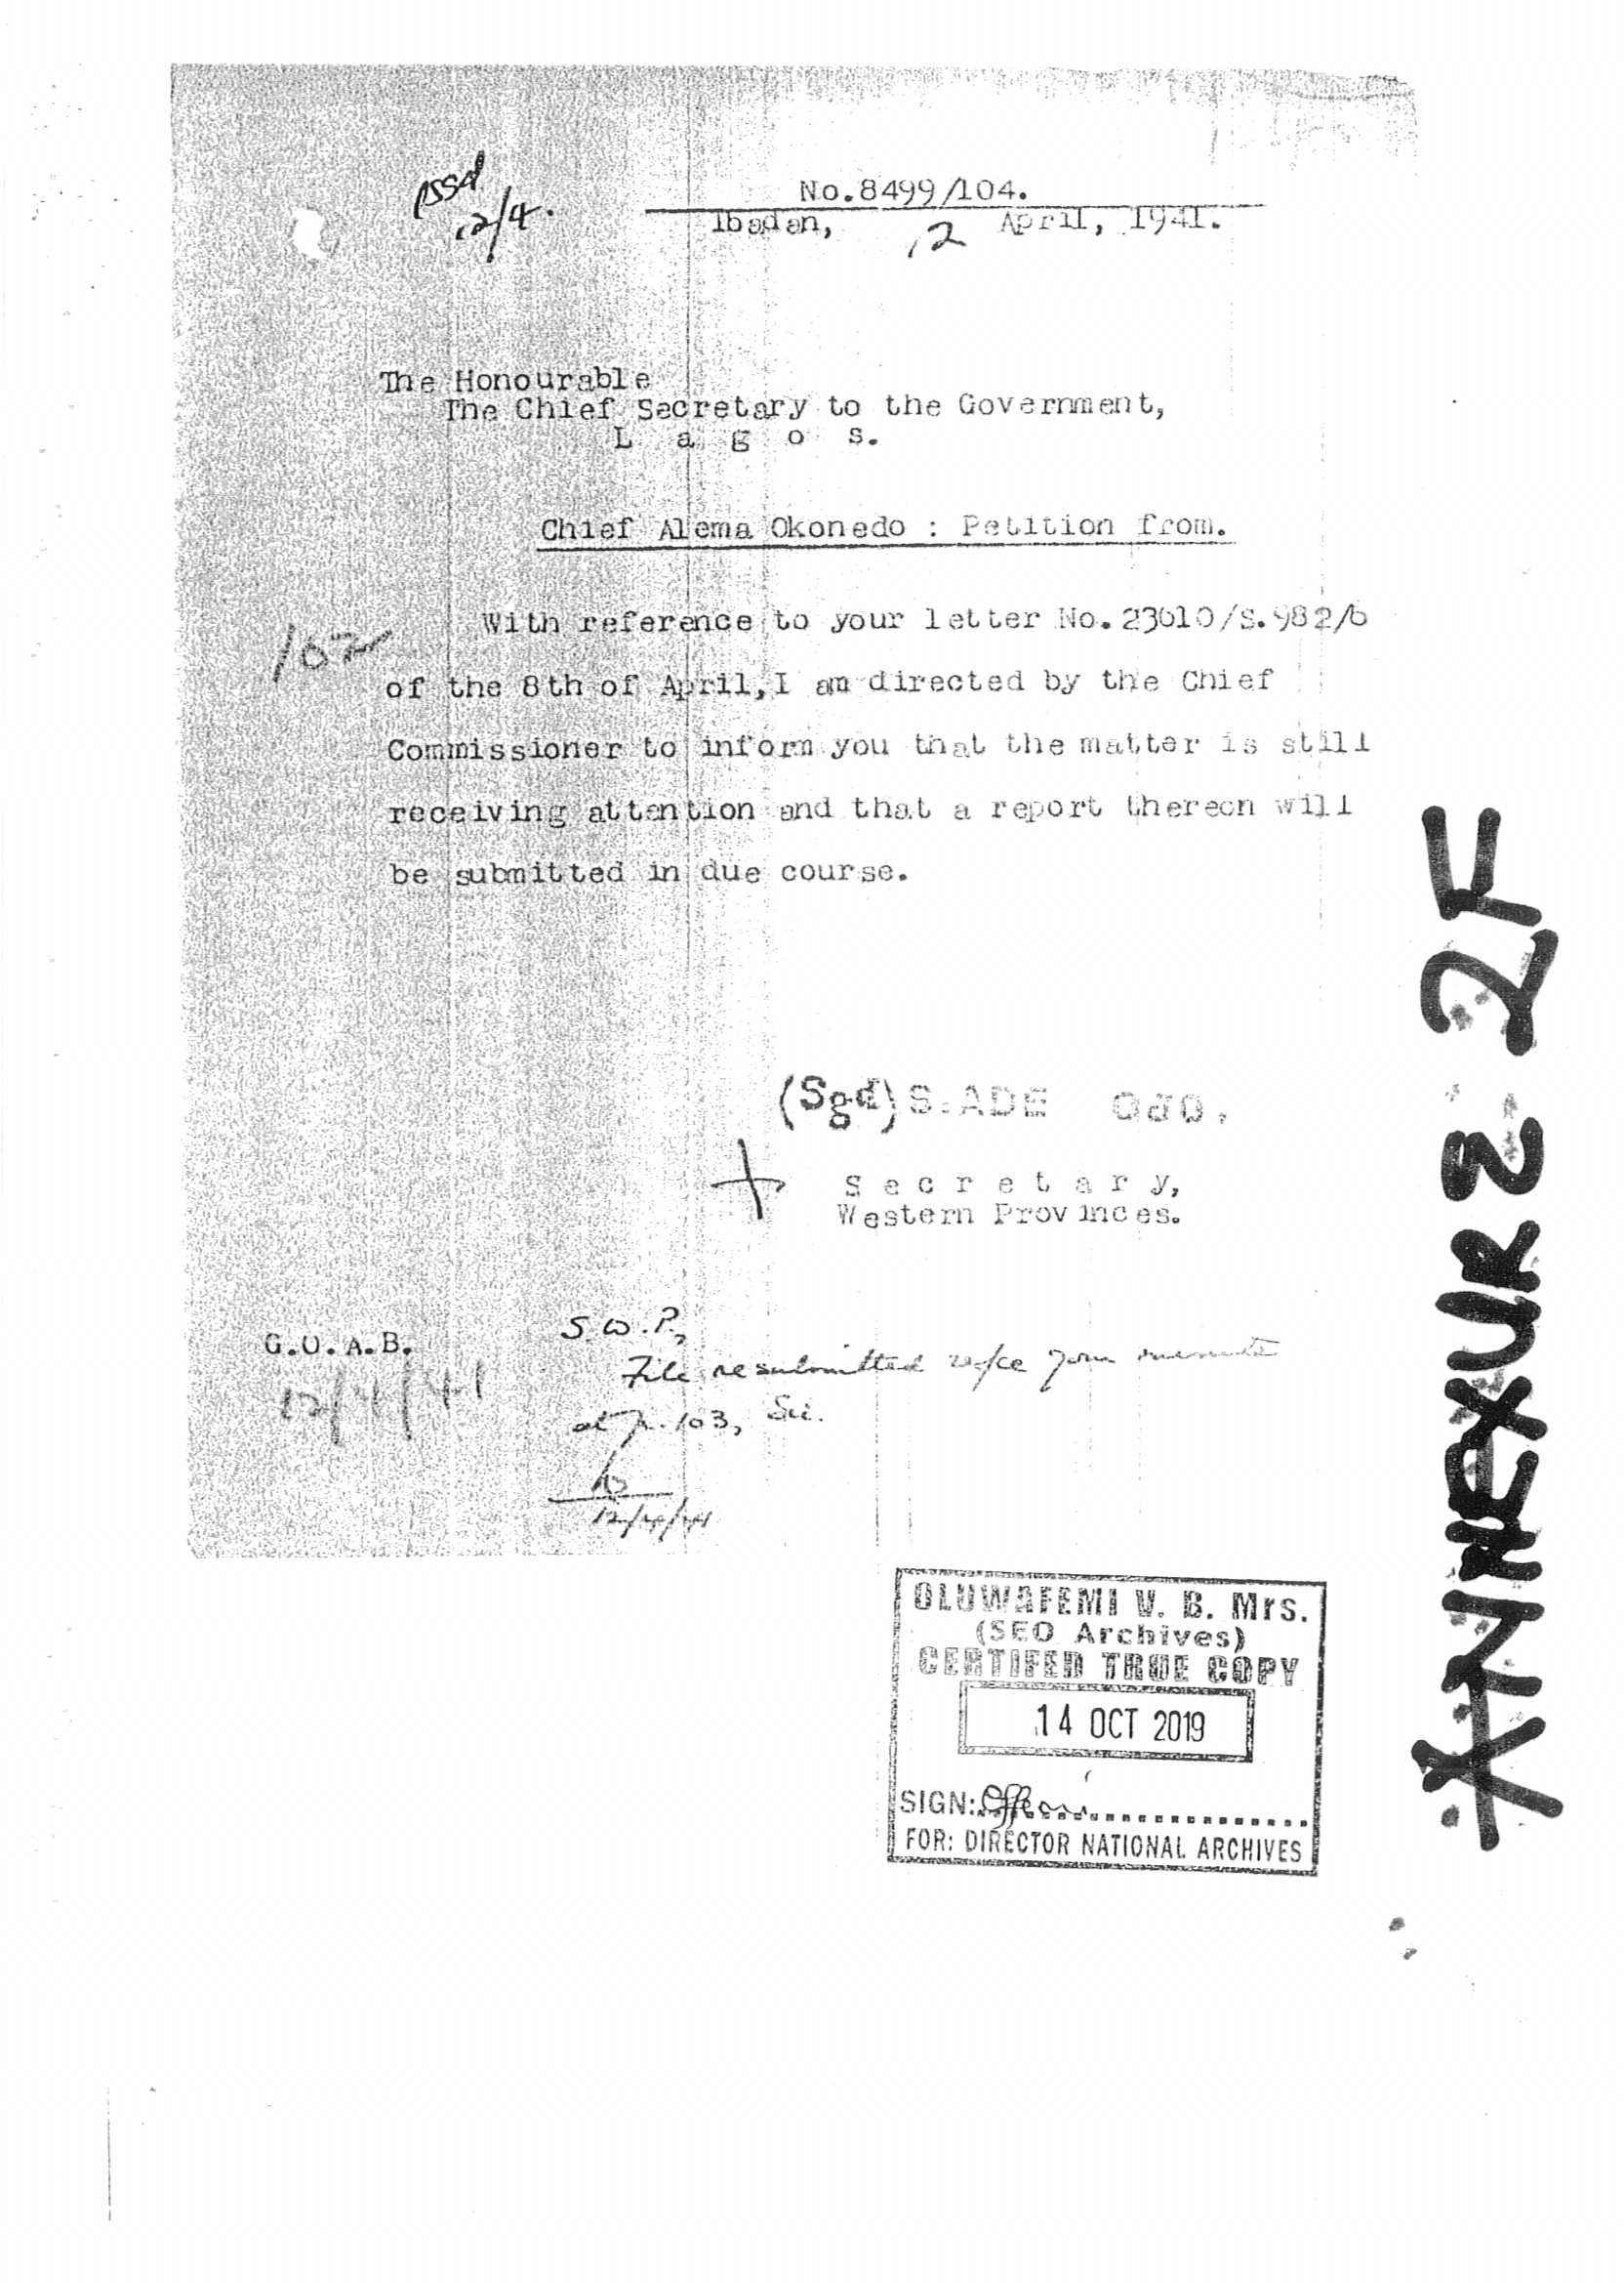

Slide 37
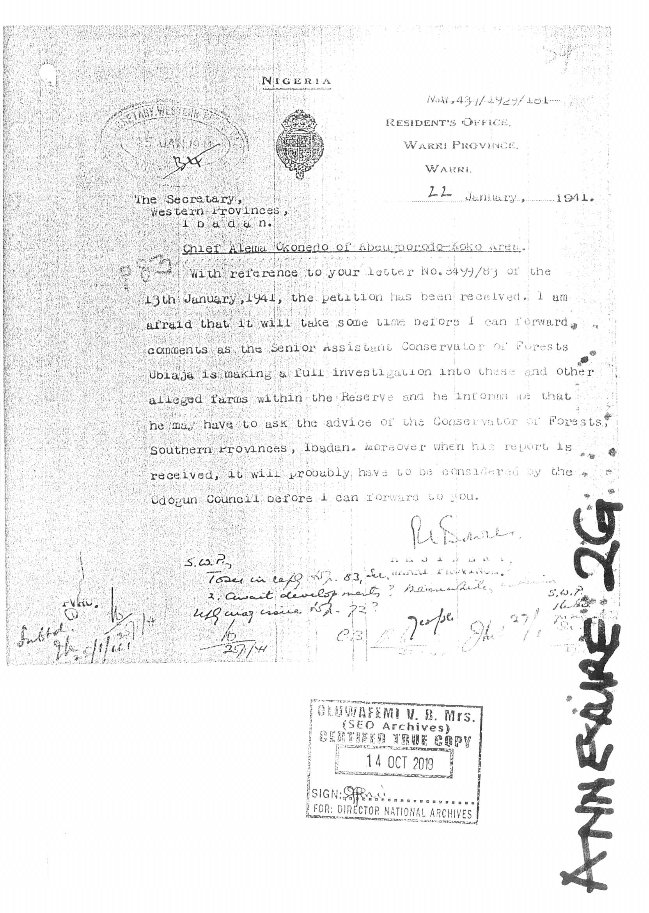

Slide 38
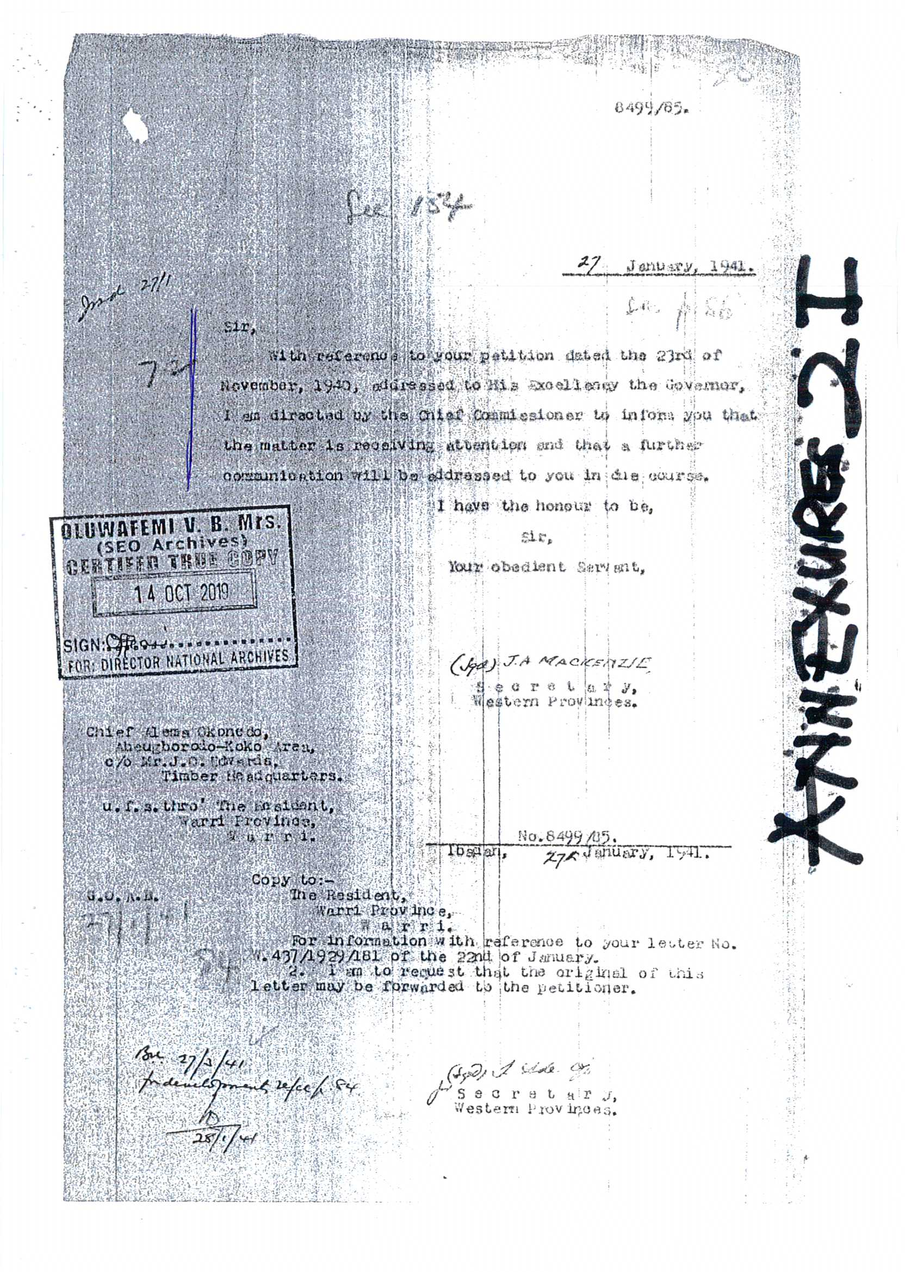

Slide 39
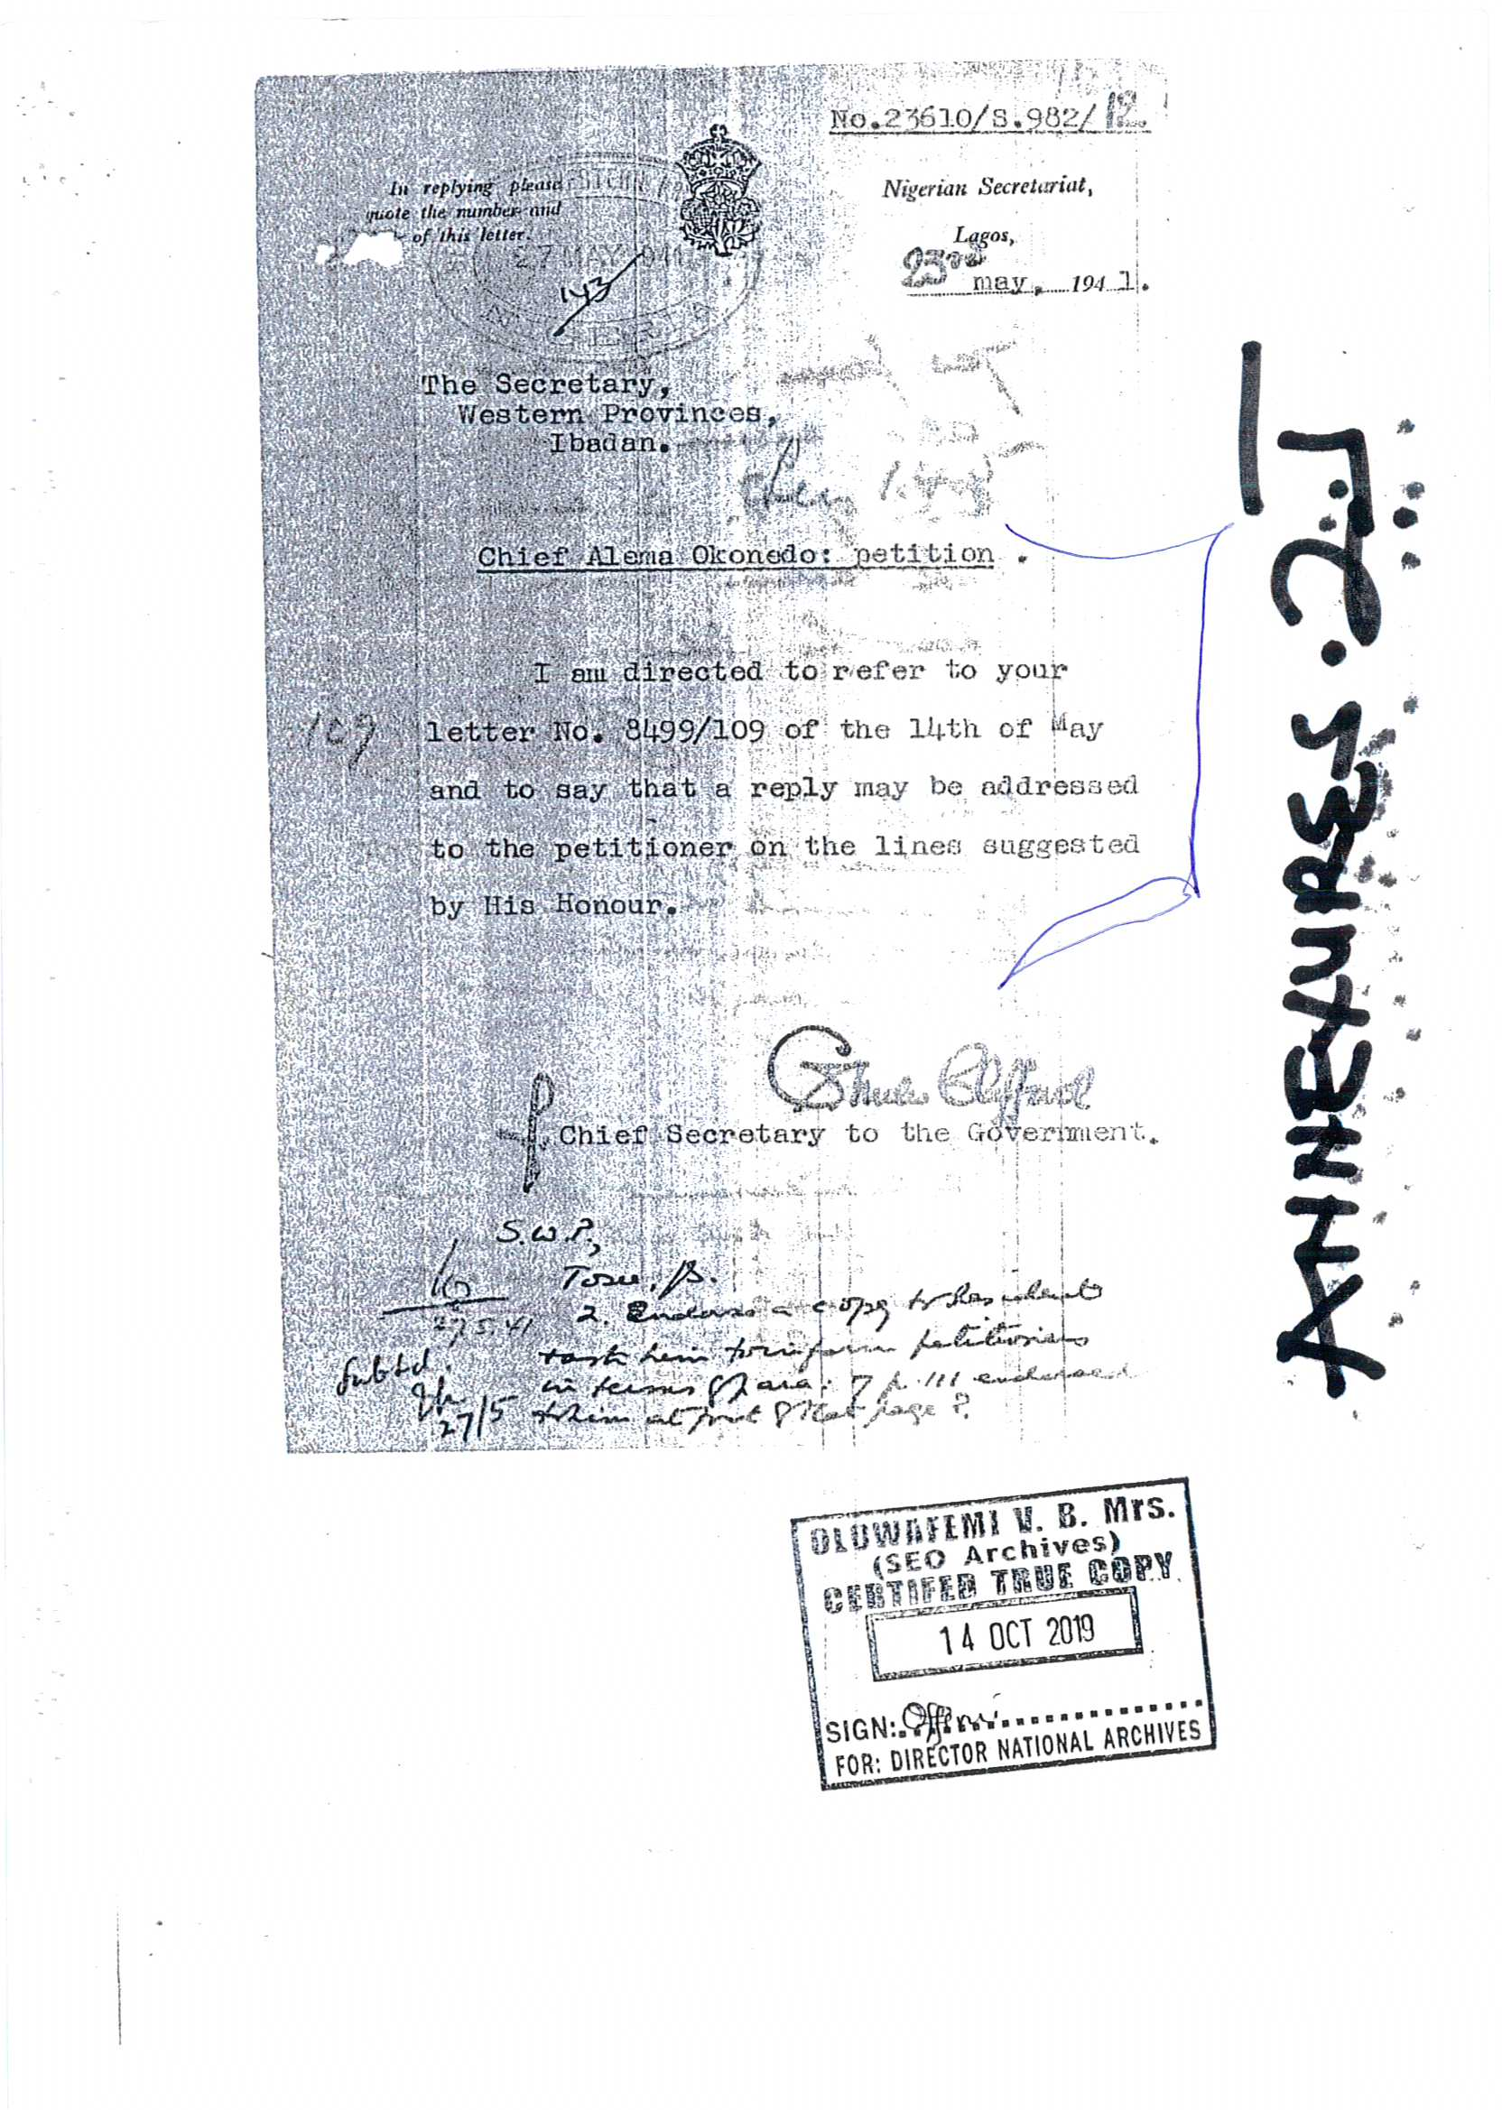

Slide 40
12. It is our further submission, that upon the conclusion of the investigation by the Conservator of Forest, Ubiaja Circle, who was directed by the Governor General to investigate the claims of CHIEF OKONEDO in reference to the said petition; a report was issued by the Governor General through the Office of the Secretary to the Government wherein the claims of CHIEF OKONEDO was found to be true and substantiated. Farming right was granted to the Abigborodo

Slide 41
community for their tenants to continue farming activities on the said land and without harassment or found to be in contravention the Forest Reserve Ordinance. To further buttress our submission on the grant of farming rights, we hereby highlight the said report issued on the 1st of May, 1941: “As far as the village of Utonyatsere and Gbekoko which are within the reserve are concerned, records are silent as to whether claims to farming rights within the reserve were lodged by Fregene or Okonedo the writer of the petition as regards the latter. Furthermore, it cannot be disputed that the people of these two villages farmed on the area now within the reserve both before and since the constitution of the reserve”

Slide 42
13. From the foregone, it is crystal clear that CHIEF OKONEDO’S claims were valid and lawful; as a result, farming rights was granted to the Abigborodo Community by extension their tenants who were farming on the said land. Herein attached and marked as Annexure 3 duly Certified by the National Archives is the Report Granting Farming Rights to the Abigborodo Community dated 1st of May 1941.

Slide 43
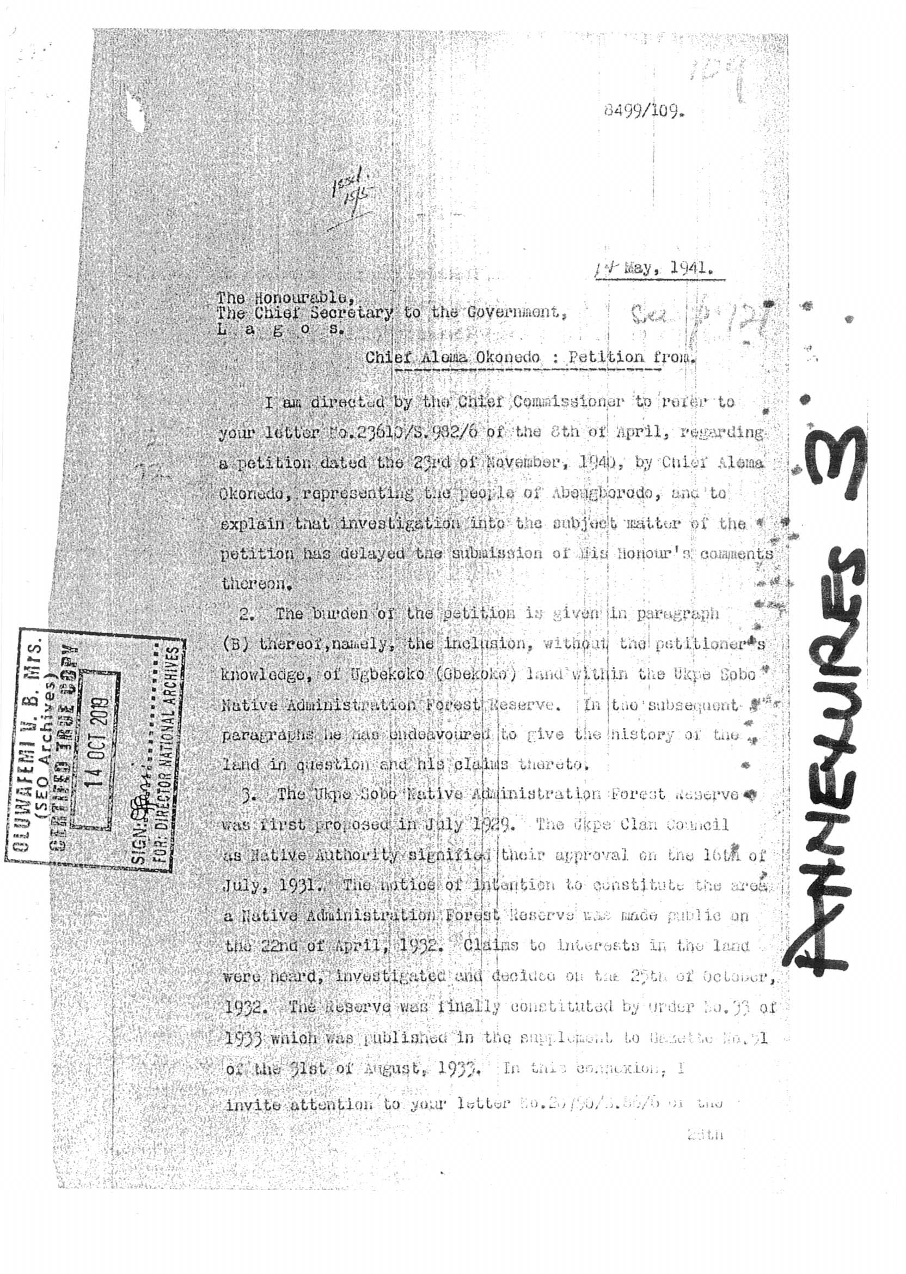

Slide 44
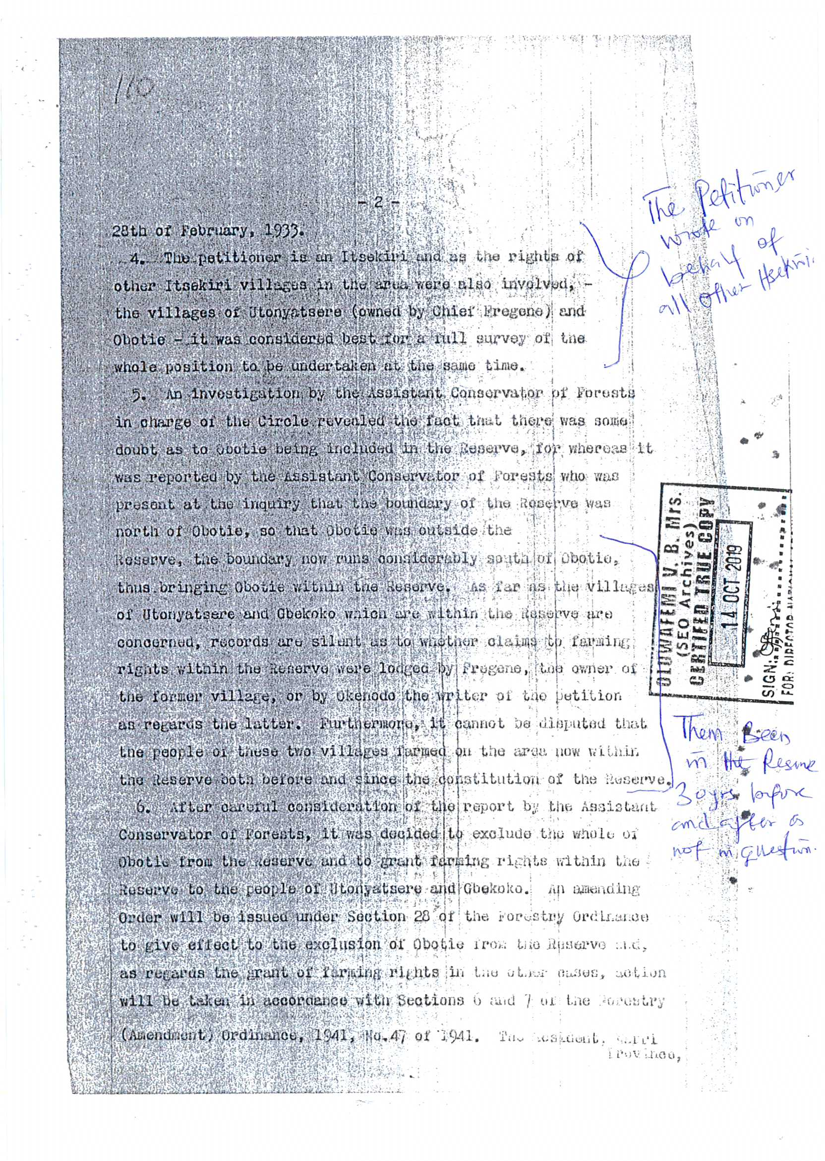

Slide 45
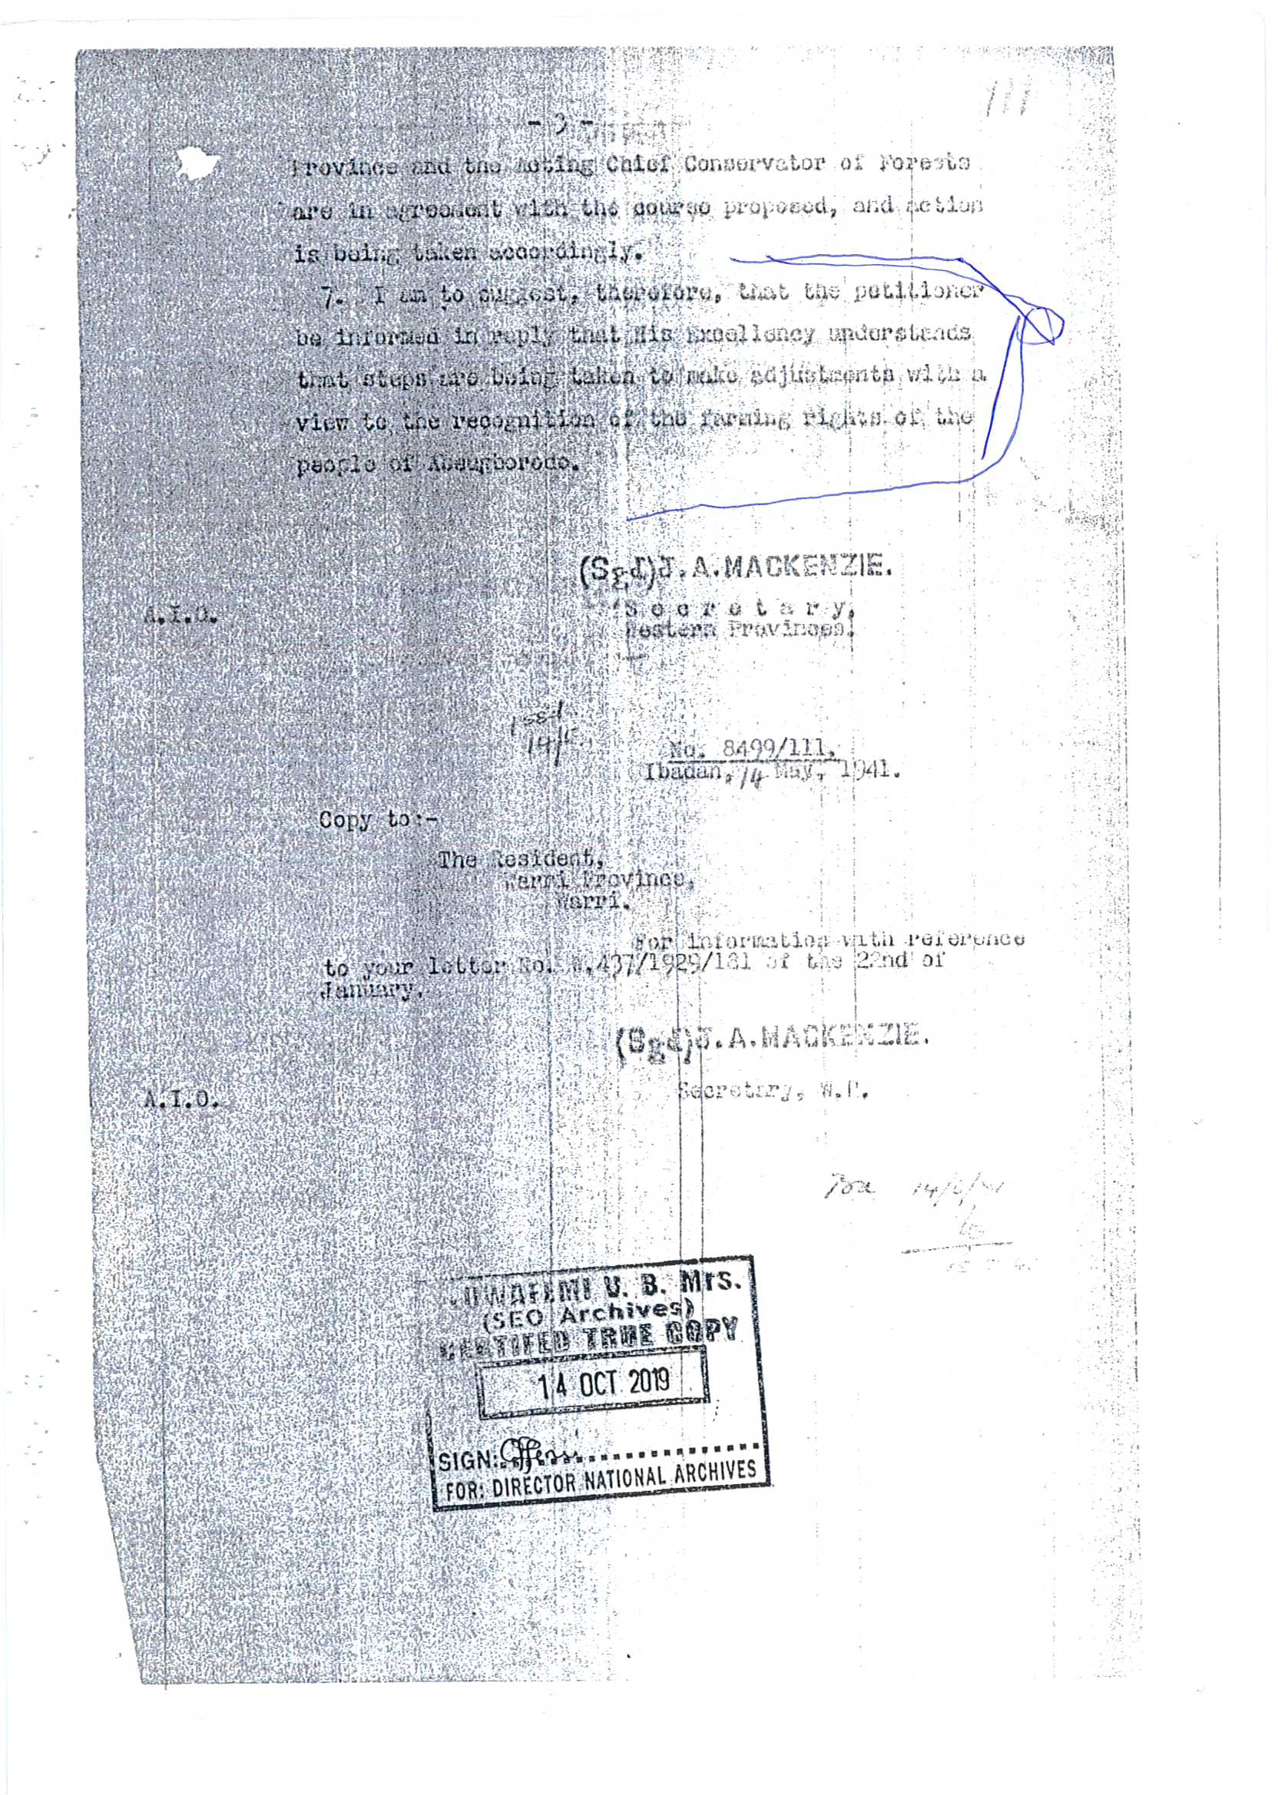

Slide 46
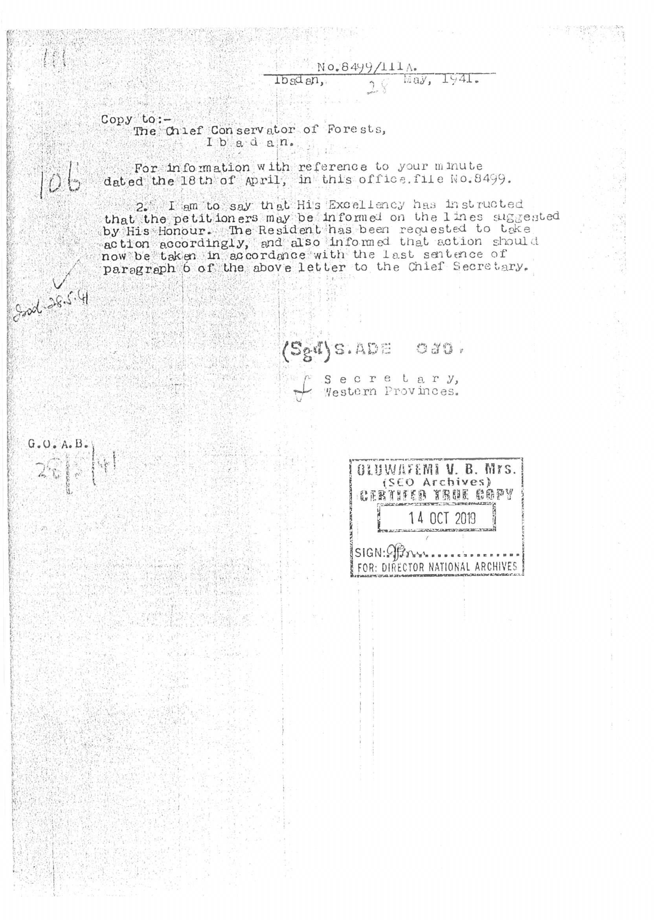

Slide 47
14. It is our further submission that when Farming Rights was granted to the Abigborodo people through the report dated 1st May, 1941, a Sketch Map was drafted to reflect the areas wherein farming rights had been admitted to the Abigborodo community. Herein attached and marked as Annexure 4 is a Sketch Map showing areas at UTONYATSERE and GBEKOKO in Ukpe-Sobo Native Administration Forest Reserve over which farming rights had been admitted and duly certified by the National Archives, Ibadan.

Slide 48
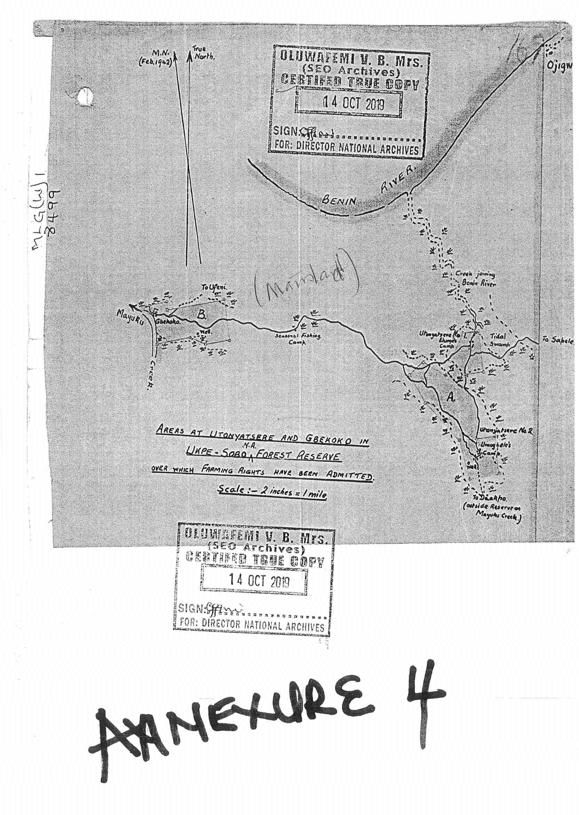

Slide 49
15. It is our further claim that after and/or before farming rights were granted to the people of Abigborodo community, a Memorandum was submitted by t he Resident Officer, Warri Province to the Secretary that it is not just enough to stop at granting farming rights to the Abigborodo community rather, the whole GBEKOKO- UTONYATSERE lands should be excised and excluded from the reserve and that a proper demarcation of the said lands with a gazette and a notice of amendment should be made in that regard. The exact word of the Warri Province Officer is herein replicated for the sake of emphasis and clarity:

Slide 50
“As regards (b) I prefer the DistrictOfficer’s recommendation that these two enclaves be permanently excluded from the reserve for the reasons he gives. They will similarly require demarcation and gazette notice of amendment”

Slide 51
16. The above, further buttresses our claim that the said GBEKOKOUTONYATSERE land was actually de-reserved and given back to the Abigborodo Community and that the said expanse of land was no longer part of the reserve. Herein attached and marked as Annexure 5 is the Memorandum dated March 3, 1941 to exclude (De-Reserve) GBEKOKOUTONYATSERE from the reserve duly certified by the National Archives.

Slide 52
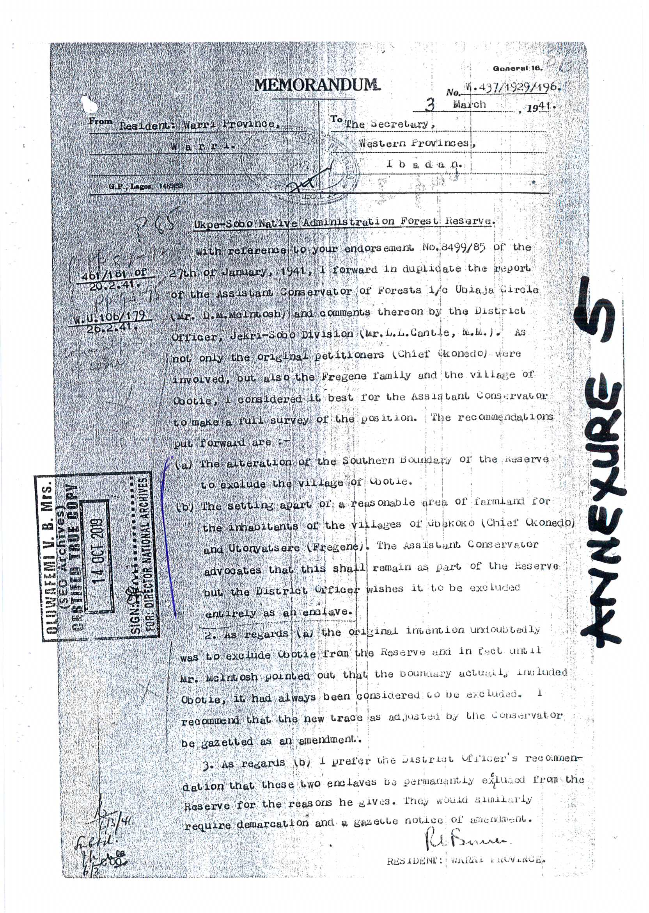

Slide 53
17. Sequel to the memorandum dated March 3rd 1941 to exclude (De-Reserve) the GBEKOKO-UTONYATSERE lands from the Reserve, a minute of instruction from the Forest Department, Ubiaja with file No. 1361 to the Conservator of forest, South-Central Circle, Owo duly signed by C. A WALKER, the Provincial Forest Officer, Ishan Area dated 2nd May, 1949 wherein a proposal was made for the constitution of the reserve and it mainly dealt on the excisions to be made as it affect communities who are the owners of the land that make up the forest reserve particularly as it affects the Abigborodo community and it was agreed that the GBEKOKO and UTONYATSERE lands of Abigborodo community be cut out as an enclave from the forest reserve. Herein attached and marked as Annexure 6 is the said Minute of Instruction from the Provincial Officer dated 2nd May, 1949 duly certified by the National Archives.

Slide 54
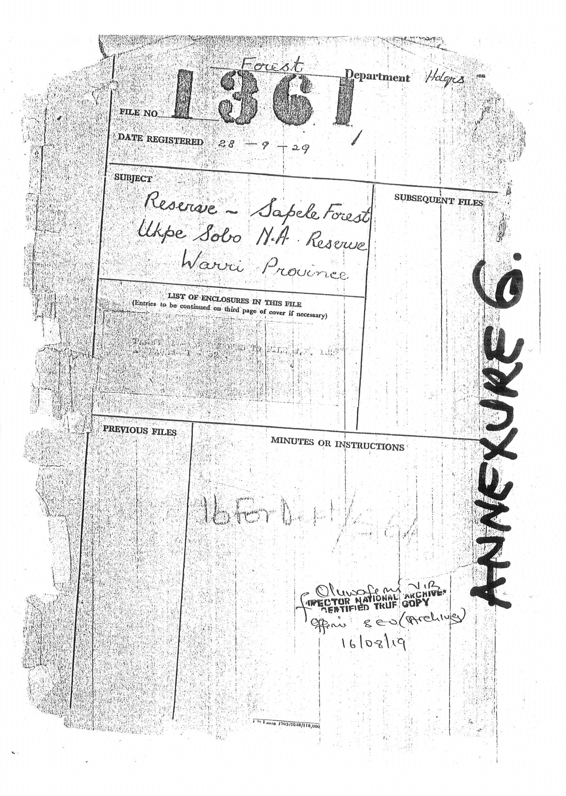

Slide 55
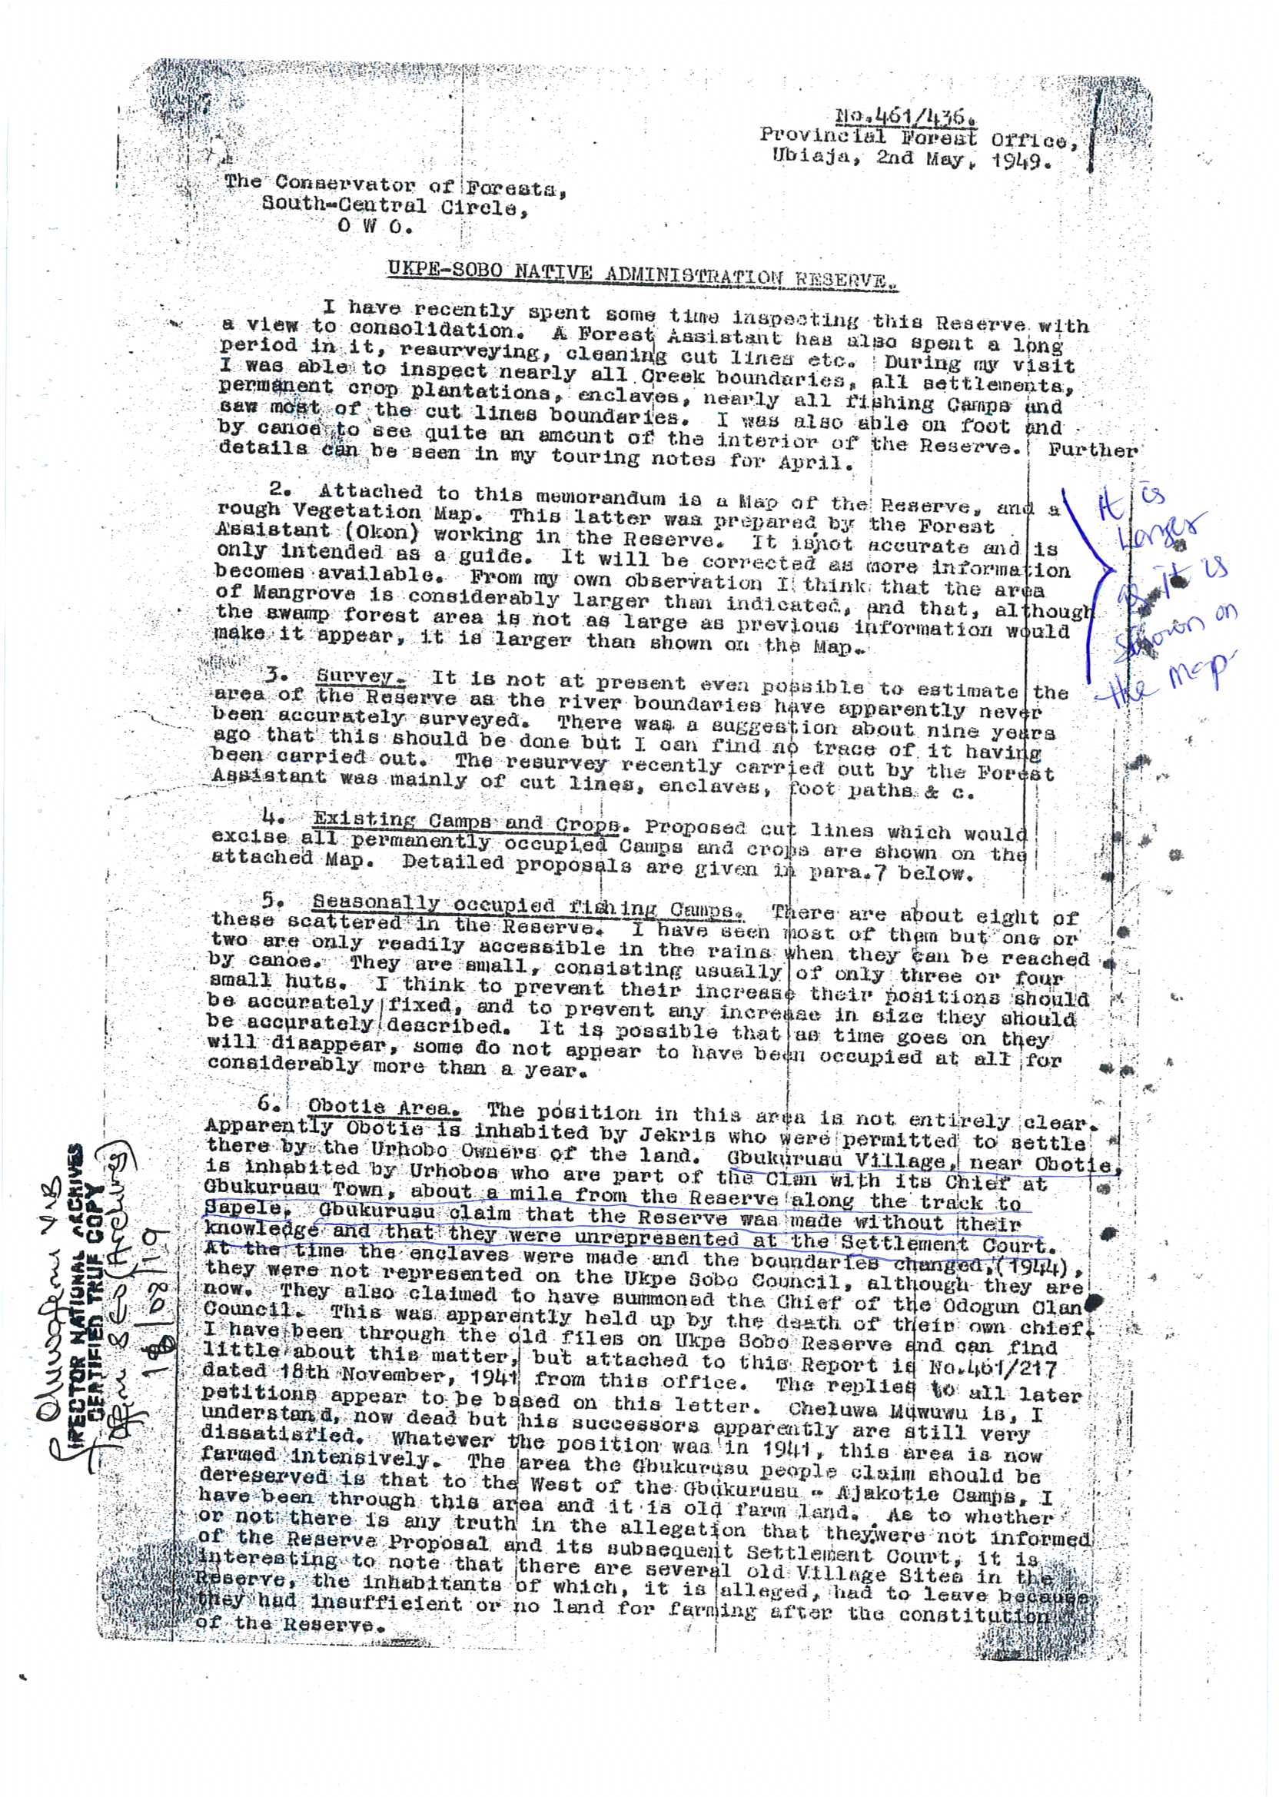

Slide 56
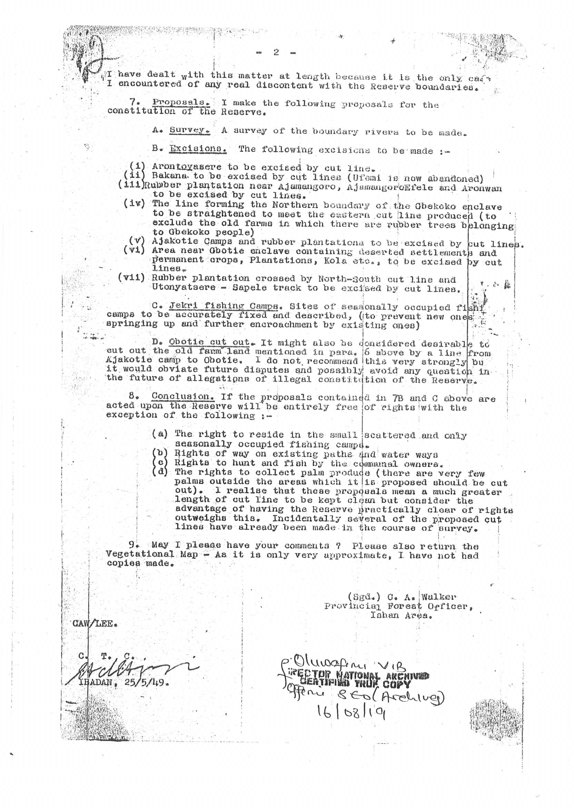

Slide 57
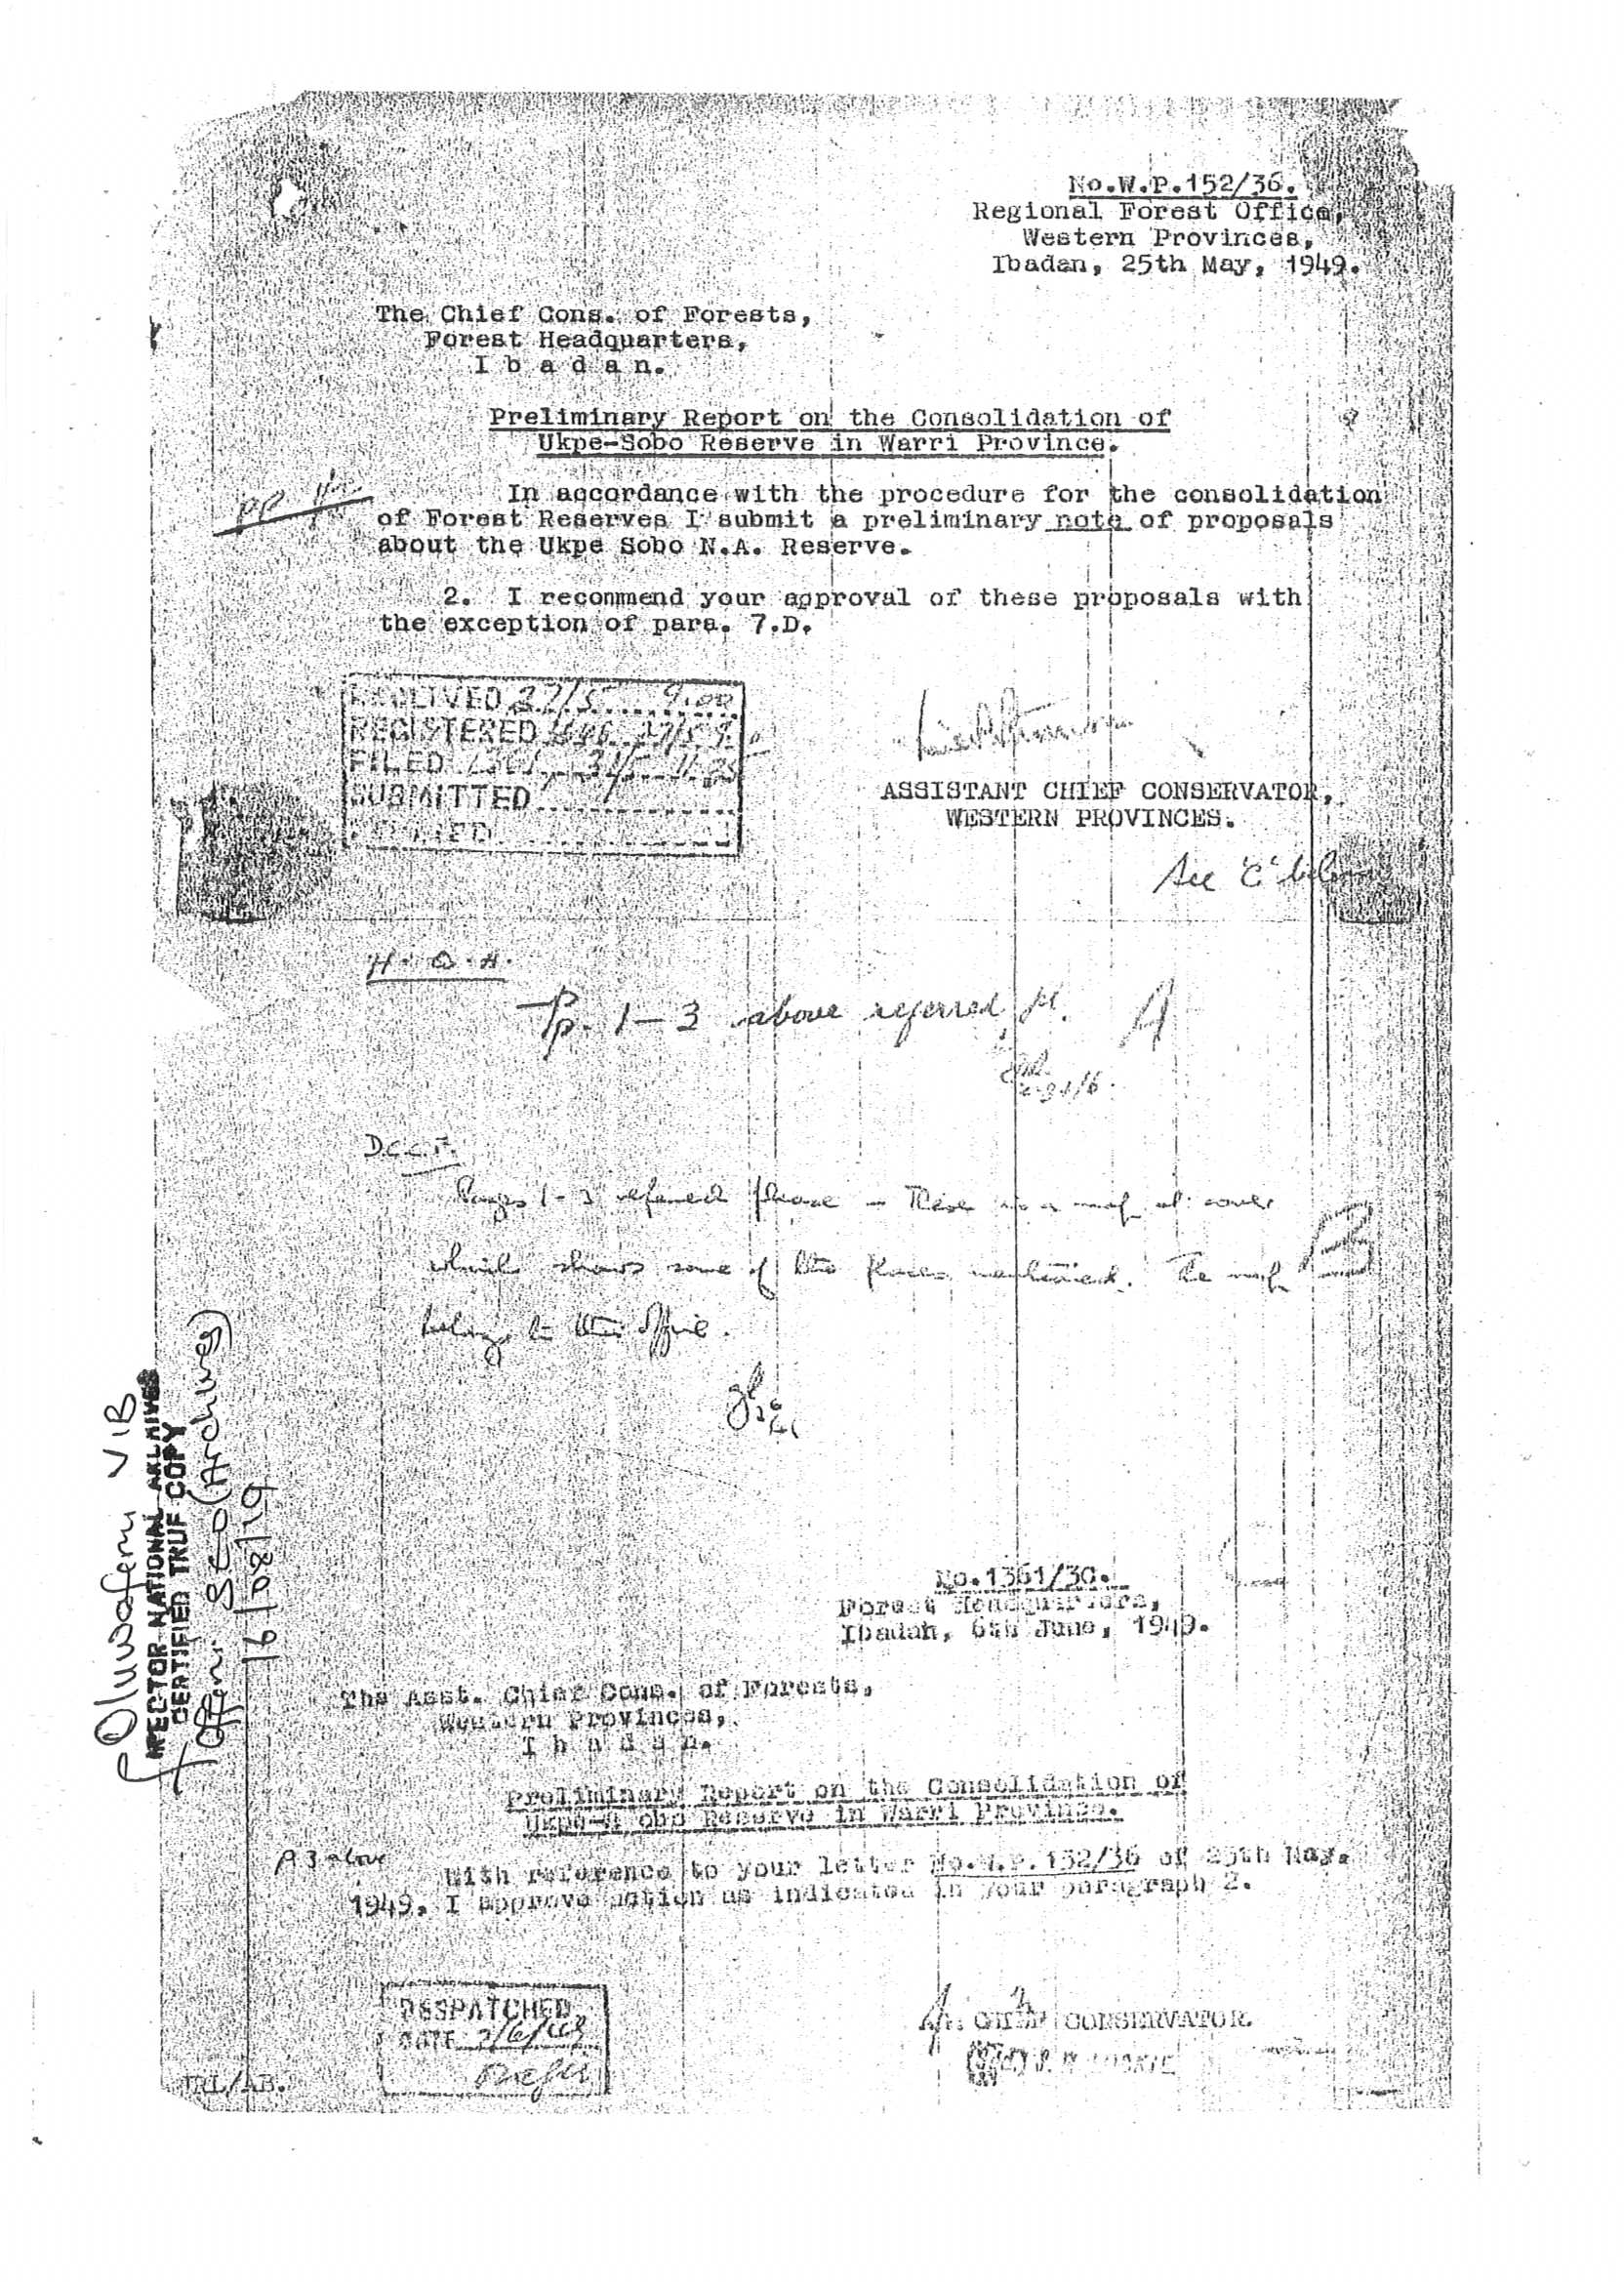

Slide 58
18. It is our further submission that GBEKOKO- UTONYATSERE is no longer part of the Forest Reserve having been excised and / or de-reserved as an enclave and no longer part of the Ukpe-Sobo Native Administration Forest Reserve. An order was made under the Forest Ordinance (Cap75) known as the Western Urhobo District Native Authority Forest Reserve (Ukpe-Sobo Forest) (Amendment) Order, 1952 wherein the Order No. 33 of 1933 was further revised and modified by revoking the first and the second schedules thereto and substituted same with as provided by the 1952 Order. The said Order of 1952 is very detailed as to the size and boundaries of the excised and de- reserved expanse of lands were clearly shown and described particularly the GBEKOKO- UTONYATSERE lands of Abigborodo community. We humbly refer the Judicial Panel to the first schedule of the Order of 1952, wherein the said size and boundaries was properly delineated and described. Find attached herein and marked as Annexure 7 and duly Certified by the National Archives the said Order of 1952 which was duly gazzetted under the Western Region of Nigeria Gazette No. 18 of the 17th of August, 1952.

Slide 59
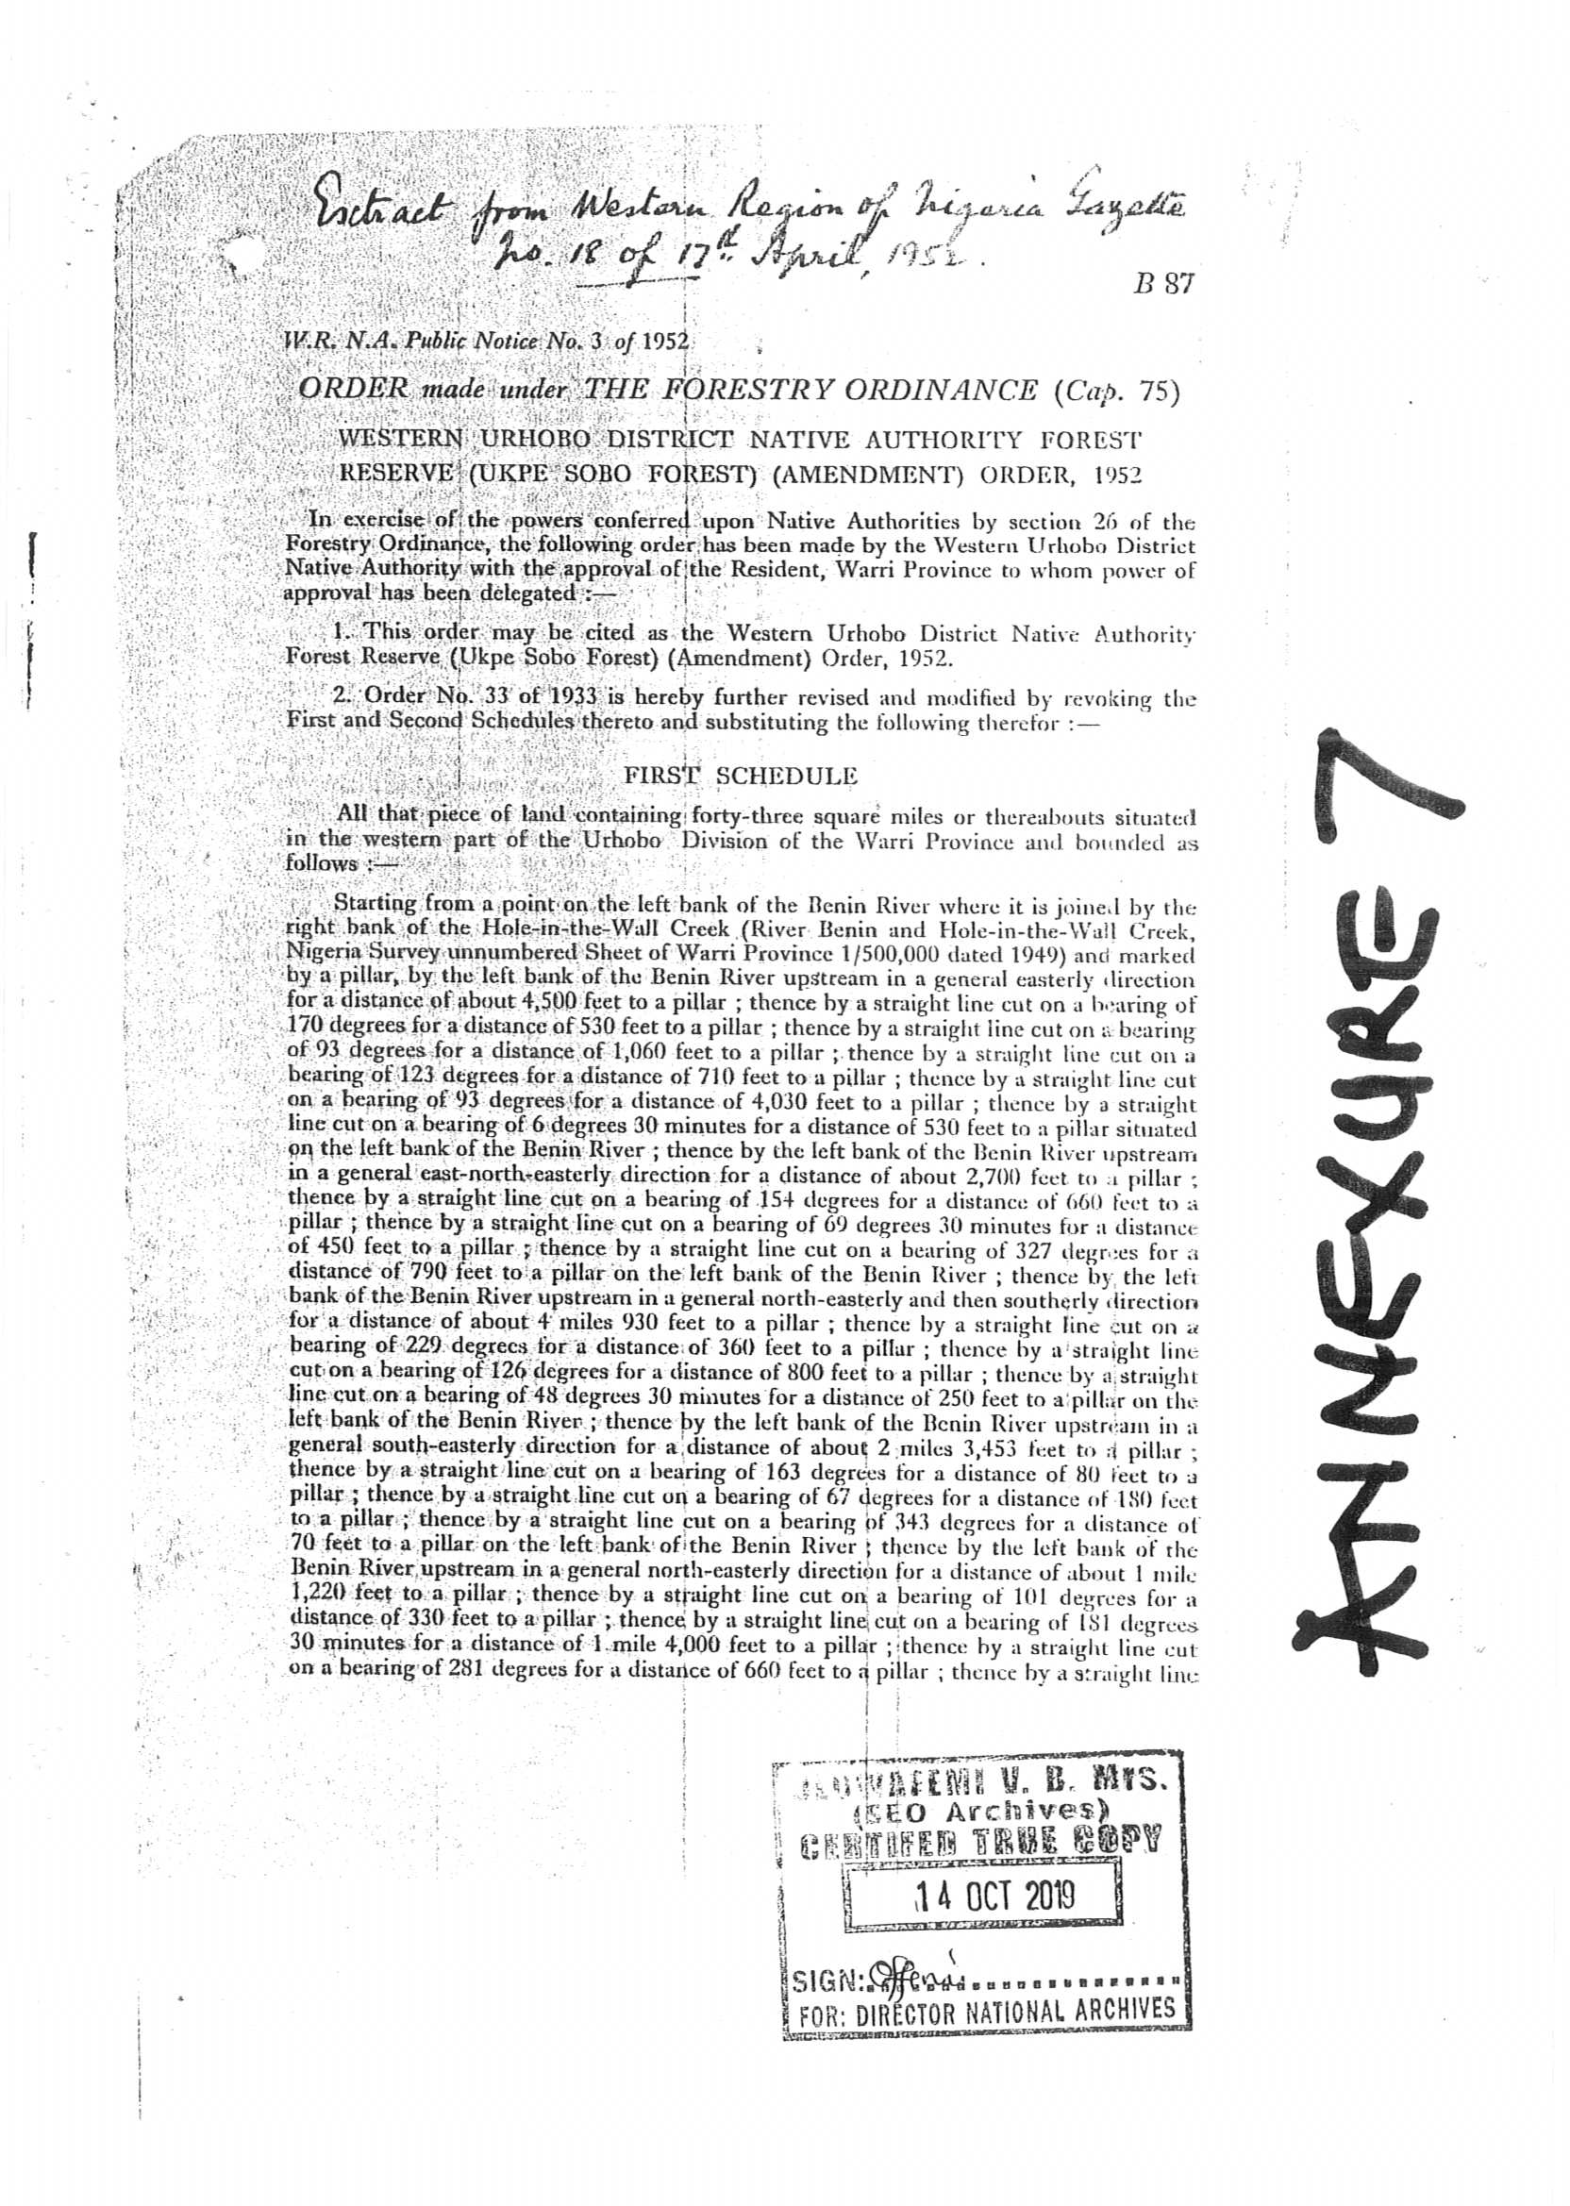

Slide 60
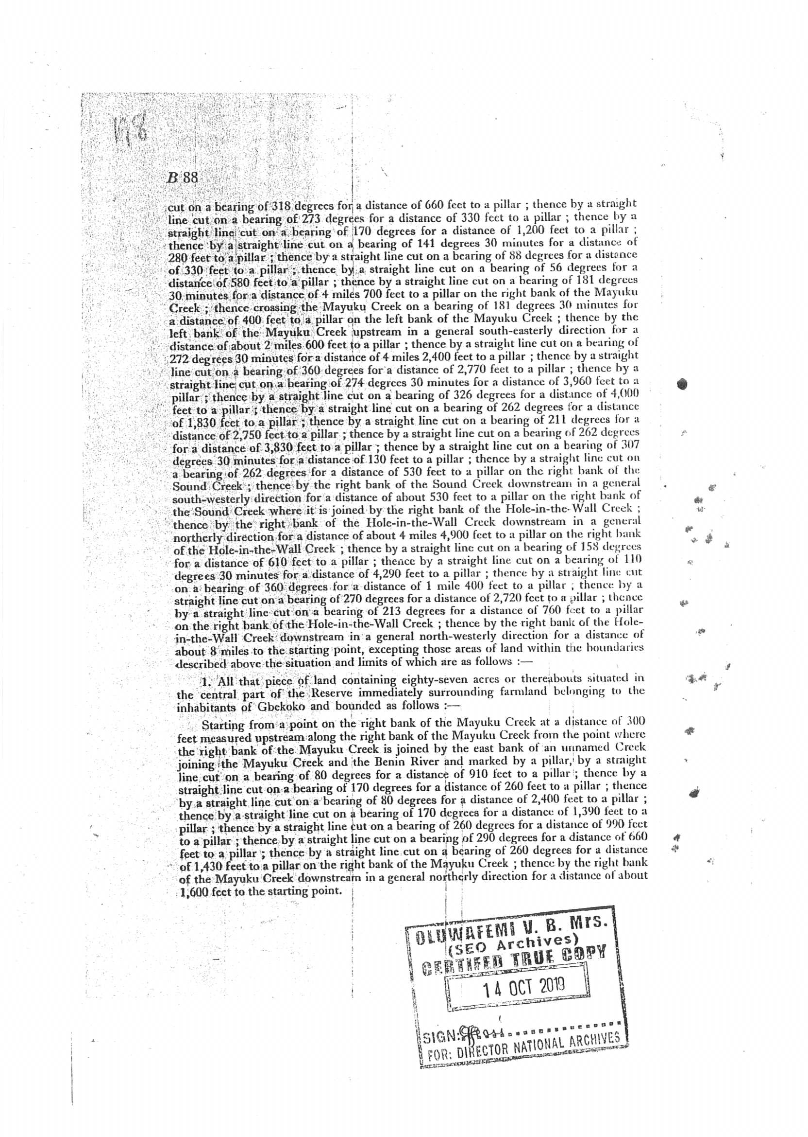

Slide 61
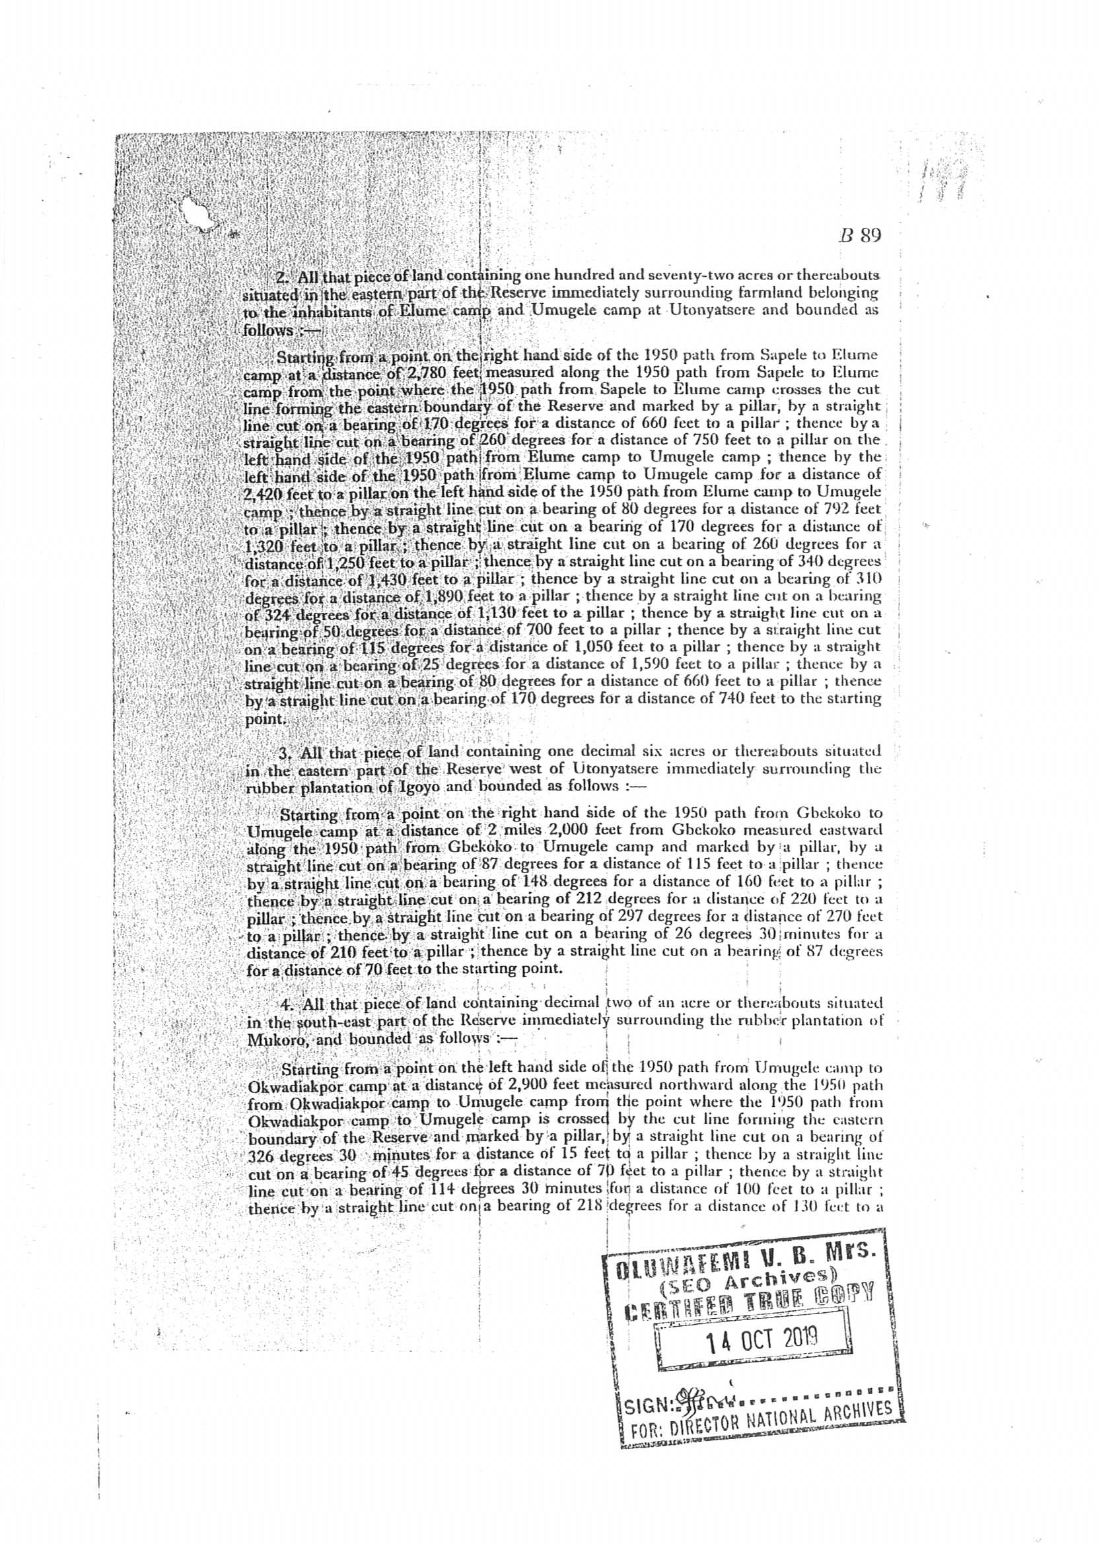

Slide 62
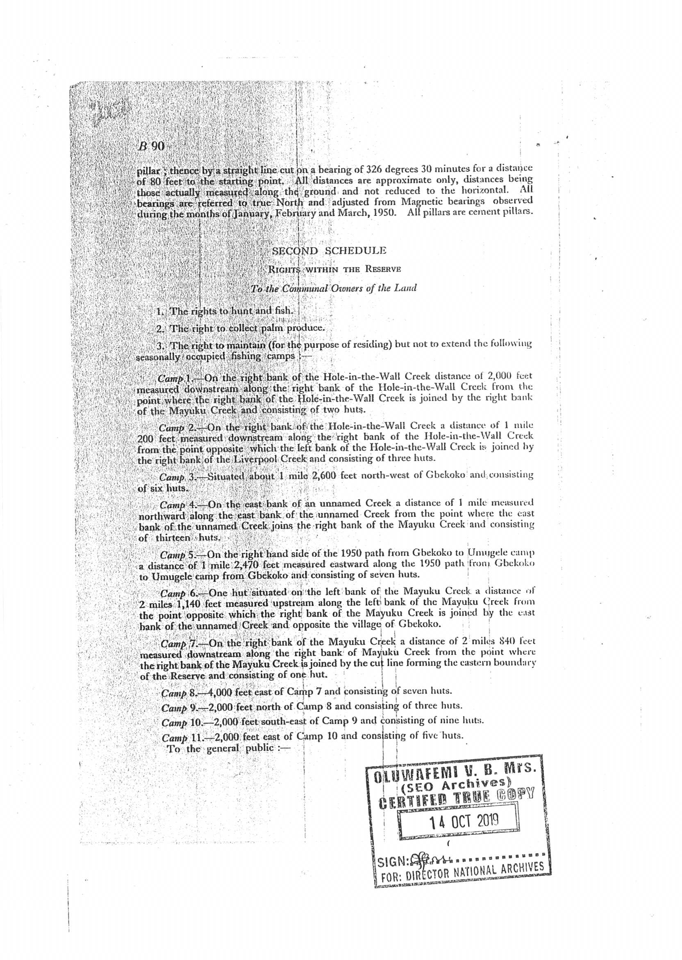

Slide 63
19. The Abigborodo community further states that in support of their claim that GBEKOKO-UTONYATSERE large expanse of land is no longer part of the said forest reserve and has been excised as an enclave and duly returned to the people of Abigborodo community. The Delta State Government of Nigeria through its gazette published by authority and dated 16th August, 1996 further released an additional two hundred (200) acres of land which was added to the already existing enclave of UTON IYATSERE. We refer particularly to page B12 of the said Delta State of Nigeria Gazette which is herein highlighted: “Enlargement of Otonyatsere Enclave by 200 (Two hundred) Acres.

Slide 64
In exercise of the powers of the Executive Council of Delta State of Nigeria as defined in section 21 cap 59 Laws of the defunct Bendel state of Nigeria still applicable in Delta state of Nigeria, Order is hereby made for the information of the general public that as from the 27th of June, 1996 200 (Two hundred) acres of the Okpe Urhobo (Ukpe-Sobo) Forest Reserve has been dereserved and added to the existing area of Otonyatsere enclave. The parcel of two hundred acres is made up of the parcel of land lying to the northern side of Shell Petroleum Development Company Road before the Otonyatsere enclave and the parcel of land lying on both sides of the Shell Petroleum Development Company Road (traversing the enclave) adjacent and contiguous to and after the existing enclave to the western end”
The said Gazette of Delta state of Nigeria published by authority dated 17th October, 1996 is herein attached and marked as Annexure 8.

Slide 65
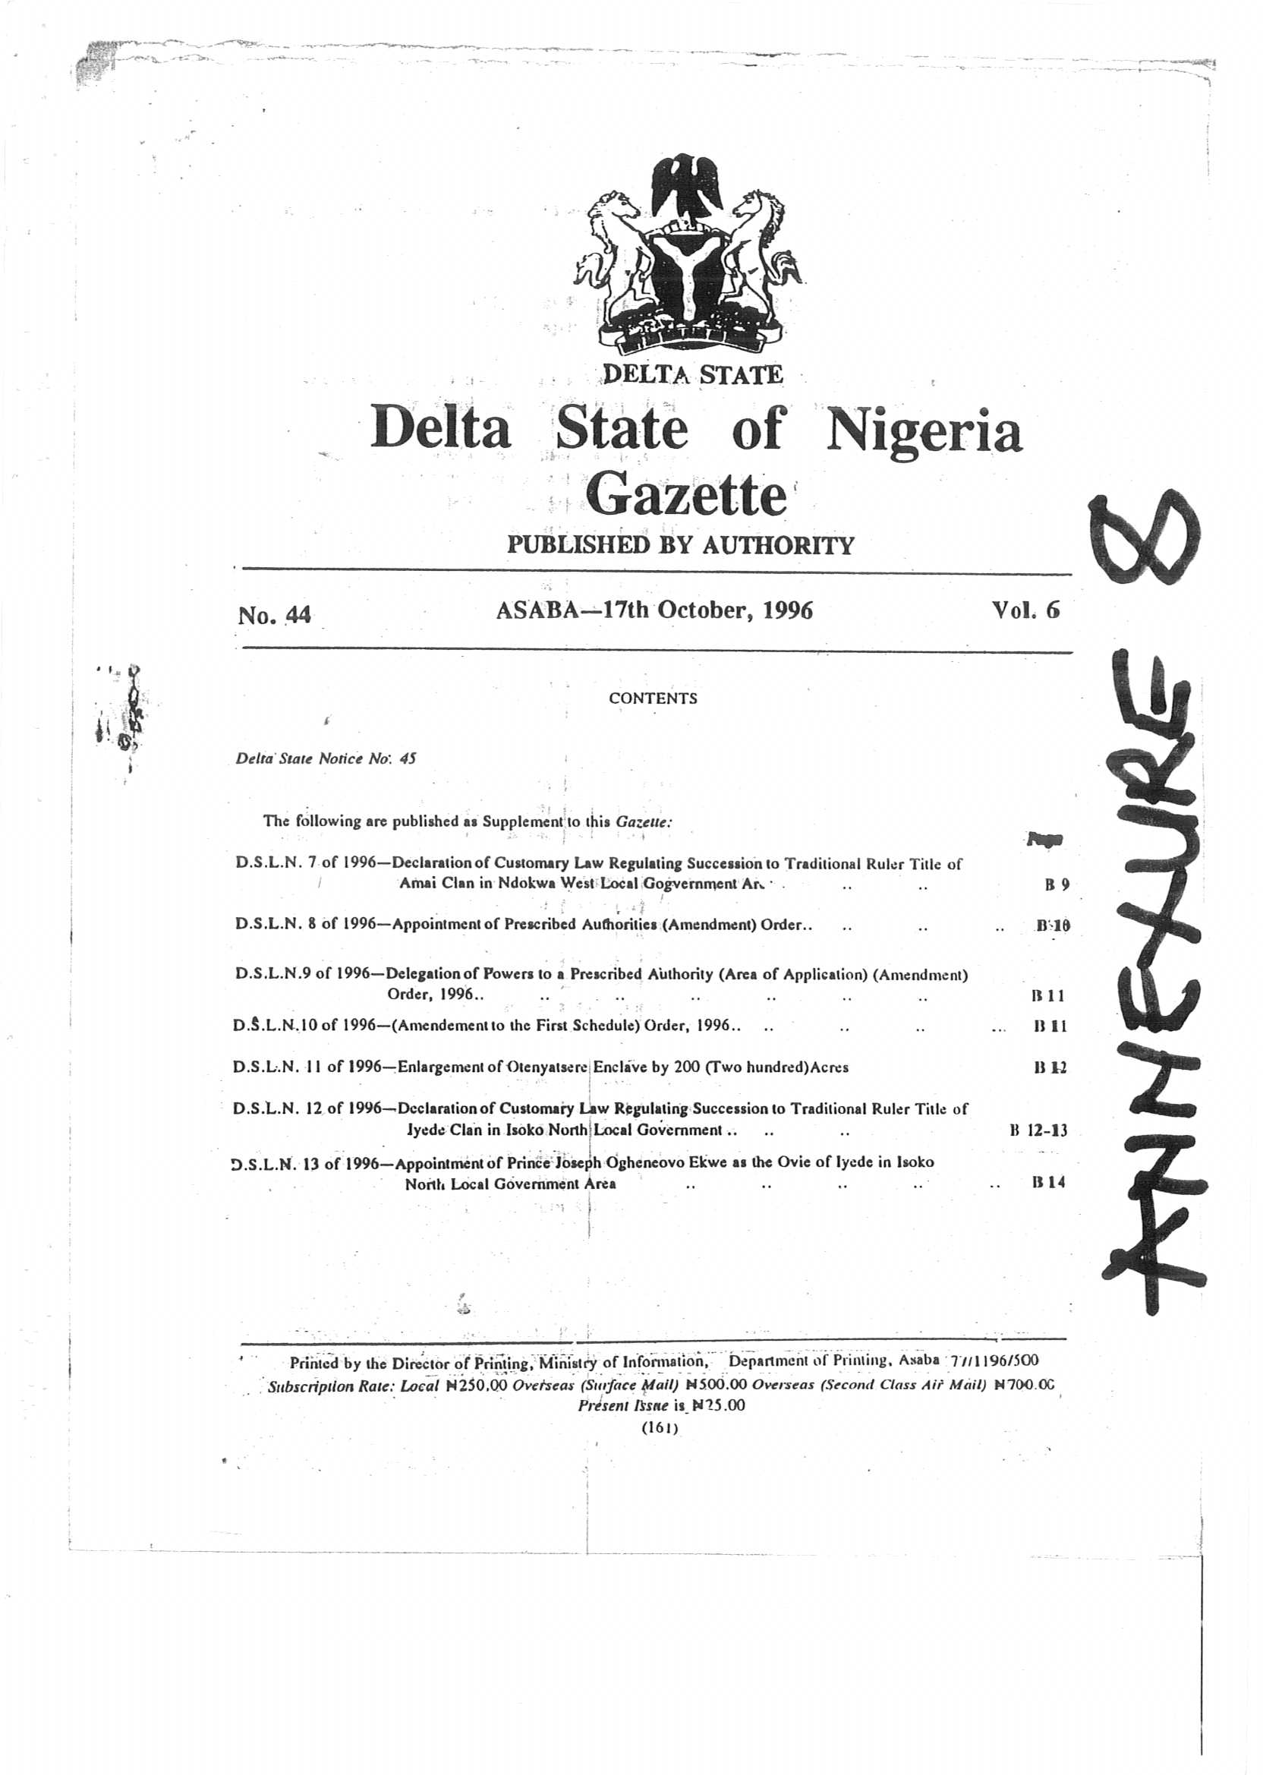

Slide 66
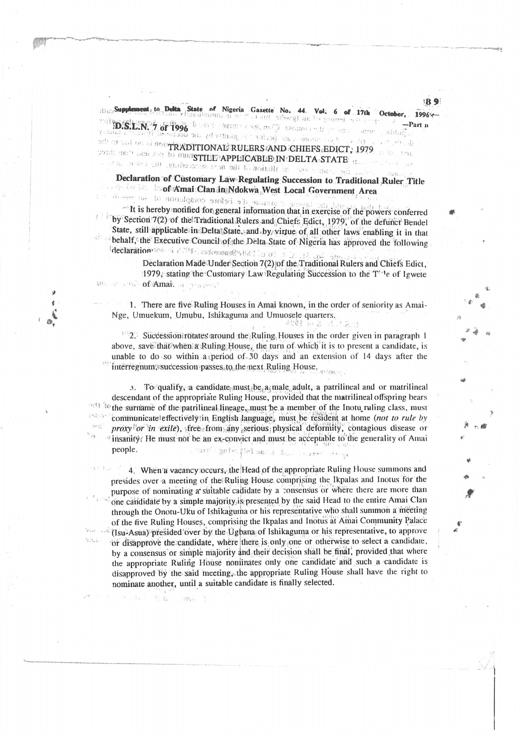

Slide 67
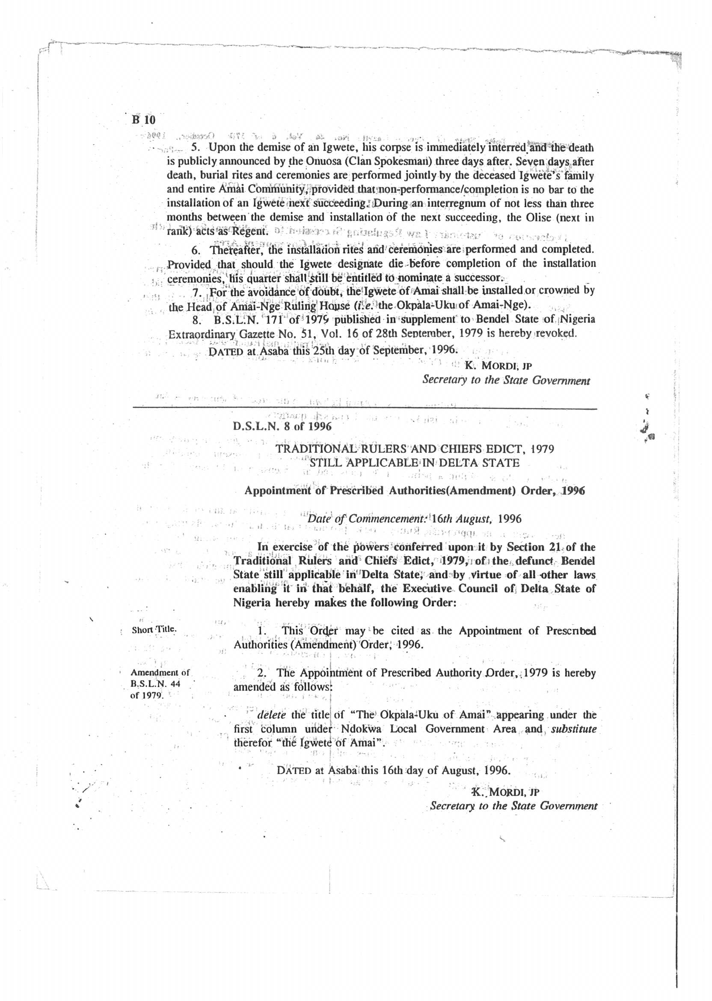

Slide 68
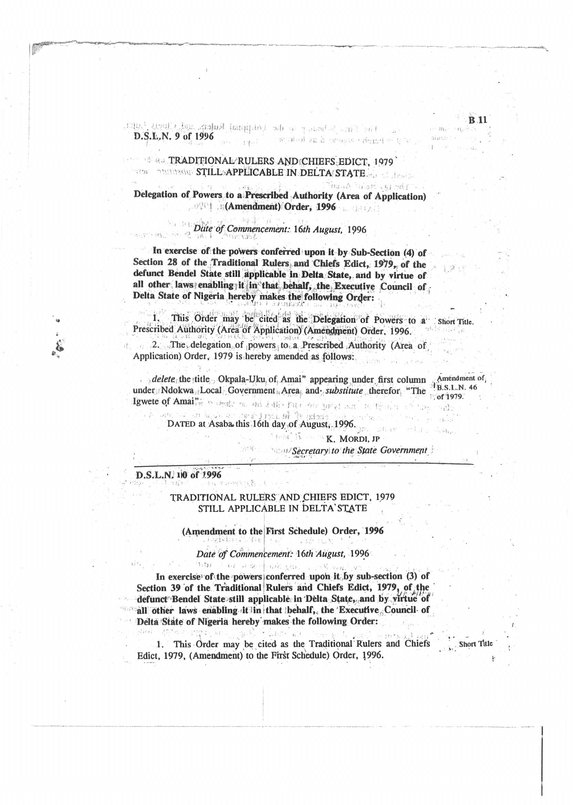

Slide 69
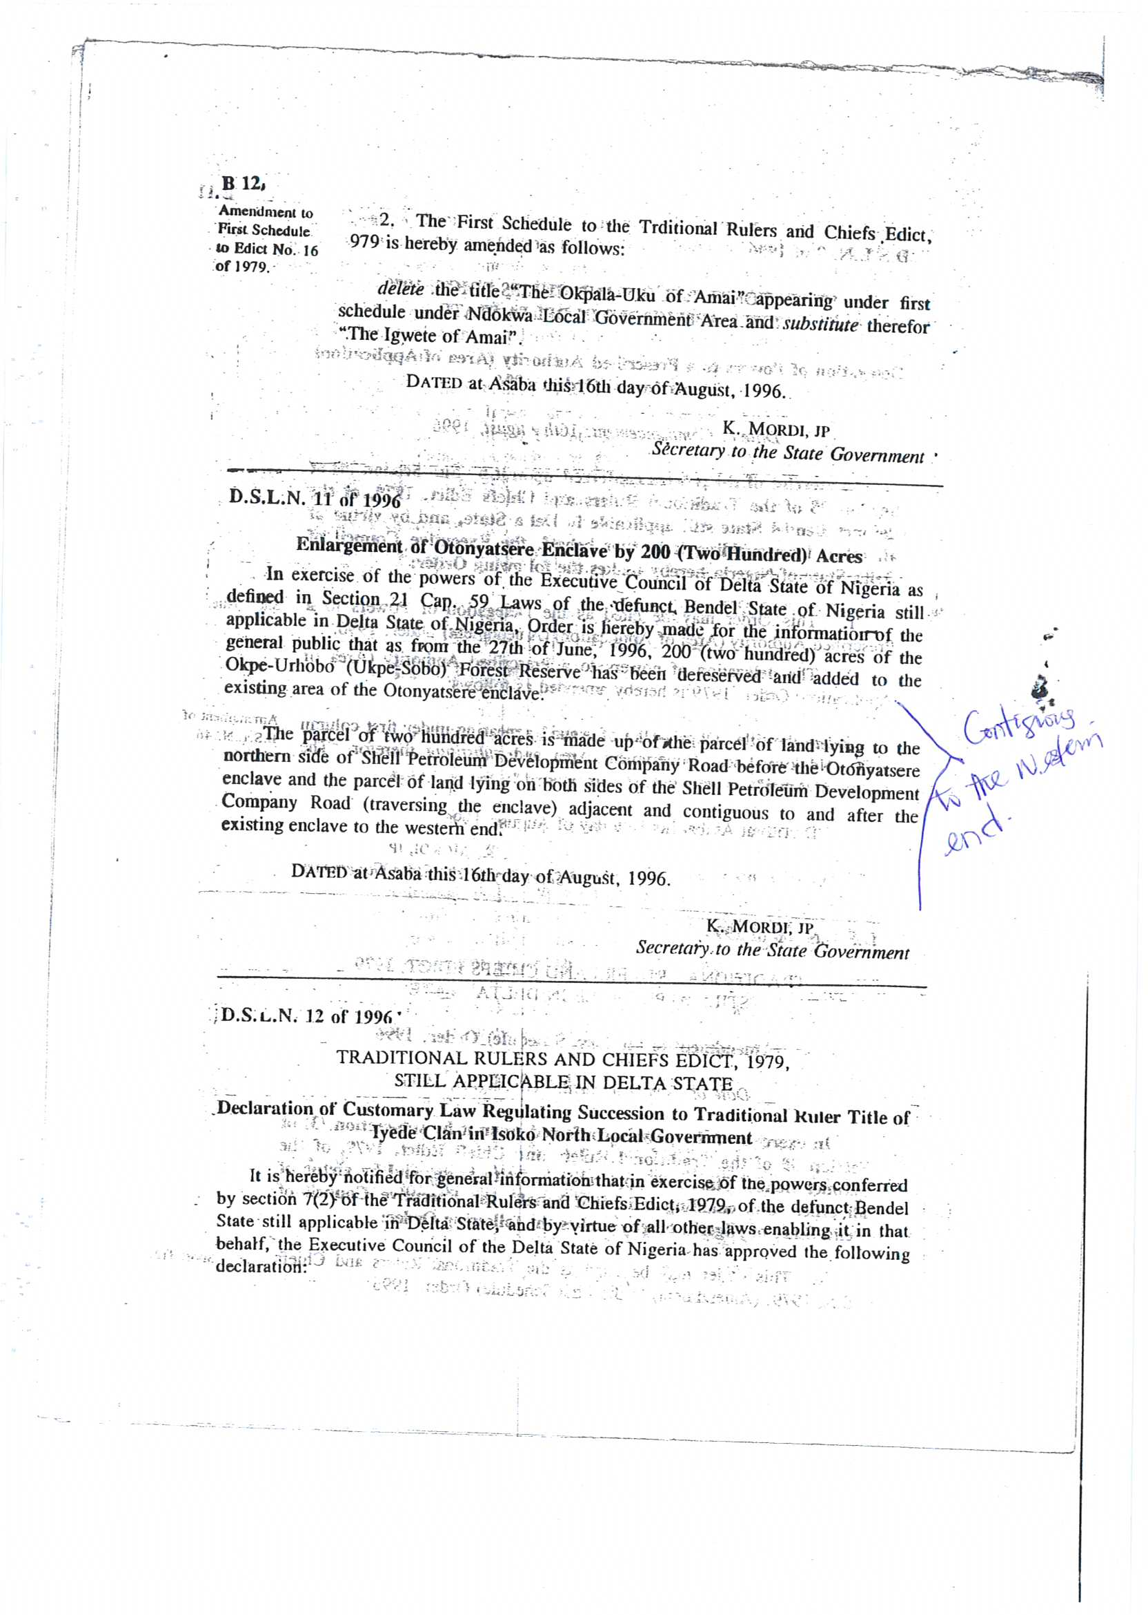

Slide 70
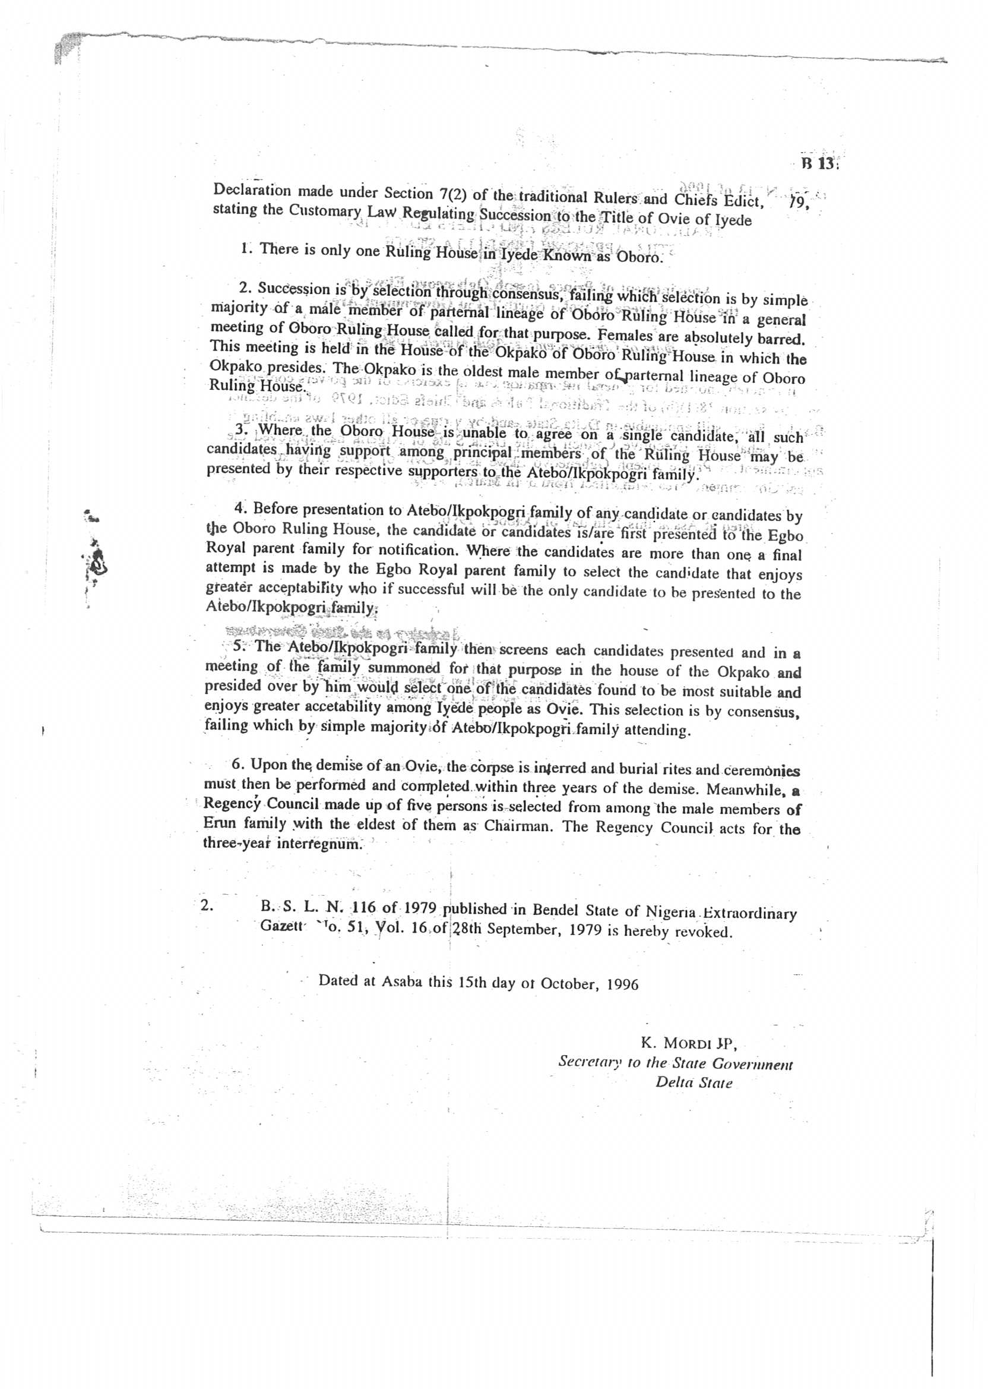

Slide 71
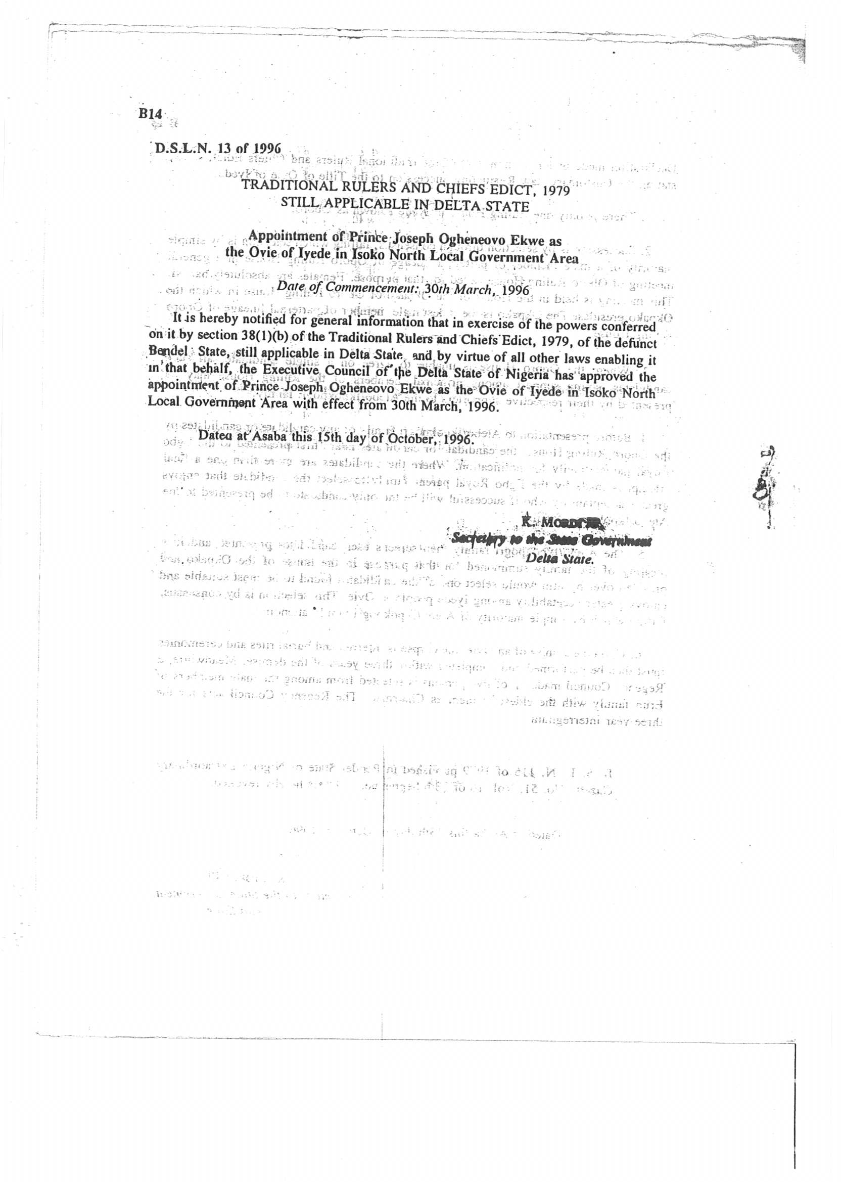

Slide 72
20. When it came to the notice of the Abigborodo Community that one MR. AUGUSTINE ARIEJA, a staff of the Delta State Ministry of Environment who is neither a native nor an indigene of Uton-Iyatsere forged an instrument of government; entered and encroached on GBEKOKO- UTONYATSERE enclave of the Abigborodo community without the consent and authority of the Abigborodo community and that the said Mr. Augustine Arieja started selling and disposing off the said expanse of land under his name for his personal gain. The Abigborodo community having confronted him to no avail caused a petition to be written to the Nigeria Police against the said Mr. Augustine Arieja for forcible entry into the GBEKOKO- UTONYATSERE enclave of the Abigborodo community.

Slide 73
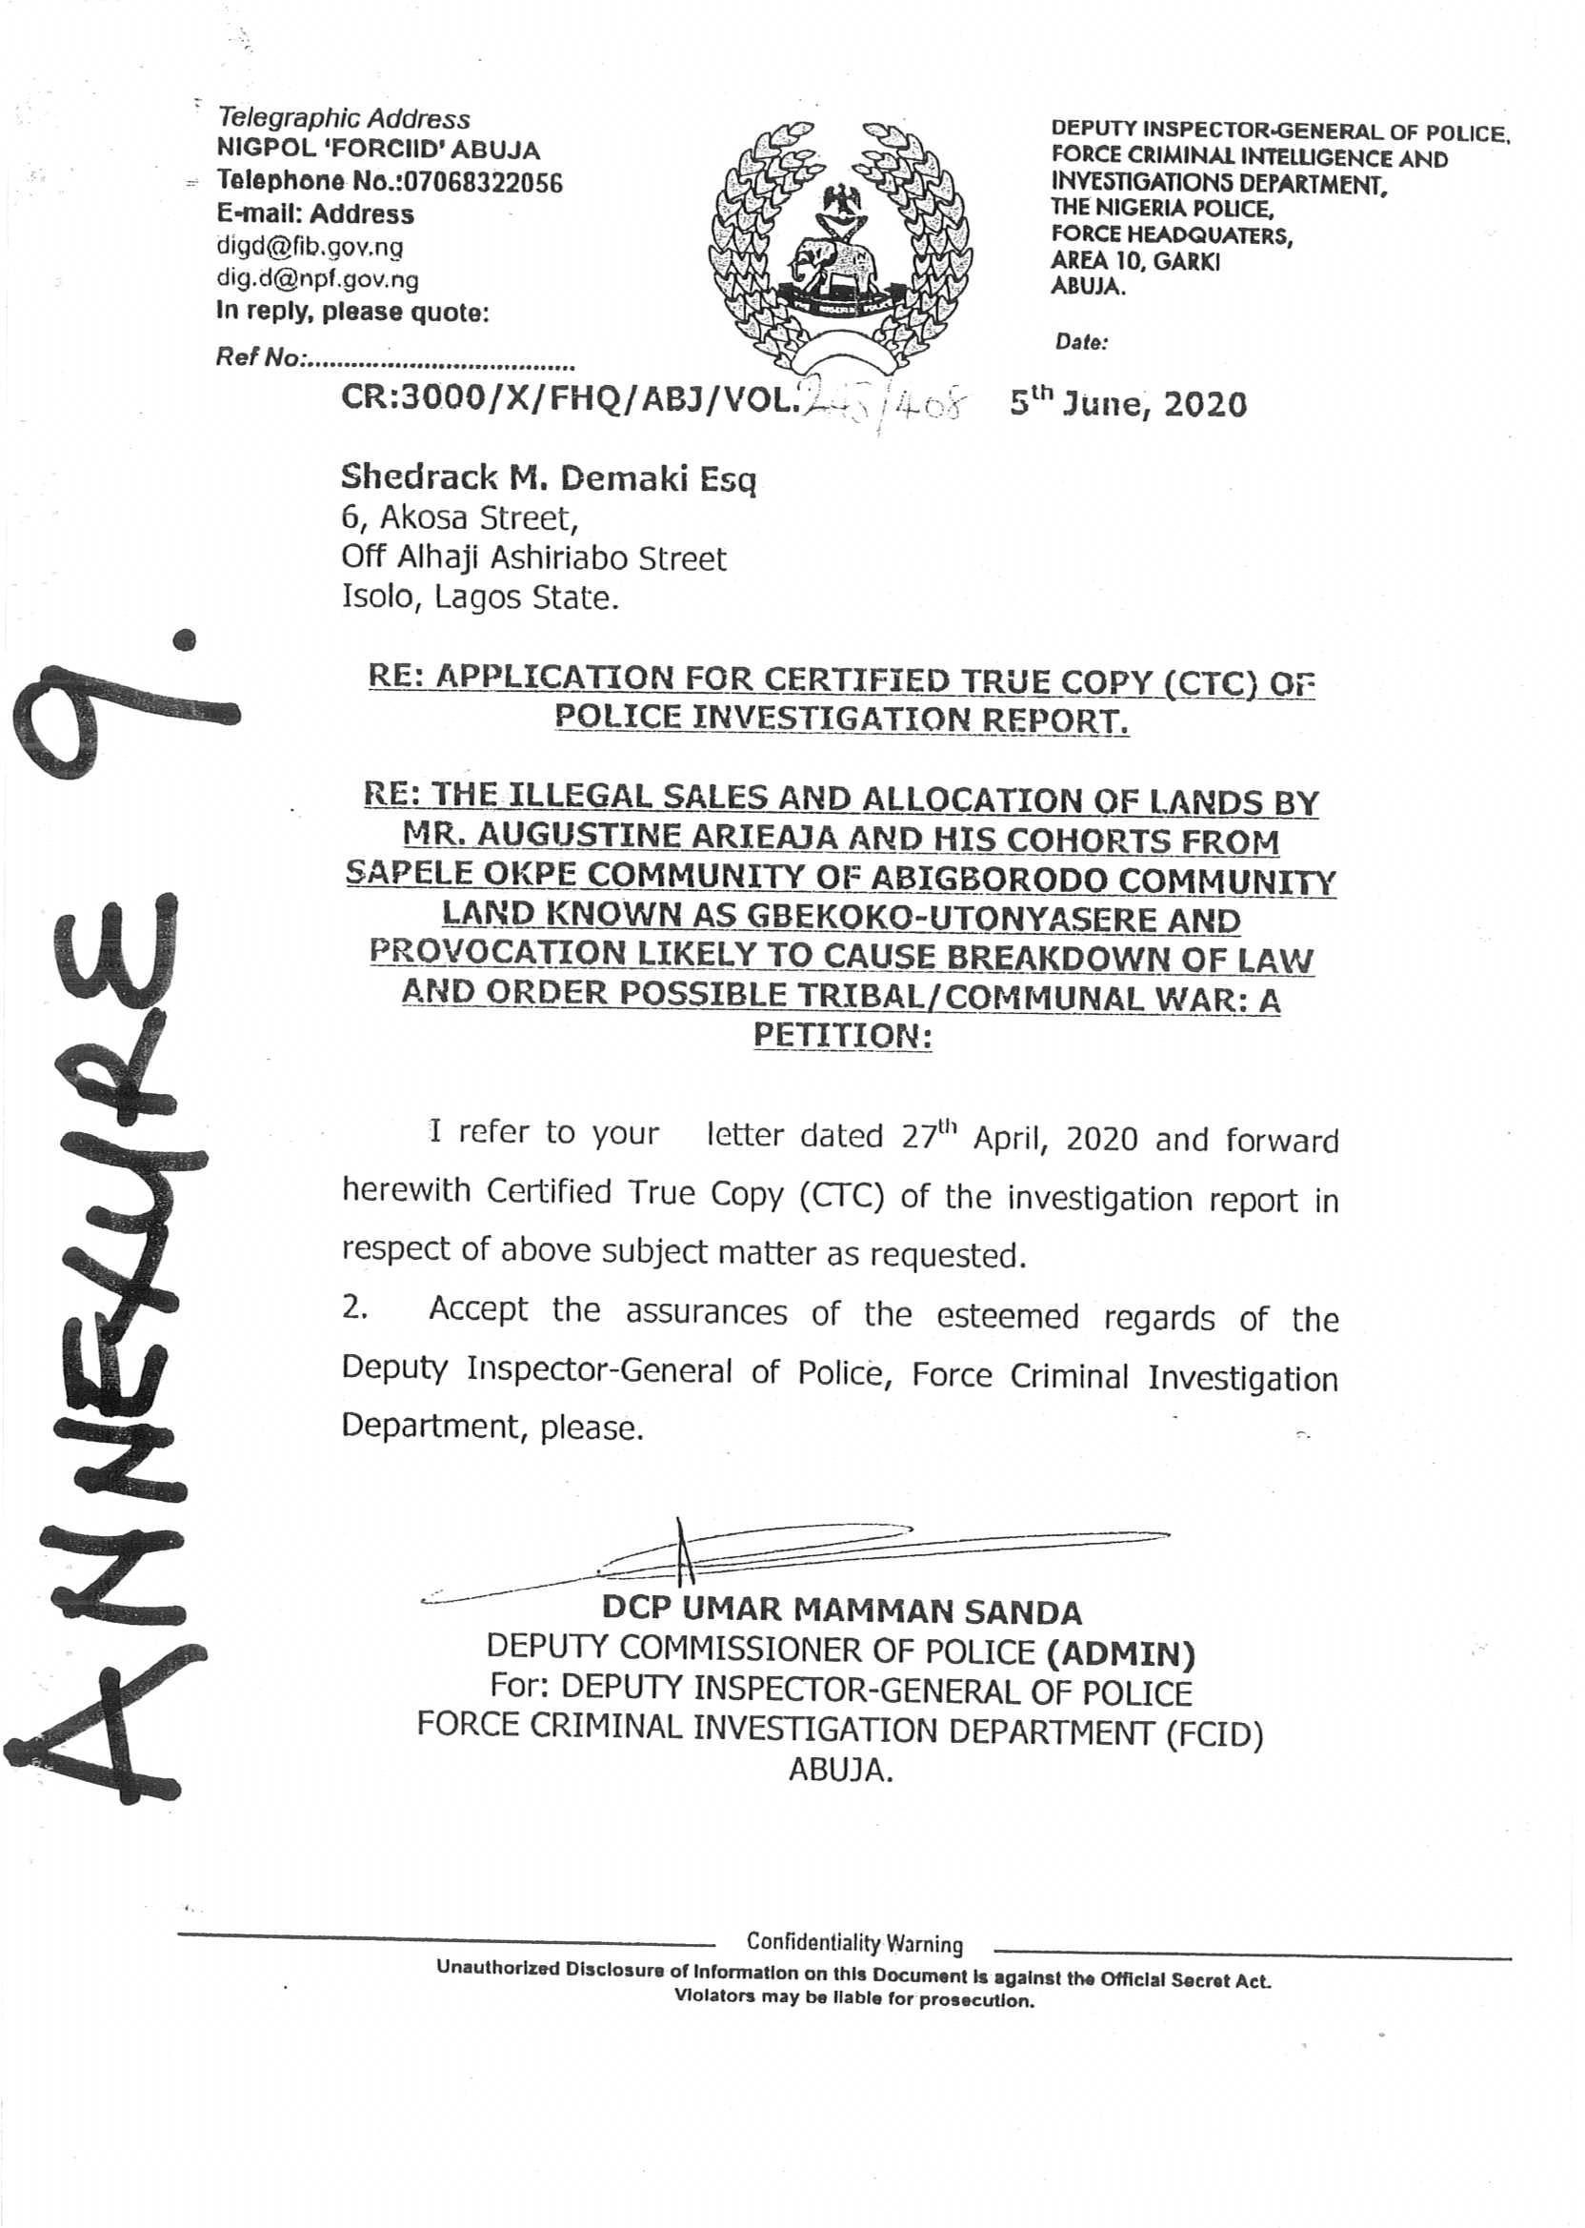

Slide 74
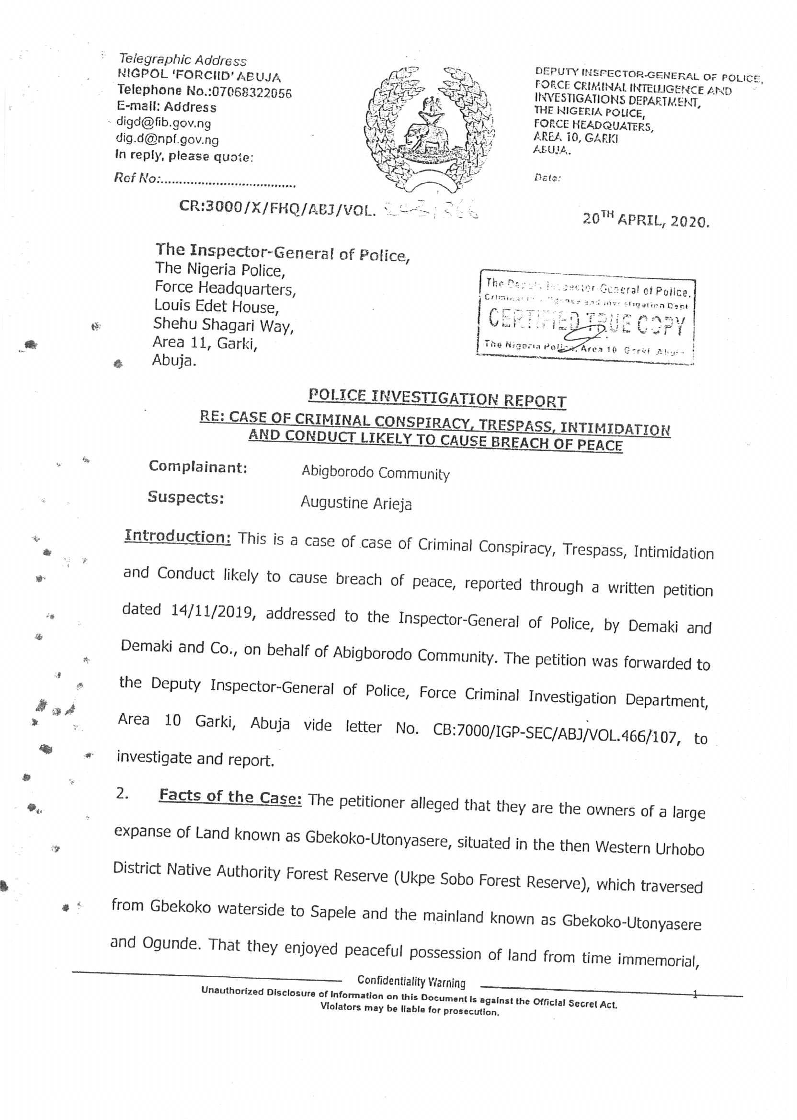

Slide 75
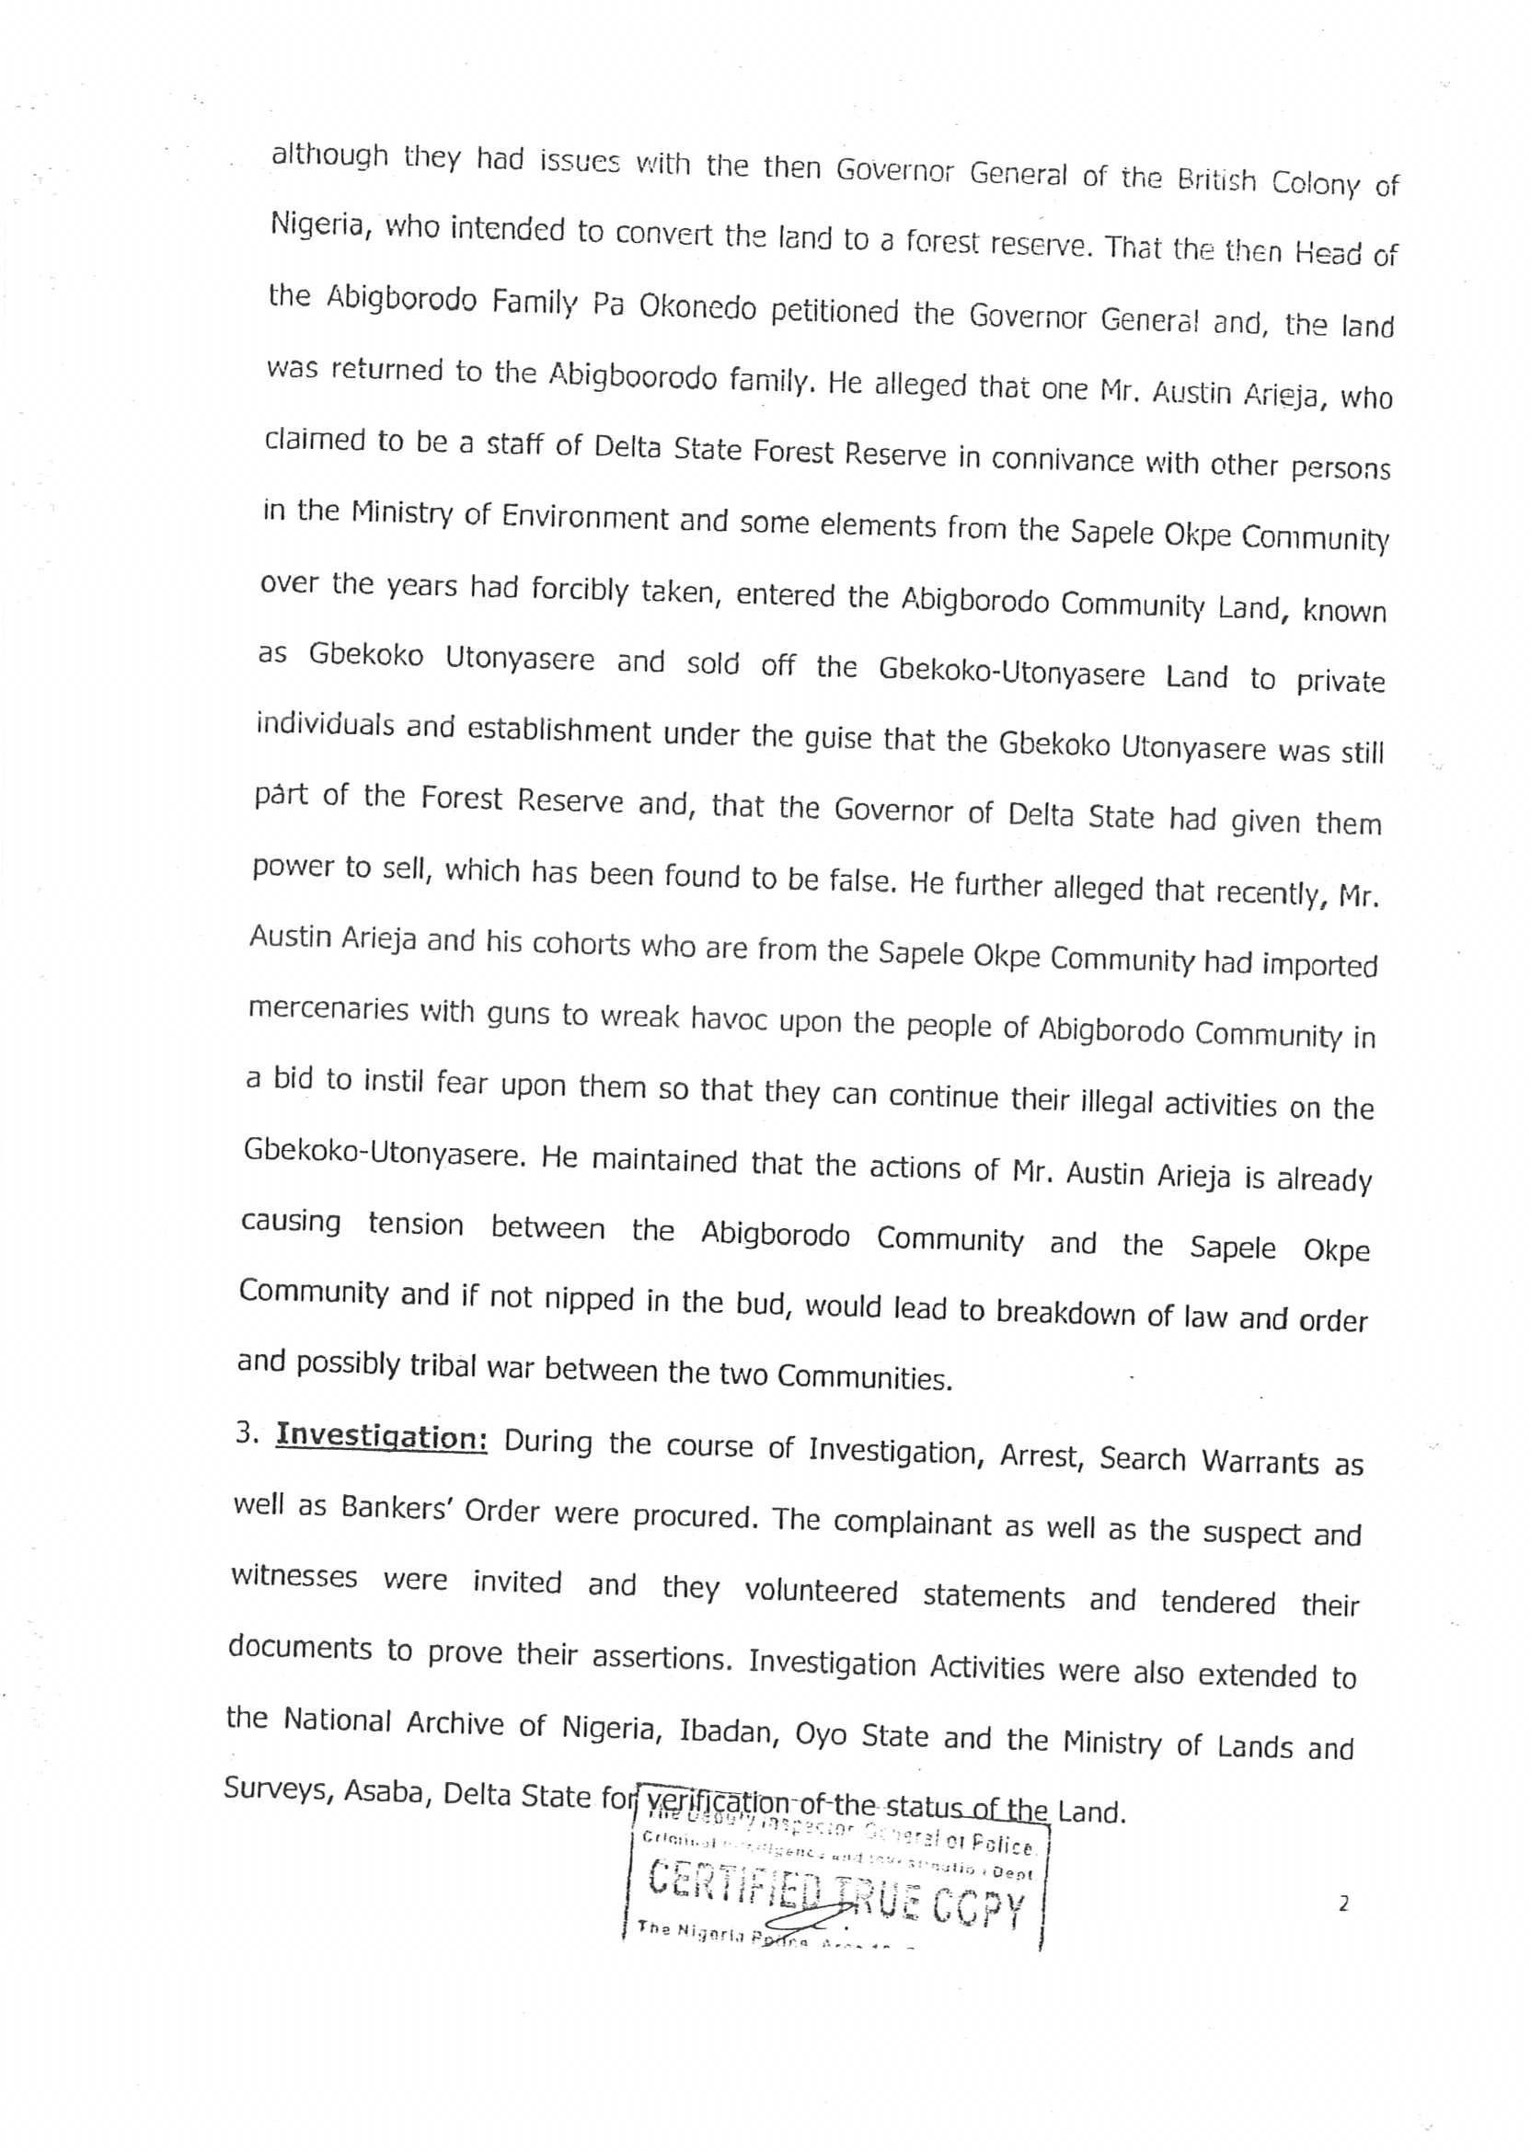

Slide 76
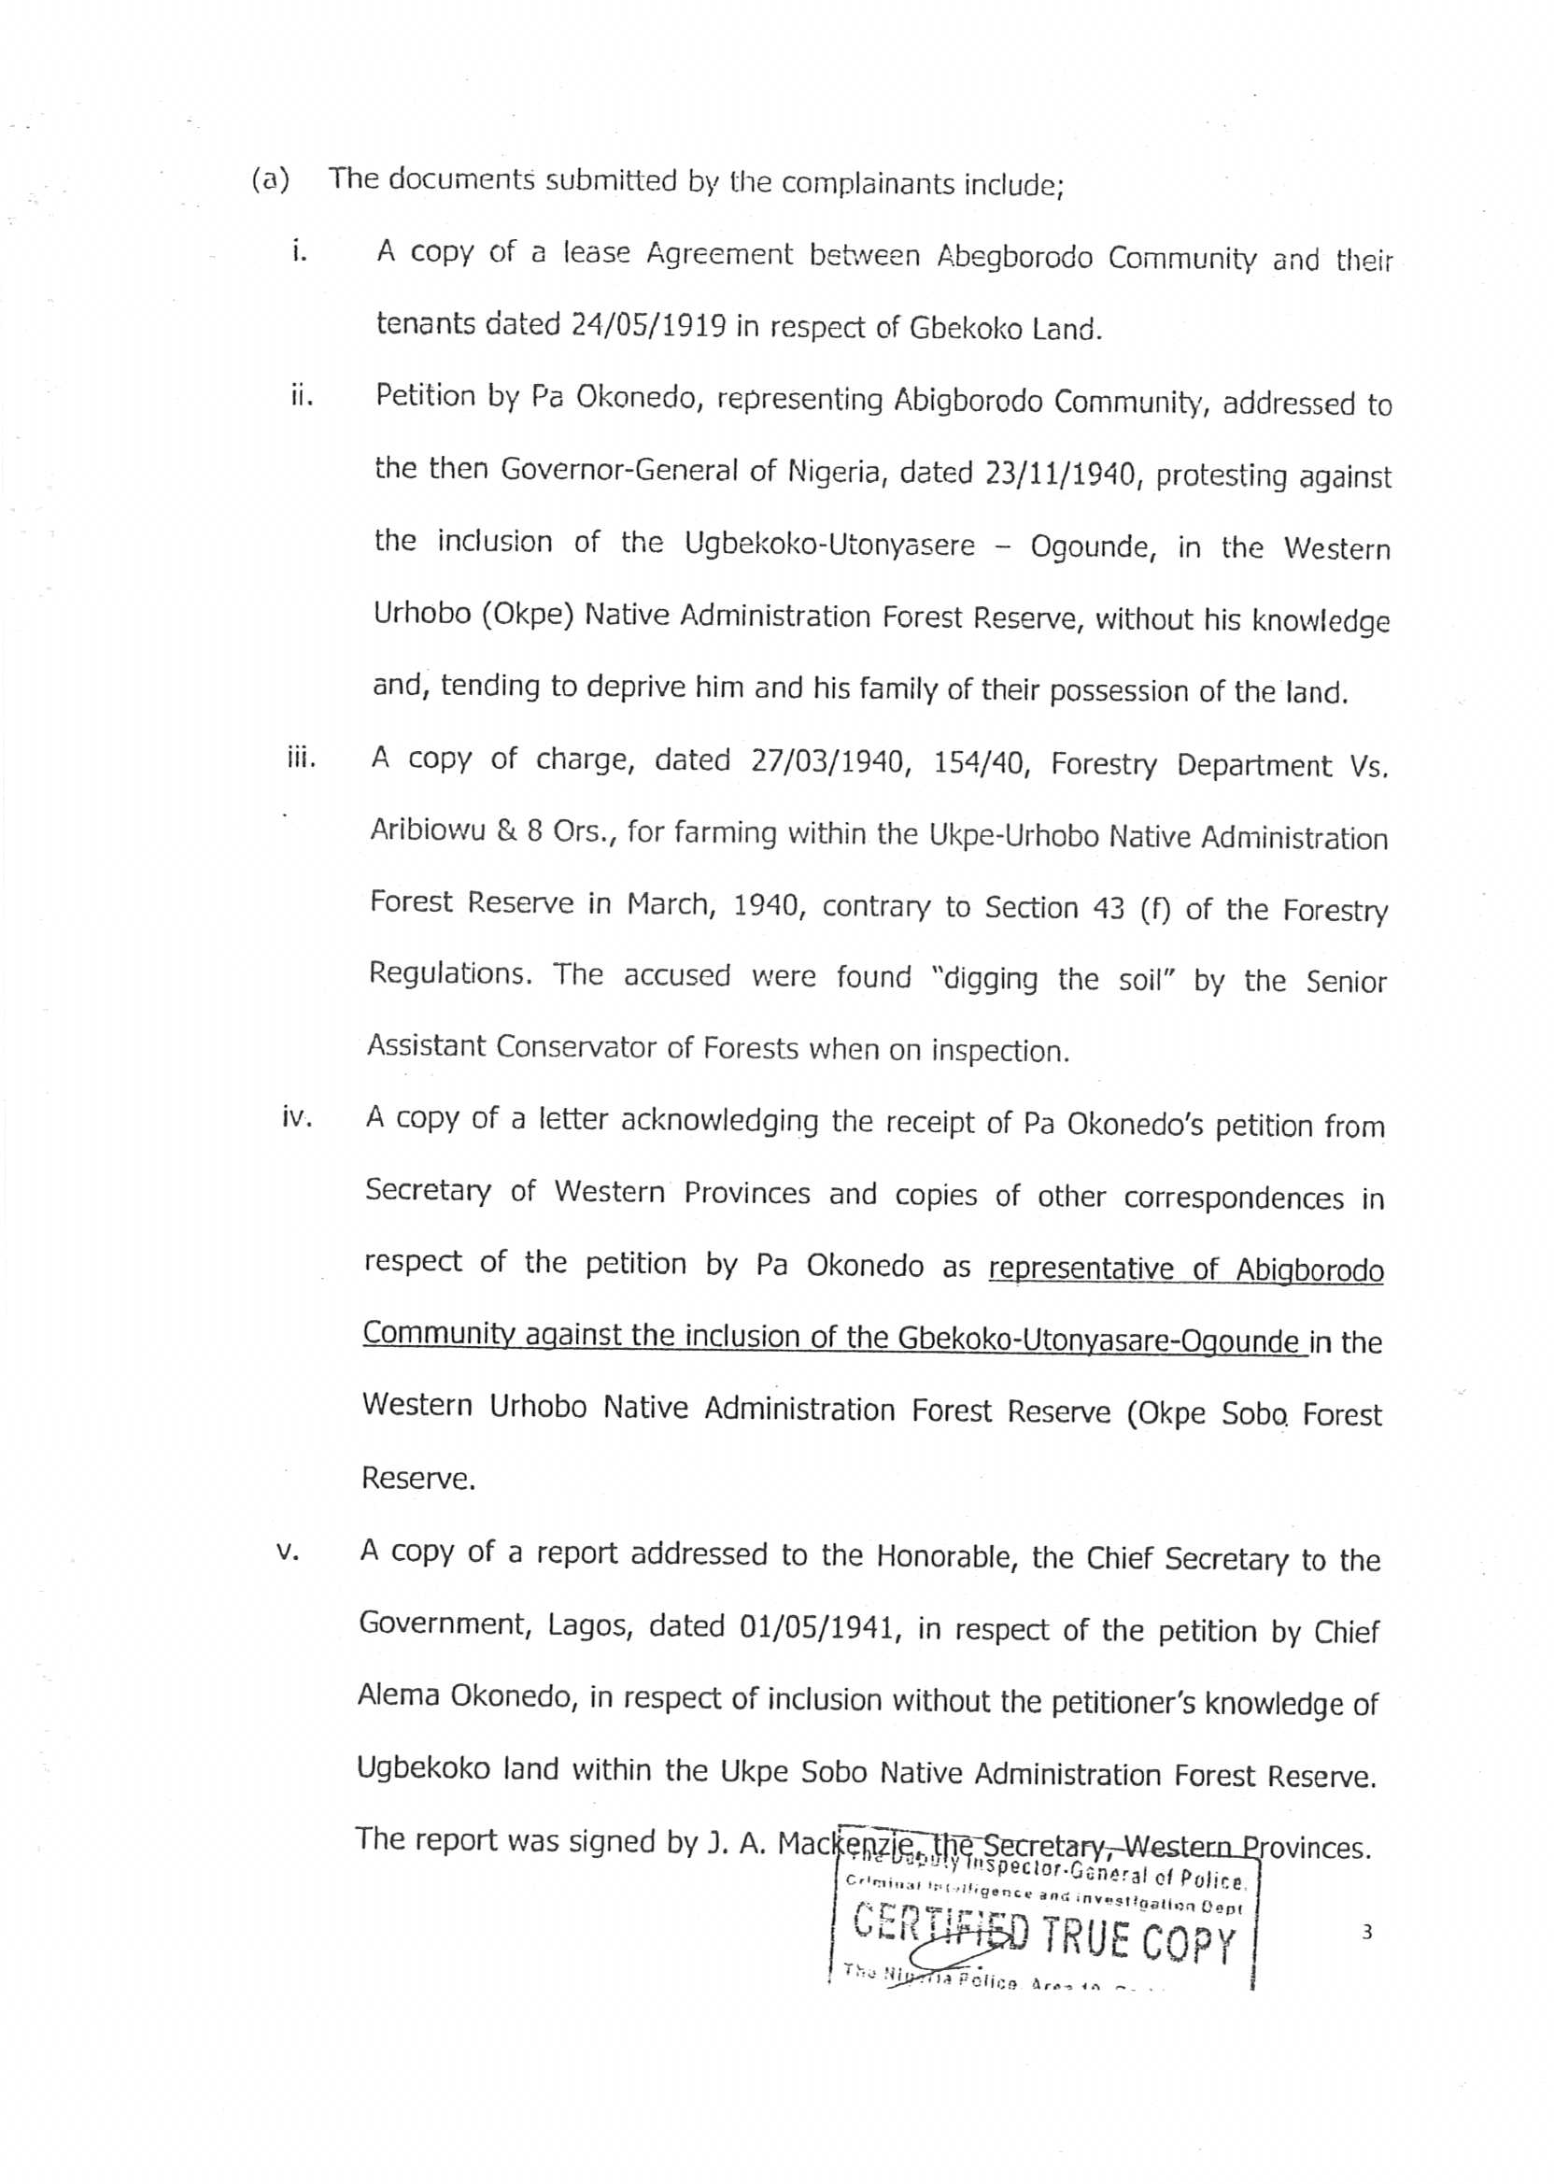

Slide 77


Slide 78


Slide 79


Slide 80


Slide 81


Slide 82


Slide 83


Slide 84


Slide 85


Slide 86


Slide 87


Slide 88


Slide 89


Slide 90
The Police investigated the claims of the Abigborodo community and at the conclusion of its investigation, the Police issued its report with reference
NO:CR:3000/XFHQ/ABJ/VOL.243/366 dated 20th April, 2020 wherein the police indicted the said Mr. Augustine Arieja for criminally encroaching on the GBEKOKO - UTONYATSERE land (enclave) belonging to the Abigborodo community and that Mr Augustine Arieja who is a staff of the Ministry of Environment abused his office by using his position and office to encroach into the De-Reserved portion of the Okpe-Urhobo (Ukpe-Sobo) Forest Reserve belonging to the Abigborodo community and selling portions of it to unsuspecting members of the public without the consent, permission or authority of the Abigborodo community. We wish to also add that the said Mr. Augustine Arieja is from Okpe Local Government Area of Delta and not Sapele Local Government Area of Delta State.

Slide 91
22. We humbly refer you to the Police Investigation Report marked and attached as Annexure 9 duly Certified by the Office of the Deputy Inspector General of Police, Force Criminal Intelligence and Investigations Department.

Slide 92
23. In Furtherance of the Police Investigation Report, the Delta State Ministry of Land and Survey investigated the claims of the Abigborodo community with regards to the ownership of the GBEKOKO–UTONYATSERE enclave which has been excised from the forest reserve. The Honourable Commissioner of Lands and Survey set up a 3- Man Committee with their point of reference being the establishment of the OKPE- URHOBO (UKPE-SOBO) FOREST RESERVE AND OTHER ANCILLARY MATTERS RELATING TO THE DE-RESERVED PORTION, ENCROACHMENT AND OTHERS.

Slide 93
24. Upon conclusion of investigation by the Three-Man Committee, the Committee came up with its findings to wit, that the said GBEKOKOUTONYATSERE enclave had been de-reserved, and returned to the people of Abigborodo community and that Mr Augustine Arieja and his cohorts from sapele encroached on the said forest reserve specifically the additional two hundred acres of land which was de- reserved in 1996 and added to the already existing area of the Otonyatsere enclave belonging to the Abigborodo community. Herein attached is the report of the Delta State Ministry of Lands and Survey, Asaba dated March, 2020 marked as Annexure 10.

Slide 94


Slide 95


Slide 96


Slide 97


Slide 98


Slide 99


Slide 100


Slide 101


Slide 102


Slide 103


Slide 104
25. It is also the position of the Agbiborodo community of Warri North Local Government Area of Delta State that apart from the GBEKOKOUTONYATSERE enclave which has been excised and/or De-reserved, cut off from Ukpe-Sobo Forest Reserve and given back to the Abigborodo community, the entire area of land left that make up the Forest Reserve belongs to Itsekiri Communities and by extension the Itsekiri Nation.

Slide 105
26. This position is clearly supported by a letter dated 11th day of July, 1932 addressed to the Resident Officer, Warri Province, Warri at the conception stage of the formation of the Okpe Sobo Forest Reserve by chiefs in the palace of the Olu-in-Council.The Chiefs who were acting in representative capacity for the Olu of Warri informed the colonial masters that the entire portion or large expanse of land that the colonial masters intended placing in the proposed Ukpe-Sobo Native Administration Forest Reserve belongs to the Olu of Warri who is the sole trustee of all Itsekiri lands and out rightly called for the cancellation of the Okpe Sobo public notice for the establishment of a forest reserve. Find herein attached the Letter of Protest dated 11th of July, 1932 marked as Annexure 11 duly certified by the National Archives.

Slide 106


Slide 107
27. The above canvassed position is further corroborated by a letter endorsed by the Chiefs of the Orodje of Okpe’s Palace dated 26th May, 1930 wherein the people of Okpe informed the Governor of the Southern Province of Nigeria that the Okpes do not have land(s) to contribute or give the colonial masters for the formation of the UKPE-SOBO FOREST RESERVE and asked that the Okpe be left out of the formation of the said reserve on the singular reason that the Okpes’land in Sapele is not sufficient for them to continue their farming talk more of giving to the colonial masters for the formation of the reserve. Herein attached is the said letter of protest signed by the Okpe Chiefs dated 26th May, 1930, addressed to the Governor Southern Province, Nigeria marked as Annexure 12.

Slide 108


Slide 109
Flowing from all the above stated incontrovertible facts and documentary evidence adduced by the Abigborodo Community on their ownership of the GBEKOKO-UTONYATSERE enclave of Ukpe-Sobo Native Administration Forest Reserve, it is glaring that the Abigborodo Community are the owners of the GBEKOKO-UTONYASERE enclave and by extension the whole land that make up what is left of the entire Ukpe–Sobo Forest Reserve. It is our argument that simply because the colonial masters named it Ukpe-Sobo Forest Reserve for whatever reason does not in any way confer ownership on the people of Okpe Community. The land conscripted by the colonial masters to form the reserve belongs to the Abigborodo Community and other Itsekiri Communities and by extension the Itsekiri Nation.
Notes:
It is our submission that gbekoko land houses and serves as host to your facilities and most notably your flow station.

Slide 110
It is our submission that gbekoko land houses and serves as host to your facilities and most notably your flow station which is clearly marked in the recreated map from the colonial map duly certified from the National Archive, Ibaban.
Notes:
It is our submission that gbekoko land houses and serves as host to your facilities and most notably your flow station which is clearly marked in the recreated map from the colonial map duly certified from the National Archive, Ibaban.

Slide 111
THANK YOU

